Slide 1
HREA Act
A brief overview
N Pardy, MD, FRCPC

Slide 2
Disclosures
Site PI & SI (HREB-approved trials in malignant and classical hematology)

Slide 3
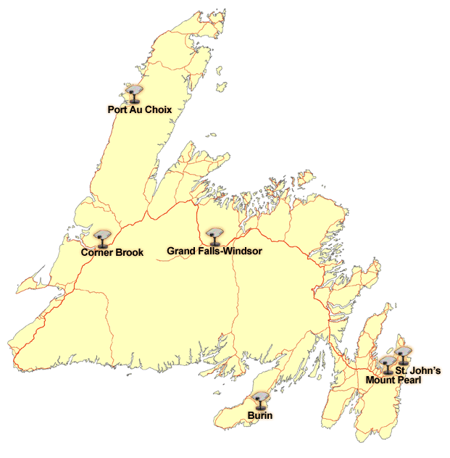
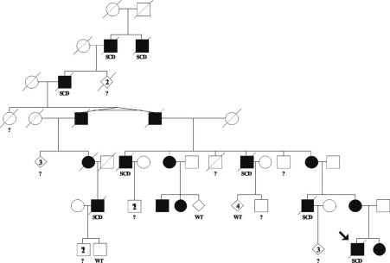
The Why
“Texas Vampires”
Baylor College of Medicine 1998
Arrhythmogenic right ventricular dysplasia (founder populations, isolation)
Informed Consent? Coercion? Disclosure?

Slide 4
HREA Act
2000 DHCS
Provincial Health Research Ethics Working Group
Genetic Standards Development Working Group
2006 Health Research Ethics Authority Act passed
2011 enacted
HREA
Established the HREA as an independent corporation
Responsible for “ensur[ing] that health research involving human subjects is conducted in an ethical manner”
Appoints HREB

Slide 5
HREA s.8
8. The authority may approve a research ethics body if
(a) it is a not-for-profit body; and
(b) it is established in conformity with the principles respecting the appointment of members to a research ethics board contained in the tri-council policy statement for the purpose of reviewing applications for approval of health research involving human subjects in accordance with this Act.
9. (1) A person shall not engage in health research involving human subjects without first obtaining approval for the research from the research ethics board or a research ethics body approved by the authority under section 8.
(2) A person shall submit an application for approval to engage in health research involving human subjects to the authority.
(3) The authority shall, within 2 business days of its receipt, refer an application made to it under subsection (2) to the research ethics board or a research ethics body approved by the authority under section 8.
(4) The research ethics board or a research ethics body approved by the authority under section 8 shall consider the application referred to it under subsection (3) within 30 days of receiving it and may
(a) approve the application;
(b) approve the application subject to the changes the board or other body may require; or
(c) refuse to approve the application.

Slide 6
HREA Regulations
All clinical trials & genetic research conducted in NL must be reviewed by the HREB
Other forms of health research may be reviewed by the HREB or by an approved body as per s.8
HREB
3 subcommittees: Clinical trials, Genetics & Genomics, all other health research
ICEHR (Interdisciplinary Committee on Ethics in Human Research)
Social Sciences
New legislation drafted
?to be tabled at next sitting
Many groups consulted including HREA
Ongoing work with CHEER

