Slide 1


www.act-aec.ca
ACT Training Committee
Update 2023 Sept 22
Charlottetown, PEI

Slide 2
Agenda
Summary of Activities since April 2023
Terms of Reference of ACT Training Committee
Goals and Objectives of ACT Training Committee
  Specific objectives
Membership
Recruitment of National Training Coordinator
Summary of the 7 Clinical Trials Training Platforms/Programs (CTTP) Offerings
Activities in development (2023-24/Q3 and Q4)
  Needs Assessment Survey to stakeholders: Clinical Trials Units (CTU), Clinical Trials Networks (CTN), Clinical Trials Community Hospitals (CTCH)
Questions/comments/discussion

Slide 3
Summary of Activities since April 2023
Development of a document (table) describing the goals, objectives, approaches, and training resources of each of the 7 Clinical Trials Training Platforms (CTTPs);
Development of a comprehensive list of ACT Consortium resources;
Designing a Needs Assessment Survey being sent to the ≤65 ACT partnering organizations (CTU, CTN, CTCH);
Recognition of the need for a National Training Coordinator for ACT, to ensure communication, coordination, and connectivity among all CTTPs and Clinical Trial Units, Clinical Trials Networks and Community Hospitals (CTU, CTN, CTCH);

Slide 4
Terms of Reference
Approved 2023-09-08
To guide and consolidate training activities across ACT, namely across Clinical Trials Units (CTU), Clinical Trials Networks (CTN) and Clinical Trials Community Hospitals;
The model proposed is one of partnership among all ACT and 7 CTTPs, to work together to share skills, resources and experiences.
This will align with already developing CTTPs partnership and current initiatives engaged between some of CTTPs.
The modalities and shared resources under which this model of ACT-CTTPs partnership will operate, remain to be defined. This committee will also focus on national success for sustainability after the 3 years of funding over 4 fiscal years, tentatively toward March, 2026. Considering the number of ACT partners (n=11+34+20), ACT engagement will have to reflect the task ahead.

Slide 5
Goals and Objectives of ACT-TC
To address issues of capacity building and training in clinical trials in the ACT Consortium, to achieve national success and sustainability
  Capacity, with quality: Multiple shareholders;
  Responsiveness: Address the needs of 11 CTUs, 20 CTCHs, 28-34 CTNs, other partners;
  Efficiency: Reducing duplication, efforts and costs across the 7 CTTPs;
Acronyms:
CTTP = Clinical Trials Training Platform
CTU = Clinical Trial Unit
CTCH = Clinical Trials Community Hospital
CTN = Clinical Trials Network

Slide 6
Specific Objectives
To facilitate the harmonisation of resources across CTTPs
  Individuals – Mentors, instructors
  Systems – LMS
  Materials – Lectures (presentations, videos), references
  Offerings - Webinars, conferences, guest speakers, special events;
To be responsive to needs of shareholders
(CTU, CTCH, CTN, partners, communities)
  Ask shareholders what they need and also what they can offer
    Competencies
    Knowledge
    Awareness

Slide 7
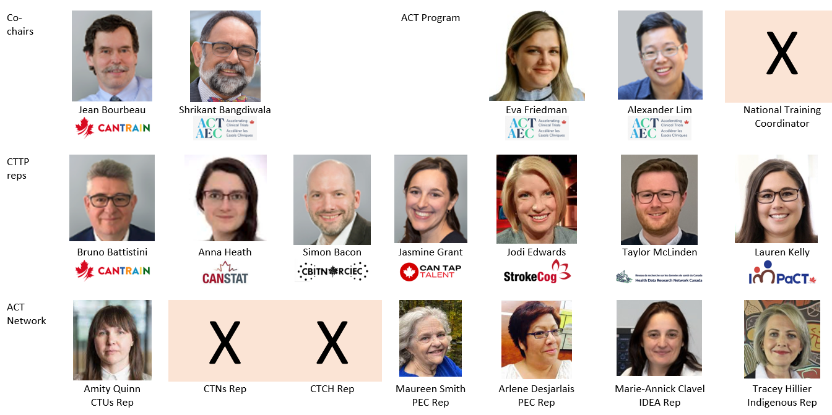




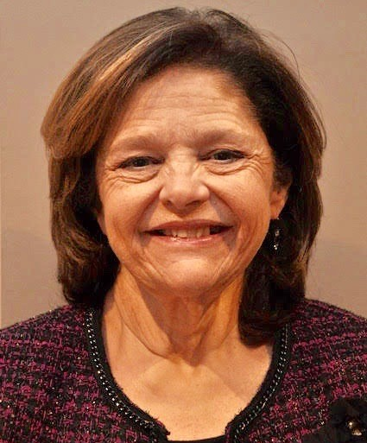
ACT-TC Membership (n≤19)
ex officio
Under
recruitment
Anna Heath
Bio-statistician at SickKids hospital in Toronto-Child Health Evaluative Sciences (CHES) program
*
Nancy Butcher
Being
Identified/
Invited
Being
Identified/
Invited
https://www.act-aec.ca/research-networks
https://www.act-aec.ca/clinical-trial-units
*https://wecantrain.ca/home/governance/allied-cttps-act/

Slide 8

Recruitment: Education Developer
(National Coordinator, Clinical Trials Training, ACT)
JD 0979
Job Summary:
Responsible for supporting teaching & learning programs
Responsible for designing, developing, supporting and delivering campus-wide educational development activities
Promotes a scholarly approach to enhance teaching and learning initiatives within the University for staff, students, and faculty
Posting:
https://bit.ly/3EFVgcD

Slide 9
Activities in development
(2023-24 / Q3 and Q4)
Activity | Date
Recruitment of National Training Coordinator | Expecting to hire by Oct 1st, 2023
Description of the goals, objectives, approaches, and training resources of each of the 7 CTTPs | Expecting to complete and share by Oct 2023
Complete and conduct the Needs Assessment Survey | Plan to put in place Oct 2023, collect and analyze data by Nov 2023
Development of a plan of action for FY03 (2024-25) - “Training offers from ACT – engaging CTTPs”, based on the Needs Assessment Survey and hiring of the National Training Coordinator | To be completed by end of 2023
Initiate contacts between 7 CTTPs and ACT | Ongoing
Development of a comprehensive list of ACT Consortium training resources across all CTUs, CTNs, CTCHs, CTTPs, other shareholders | Future directions- TBD

Slide 10
Summary of 7 CTTP Offerings
Summary Table of:
  Goals
  Aims
  Mission
  Vision
  Values
  Main and Specific Objectives
  Resources: Budget, staff, infrastructure

Slide 11

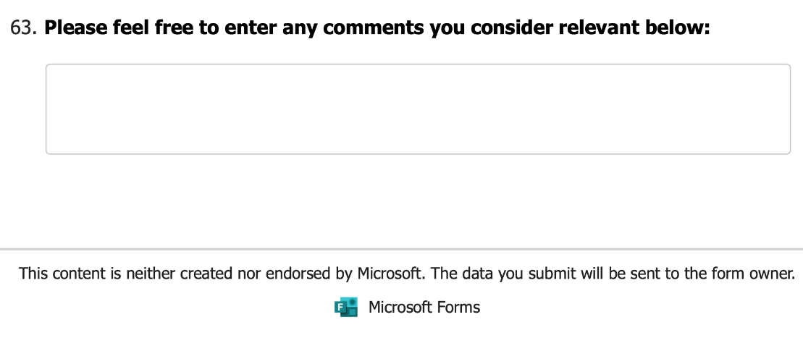
The ACT Needs Assessment Survey is being based on the CANTRAIN survey
up to ≤30

Slide 12
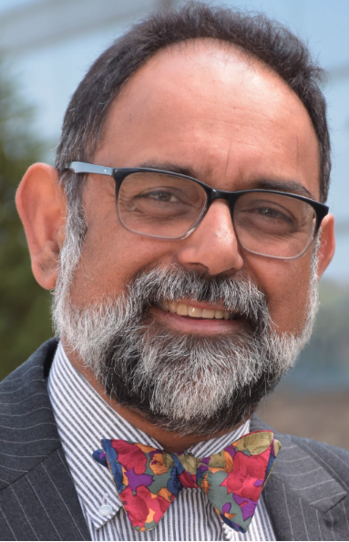




Questions/comments/discussion
Training Committee (Co-Chairs):
Prof. Shrikant I. Bangdiwala
McMaster University
Prof. Jean Bourbeau
RI-MUHC/CORE

