Slide 1
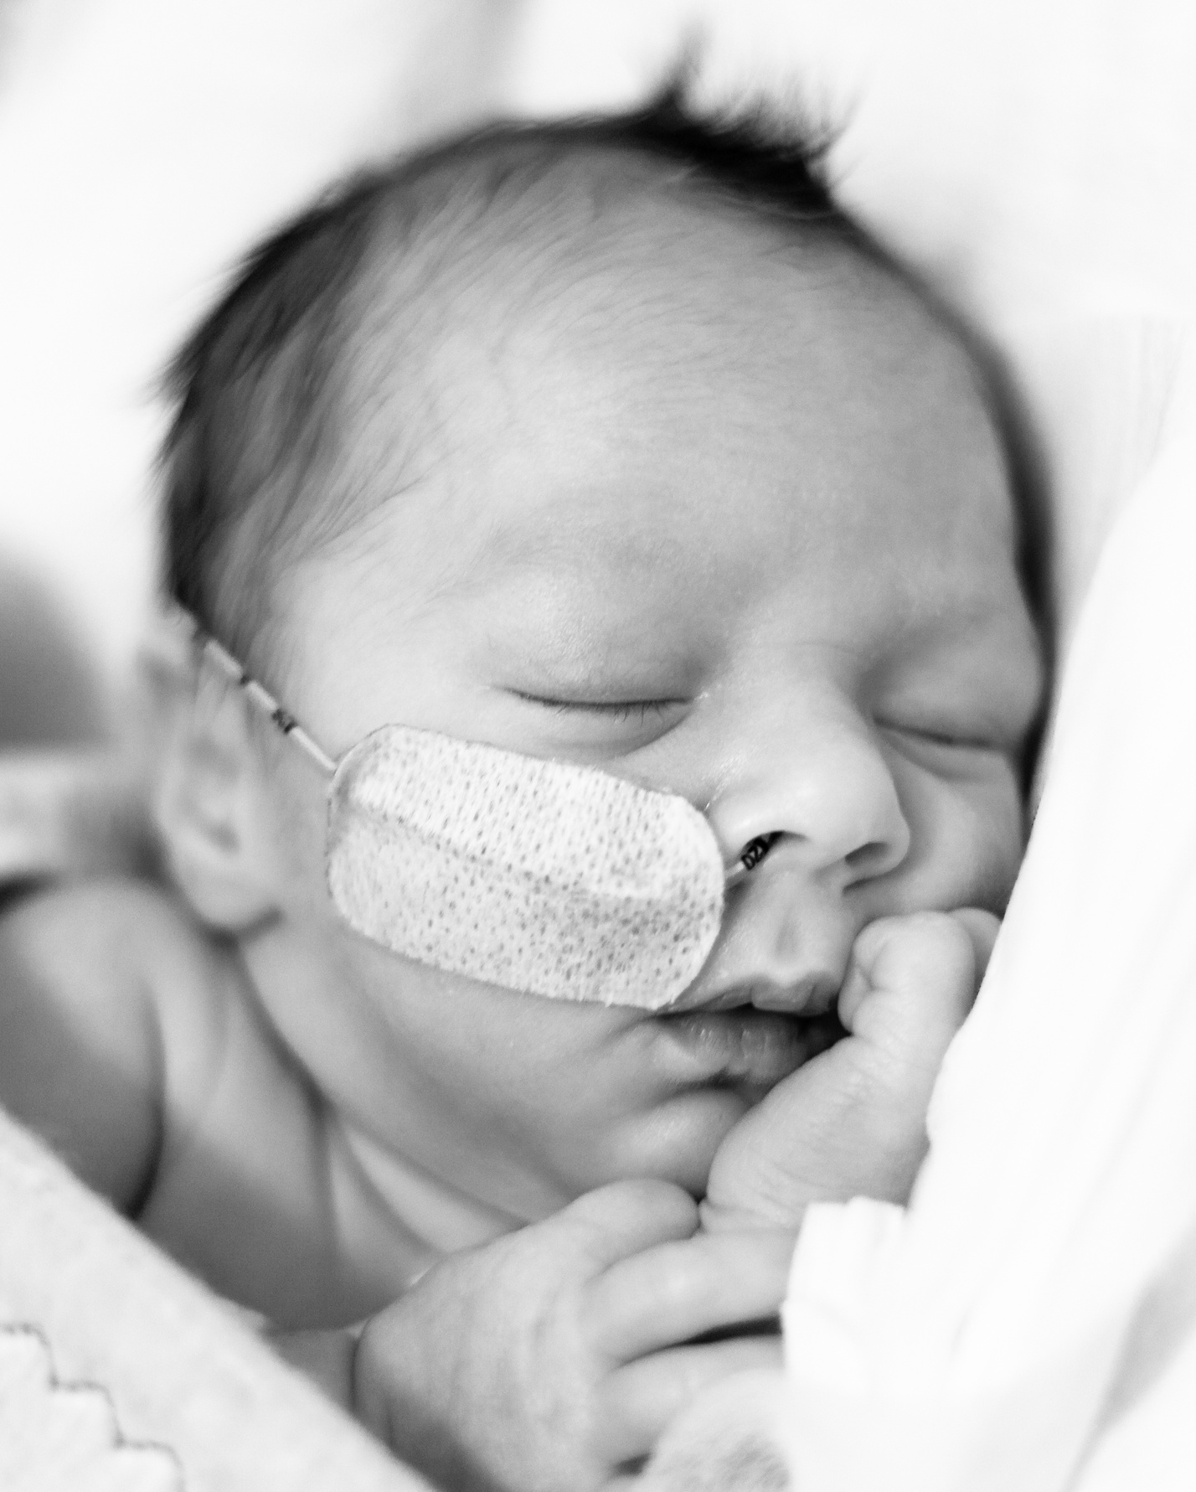
Examining the efficacy of a parent-targeted co-designed digital media intervention to increase recruitment rates across a multi-site randomized clinical trial In Canadian NICU’s.
Short Title: WHEAT-BOOST
Co-Principal Investigators
Dr. Balpreet Singh
Dr. Jon Dorling
Dr. Chris Gail
Dr. Marsha Campbell-Yeo
Research Coordinator
Cari-Lee Carnell

Slide 2
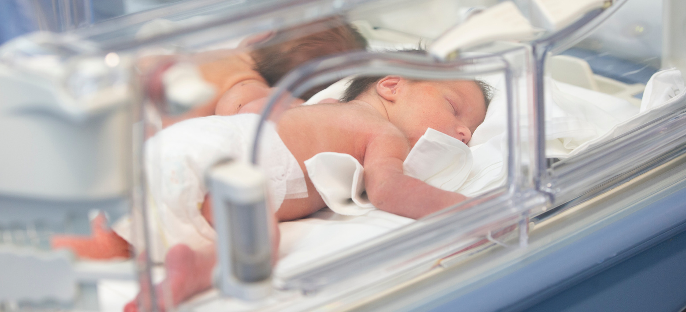
Research Question
P Parents/Primary caregivers approached for participation in the WHEAT International Trial; those with infants born < 30 weeks gestation
I Families approached through the usual informed consent process with the addition of a short video
C Families approached through the usual informed consent process; no video shown
O Rate of recruitment to participate in the WHEAT International Trial pre- randomization.
Does the use of a digital media intervention targeting parent-reported questions regarding a complex RCT improve the overall recruitment rate for a large RCT (WHEAT International Trial) taking place in 16 NICU’s across Canada?
Notes:
Aims to explore rate of recruitment for RCT
Health literacy & parental comprehension of trial-specific details
Explores parental experiences with the consenting process

Slide 3
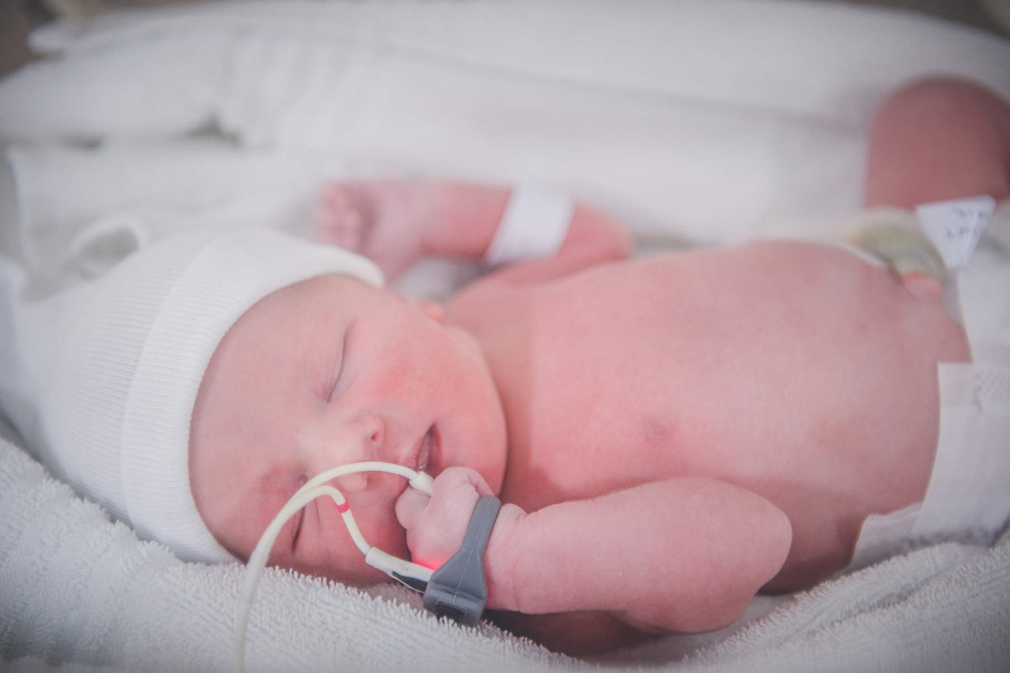
The WHEAT International Trial explores withholding feeds around time of transfusion and aims to identify whether withholding feeds at time of transfusion will reduce the incidence of NEC in preterm infants.
It is a randomized, controlled, comparative effectiveness study funded by the CIHR with a goal of 4333 participants across Canada and the UK over 4 years.
SWAT Sub-Study
16 Canadian NICU sites participating in the WHEAT International Trial will be cluster randomized with a stepped wedge design.
Optimal sample size is 900 participants over 1.5 years of recruitment.
Design

Slide 4
Proposed Timeline

Slide 5
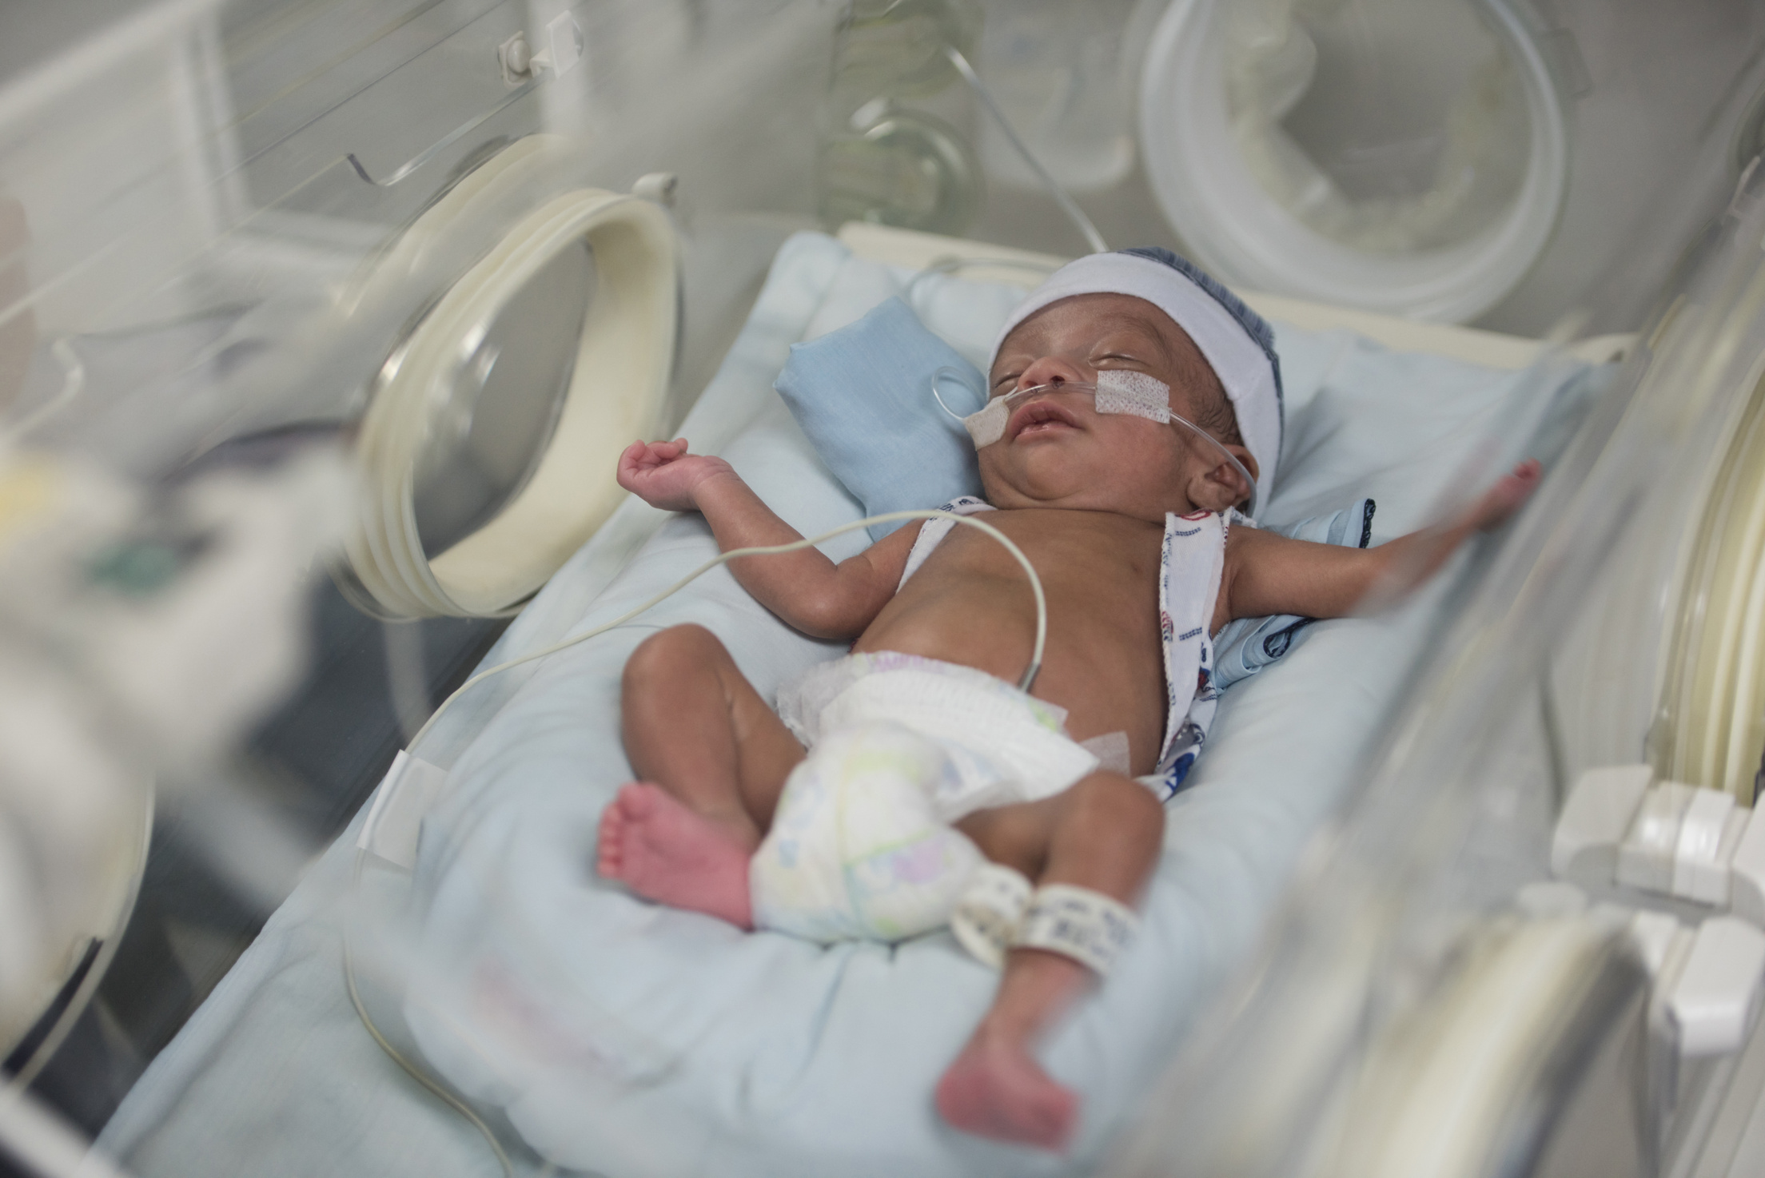
Update
Meeting of Parent Partner Co-Design Team
Video Creation
Research Ethics Board submission
Notes:
Early stages

