Slide 1
VICTORY Virtual, Innovative, postsurgical Care To Optimize Return home for older people with frailtY
Sylvie Aucoin, MD, MSc Manoj Lalu, MD, PhD Daniel McIsaac, MD, MSc Michael Jacka, MD

Slide 2
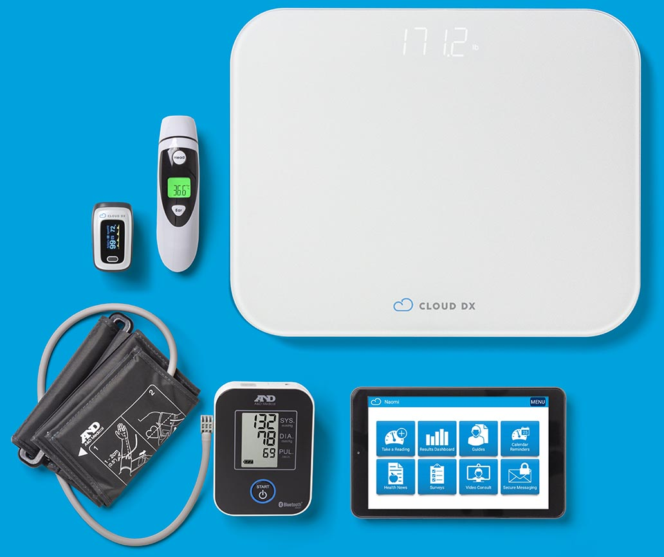
VICTORY Pilot Trial
Is a multicenter RCT of frailty-specific virtual post-surgical care to improve patient-centered outcomes for surgical patients with frailty feasible?
Notes:
What is virtual post-surgical care?
Innovative model of care for patients which has evolved following the first PVC-RAM trial in 2020. It that exists in many centres across the country, including in Ottawa and Edmonton, who are the the two sites where this pilot will be conducted.
Patients discharged from hospital with a tablet that has Cloud DX software on it and bluetooth monitoring equipment. They do twice daily vital signs and complete a daily symptoms survey and regular video calls with a virtual nurse.

Slide 3
VICTORY – Vanguard RCT Design
Intervention Group
>60 years old
Clinical Frailty Score ≥4
Non-cardiac surgery
Remote monitoring
Virtual nursing care
‘4Ms’ assessment
14 days discharge
Control Group
3 centers
96 patients
Institution-standard post-discharge care
Notes:
-

Slide 4
Victory Trial Outcomes
Pilot
Feasibility:
Full – Primary Efficacy Outcome
Full – Secondary Efficacy Outcomes:
Resource use: length of stay, readmissions, total hospital days, ED use
Patient-Centred: quality of life, delirium, pain interference, satisfaction, goal attainment
Safety: medication adverse events
Days Alive at Home 30-days
Enrollment
Intervention fidelity
Complete follow-up

Slide 5
Timeline
Mid 2023
Early 2024
Mid 2024
End of 2024
12 months to complete pilot
Will inform adequately powered VICTORY trial
Work to Date
REB approval
Liaison b/w sites
Funding for trial
Recruitment
8 participants/month

