Slide 1
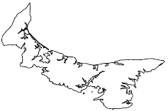
BRAVE-SWIFT SWAT trial Prof. Susan Jack, School of Nursing Prof. S.I. Bangdiwala, Health Research Methods
https://www.act-aec.ca/
Update 2023 Sept 22
Charlottetown, PEI

Slide 2
Background
Recruitment into the Bariatric Surgery for the Reduction of cArdioVascular Events (BRAVE) RCT is challenged by the complex patient population & lengthy surgical assessment process
Recruit
>18 years & BMI > 35 & high-risk CVD
Pts undergo bariatric surgery work-up
Eligible & willing patients randomized
1 visit (~2hrs)
Rand.
Surgical Assess.
Referral from cardiologists & other physicians
>5 visits, takes 3-6 months to complete
32% of approached consent to assessment
13% able/willing to rand after assessment

Slide 3
BRAVE - SWIFT
BRAVE-SWIFT is a “study within a trial” (SWAT) to understand the factors impacting recruitment and to test a recruitment intervention
3 components:
Qualitative Descriptive Study to identify patient level, health care provider level, and systems level factors influencing recruitment;
Development of a novel Recruitment Intervention using a modified version of the QuinteT (qualitative) Recruitment Intervention (aka mod-QRI);
Evaluation of this intervention using a novel design, the Stepped Wedge In Flexible Batches (SWIFT) design

Slide 4
(1) Qualitative Descriptive Study
Led by Prof. Susan Jack, School of Nursing (McMaster), an expert in applied qualitative health methods
Conducted at 2 BRAVE centres (Hamilton & Laval)
Include physicians, clinic administrators, and patients who agreed & patients who declined at any time in recruitment
Results will include:
factors influencing recruitment, consent & engagement;
contextual information on each factor as a barrier or facilitator; &
participants’ recommendations to enhance the recruitment process.

Slide 5
(2) mod-QRI Recruitment intervention
To be implemented at ALL Vanguard centres
Intervention will be based on the identified barriers & facilitators to recruitment
mod-QRI intervention consists of :
Screening, Eligibility, Approached and Randomized (SEAR) log tracking;
discussions with site recruitment team;
observations of recruitment & consent process;
mapping eligibility pathways to identifying potential obstacles & delays;
review of patient-facing materials
site recruitment team developing an ‘action plan’ based on above feedback

Slide 6
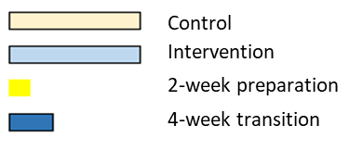
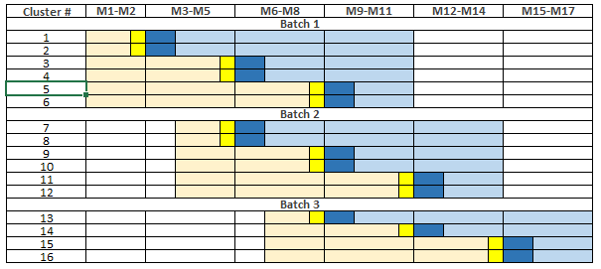
(3) Stepped Wedge In Flexible baTches (SWIFT) trial
Each centre (N=16) will be randomized to mod-QRI intervention using a flexible, staggered batched SW design

Slide 7
SWIFT-BRAVE Outcomes
Primary outcome: Proportion of eligible patients that consent to undergo bariatric assessment
Secondary outcomes:
# of cardiologists and other doctors who refer patients for the trial
# of anesthetists who are willing to accept patients with CVD for bariatric surgery
Avg. # of discussions needed per patient/relatives between screening & rand
Duration of bariatric workup (currently 133 days in Ontario & 88 days in Quebec)
Centre-level recruitment performance score (RPS) will be constructed, based on patients approached, screening, completing bariatric assessment & randomizations

Slide 8
SWIFT-BRAVE expected impact
SWIFT-BRAVE is a unique SWAT - combining qualitative methods with an RCT, utilizing an innovative study design, and applicable in other trials
Results will assist with improving recruitment for the main trial
Provides an important opportunity for patient feedback & engagement

