Slide 1
SIMPLY-SNAP
Evaluating the impact of a SIMPlified LaYered consent process versus a conventional informed consent form on recruitment of potential participants to a large platform clinical trial: a pragmatic nested randomized controlled trial
Dr Sean Ong
Dr Nick Daneman

Slide 2
Research Question
Population: For potential participants (or surrogate decision makers) of the SNAP trial,
Intervention: does use of a novel simplified layered consent process,
Control: compared to a conventional consent form,
Outcome: lead to an improved recruitment rate without compromising participant understanding and satisfaction?

Slide 3
Design
Nested within larger SNAP (Staphylococcus aureus Network Adaptive Platform) trial at select sites in Canada
Pragmatic, multi-centre, open-label, two-arm parallel-group RCT
SNAP eligible patients randomized 1:1 to conventional or simplified layered consent
Outcomes:
Primary: recruitment success into SNAP
Participant satisfaction with consent process
Research staff satisfaction with consent process
Time taken for entire consent process
Participant understanding of the clinical trial

Slide 4
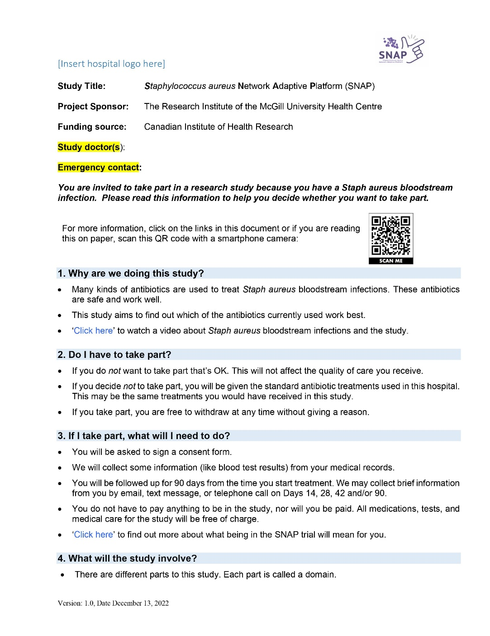
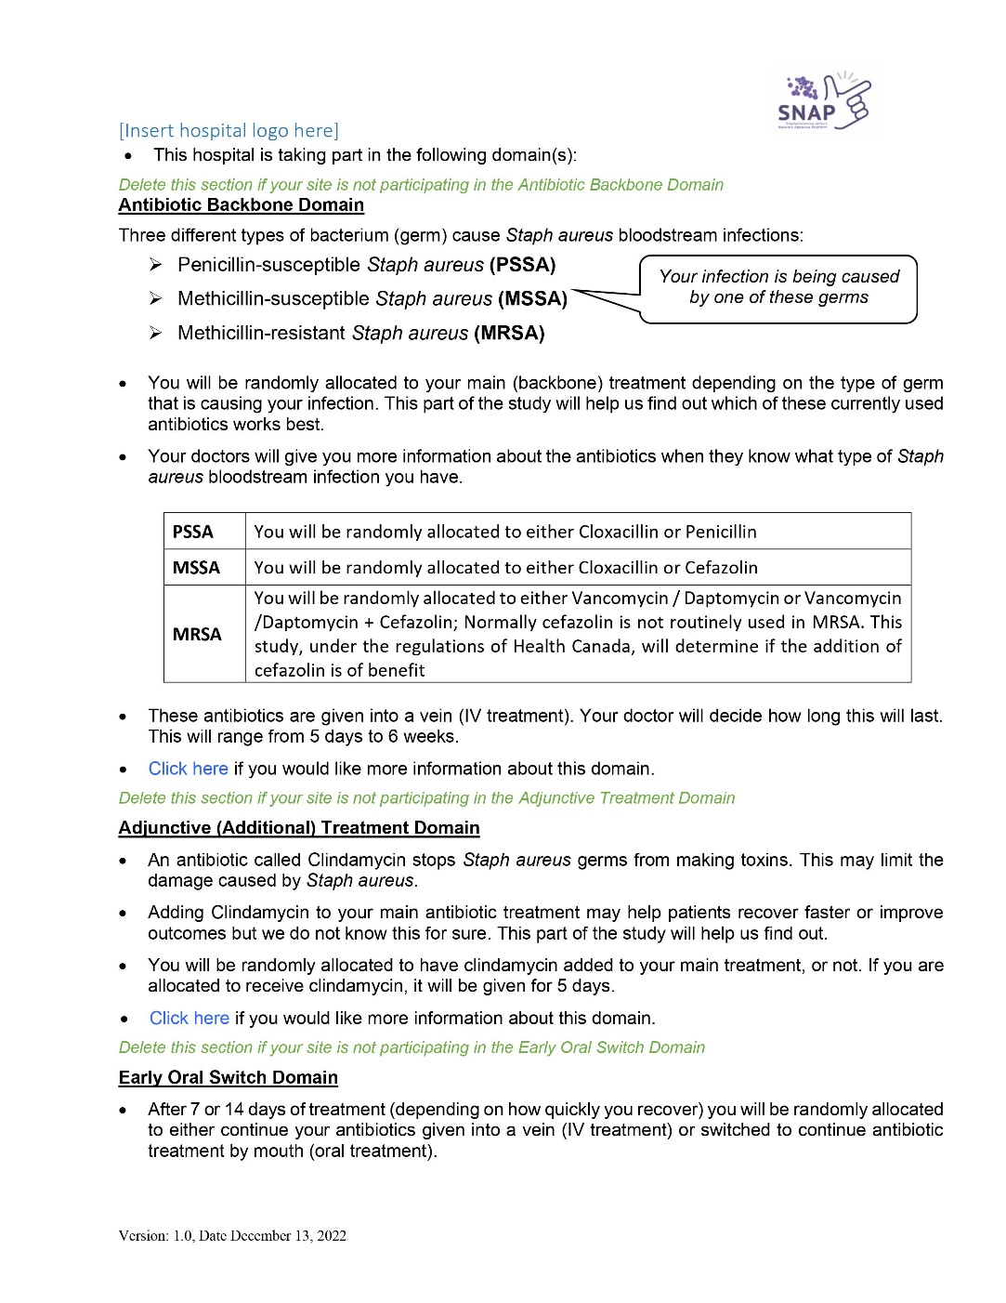

Slide 5
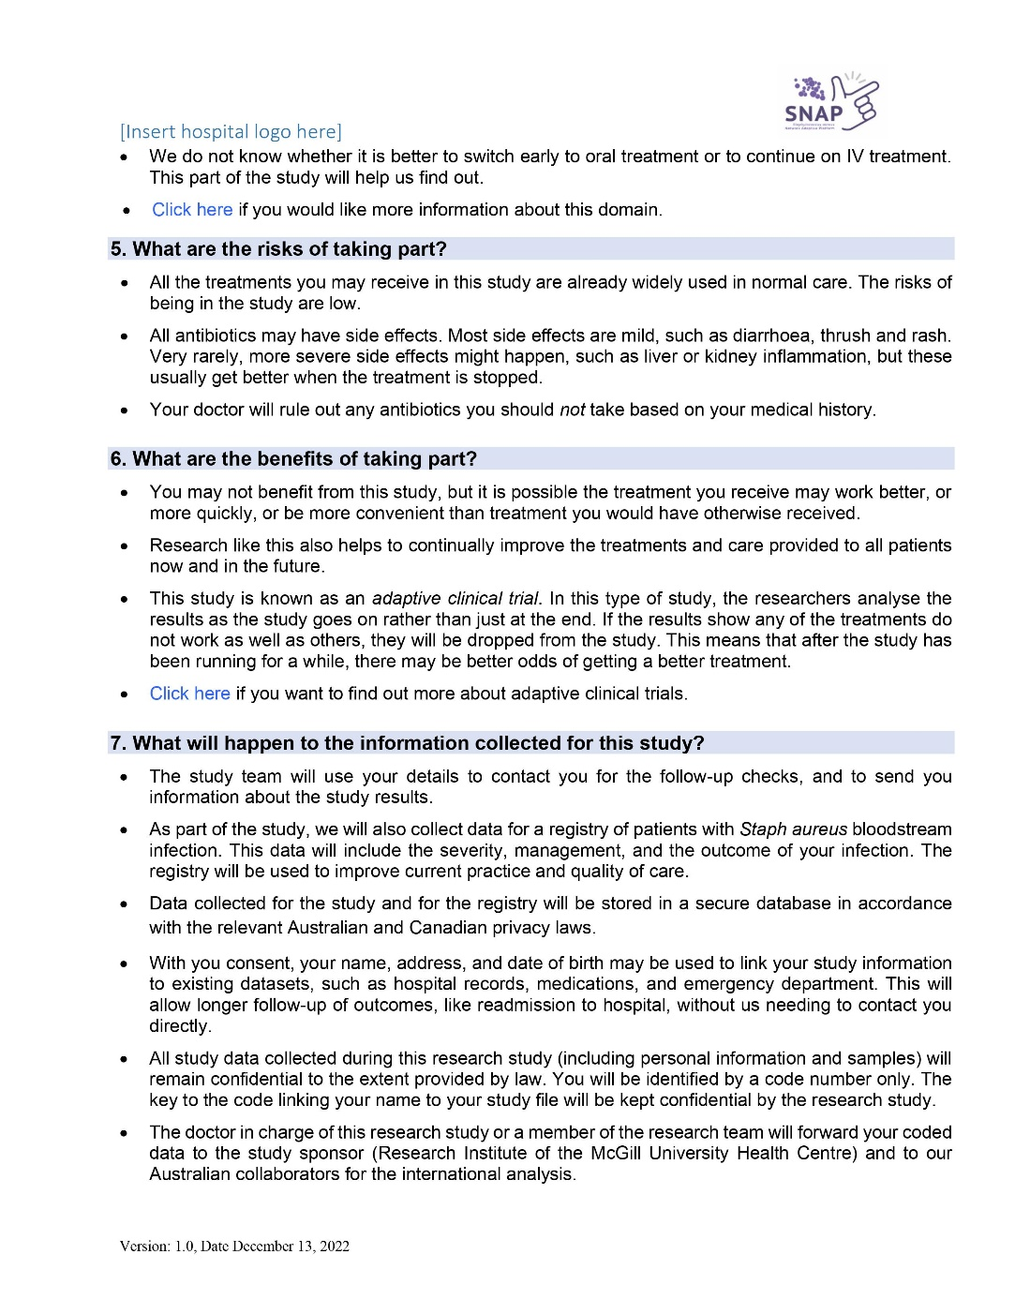
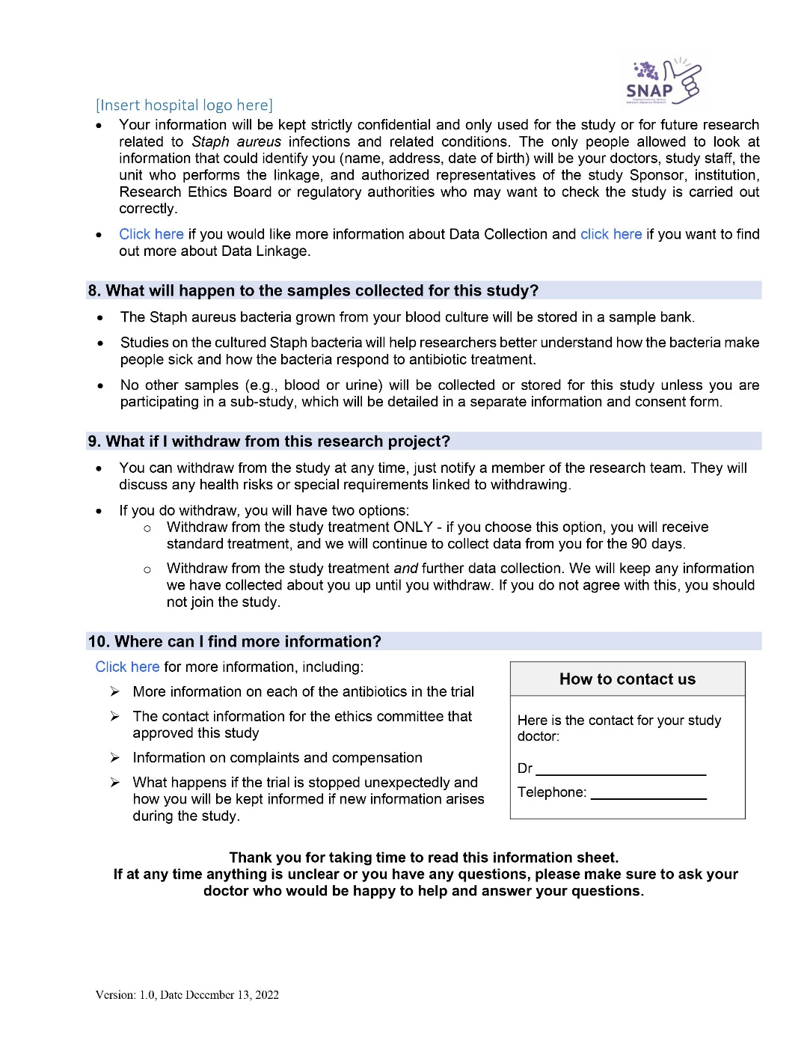

Slide 6
Update
Funding obtained from CIHR and ACT
Database and randomization module in construction currently (embedded within larger SNAP trial)
Aim to start enrolment in Nov-Dec 2023
Target sample size 322, aim to complete recruitment in one year (~10 sites)

