Slide 1
Surgical Ablation of Atrial Fibrillation Efficacy (SAFE) trial
Emilie Belley-Côté MD, PhD
Richard Whitlock MD, PhD

Slide 2
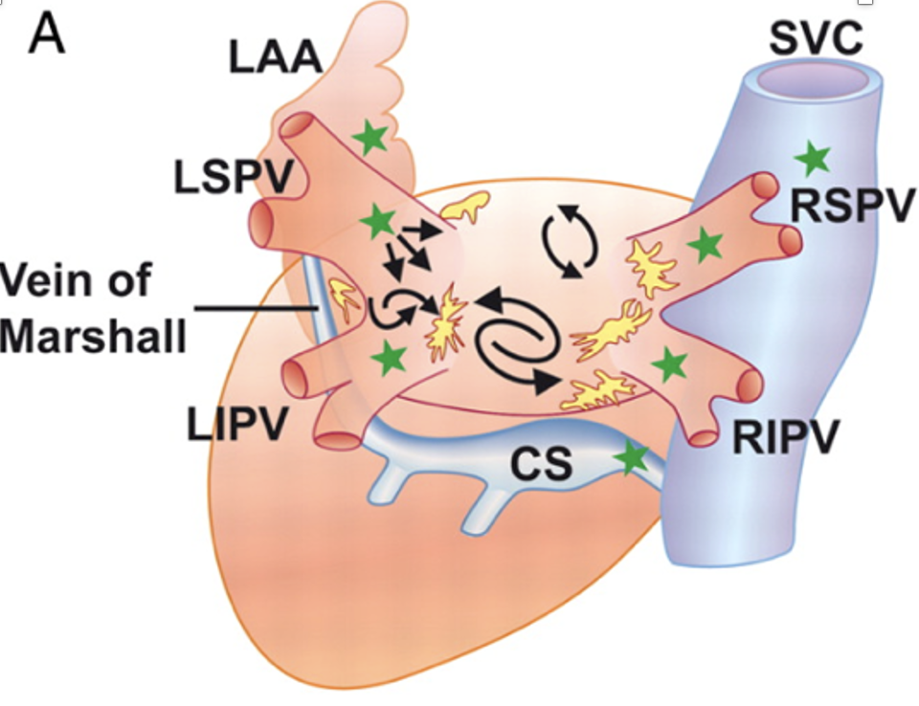
Atrial Fibrillation
10-15% of population >80 years old
11% of patients undergoing cardiac surgery
Associated with:
- stroke
- heart failure
- mortality

Slide 3
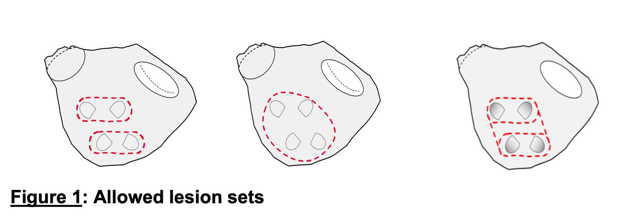
Ablation of Atrial Fibrillation
Catheter AF ablation reduces:
Death, hospitalization for heart failure, heart failure progression
AF ablation can be performed cardiac surgery
Reduces AF burden
Notes:
Castle, Castle Htx
Non blinded trials

Slide 4
SAFE Trial Design
Planned Cardiac Surgery Patients
With pre-op AF
N=2000 patients
1:1
AF ablation
No AF Ablation
Follow-up Visits
Discharge after cardiac surgery procedure
4-6 weeks
Every 6 months thereafter until a common end date with mean fu 4 years
Powered to Assess:
Hospital Admissions with HF
Further fu for mortality
Clinicaltrials.gov: NCT05478304

Slide 5
What is novel about SAFE?
Total events analysis
- reflects patients’ experience
- mirrors burden on healthcare system
- may increase trial efficacy
Blinded assessment of AF ablation
- sham trial identified as a priority in the field
Clinicaltrials.gov: NCT05478304

