Slide 1
Building Capacity for Research in Community Hospitals in Canada – RICH-Canada Program
ACT Conference
September 21, 2023
Charlottetown, Prince Edward Island
Jennifer Tsang, MD, PhD, FRCPC, ABOM
Executive Director and Chief Scientist, Niagara Health Knowledge Institute
Intensivist, Physician Co-Lead, Critical Care Research Program, Niagara Health
Associate Professor of Medicine, McMaster University
Regional Deputy Research Director, Internal Medicine Residency Program, McMaster University

Slide 2
Land Acknowledgement
Charlottetown, Prince Edward Island
In the spirit of Reconciliation, we acknowledge that the land upon which we gather is unceded Mi’kmaq territory. Epekwitk (Prince Edward Island), Mi’kma’ki, is covered by the historic Treaties of Peace and Friendship. We pay our respects to the Indigenous Mi’kmaq People who have occupied this Island for over 12,000 years; past, present and future.
Niagara Region, Ontario
We acknowledge that the land on which Niagara Health is located is part of the traditional territory of the Haudenosaunee and Anishinaabe Peoples. We also acknowledge that the land of the Niagara Region is covered by the Upper Canada Treaties and is within the land protected by the Dish with One Spoon Wampum Agreement.

Slide 3
Disclosure
Clinician scientist in a community hospital
Received funding from:
CIHR
PSI Foundation
McCall MacBain Foundation
Mohawk-Medbuy – non-profit organization
COVID-19 Network of Clinical Trials Networks (CIHR)
ACT Consortium (CIHR)

Slide 4
Objectives
RICH-Canada Program timeline
Advocacy
Data
Community of practice
Support
Status
Future work

Slide 5
RICH-Canada Program Timeline

Slide 6
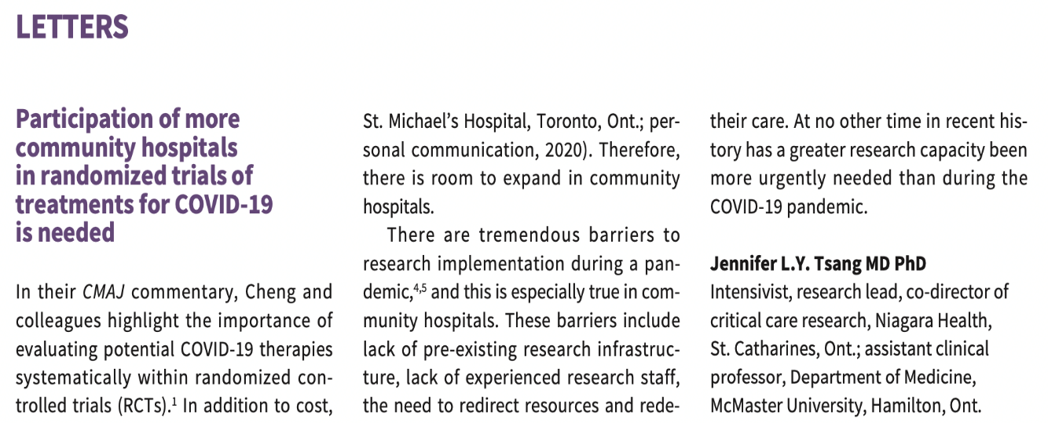
Advocacy
2017
2019
2020
2021

Slide 7
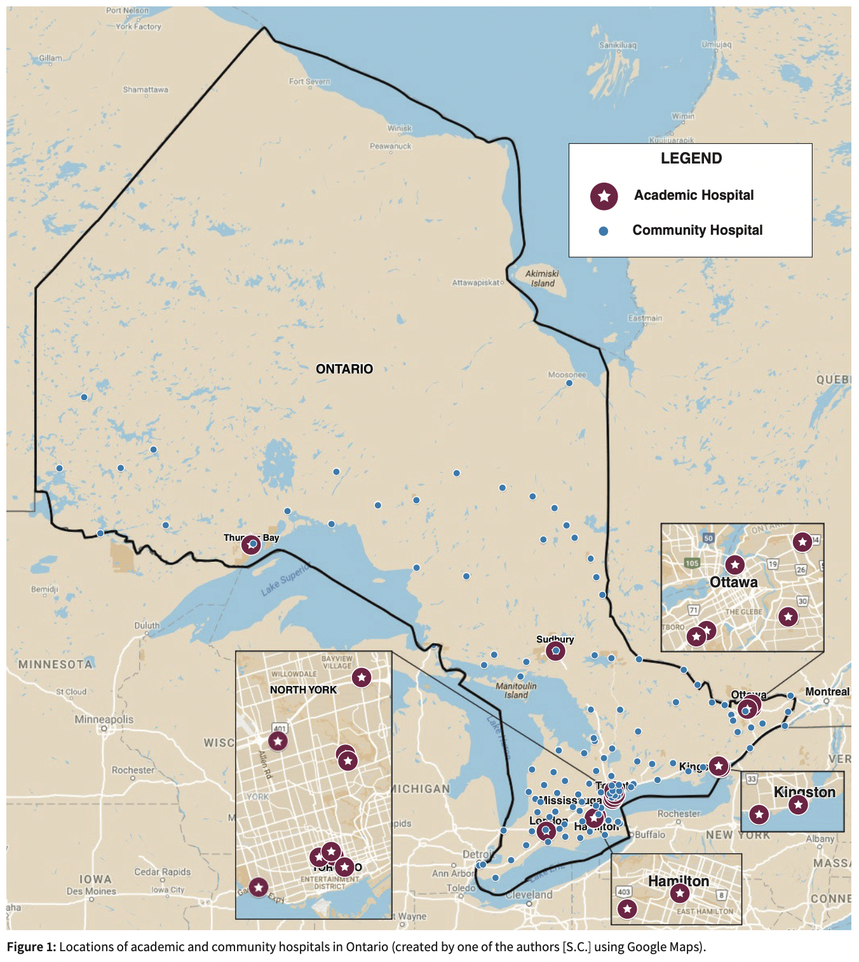
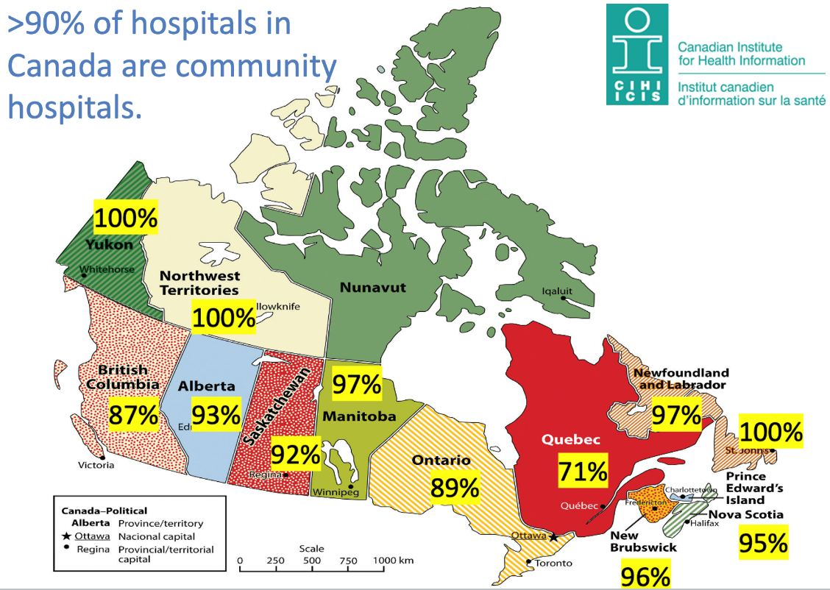
Advocacy
Geographical difference
<10% of hospitals are academic hospitals

Slide 8
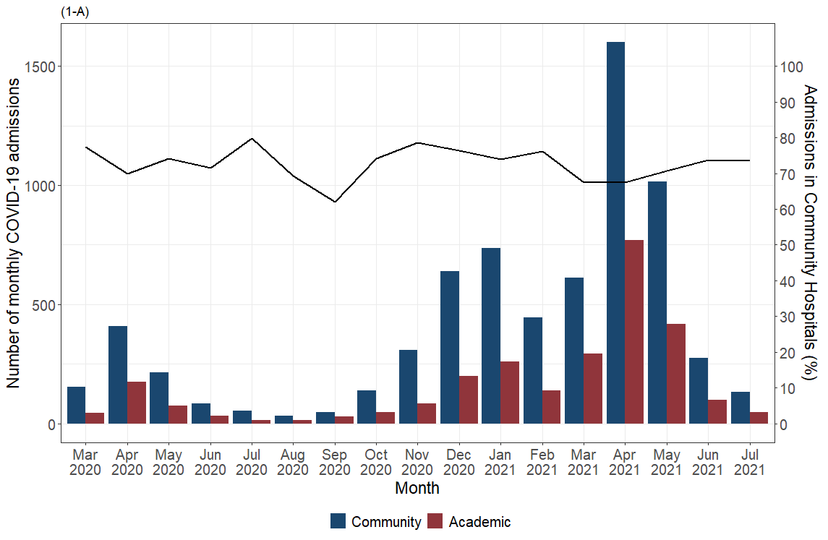
Data
Most patients receive care in community hospitals
COVID-19 ICU Admissions in Ontario
Academic ICUs (N=799, 28.5%) Community ICUs (N=2,040, 71.5%)

Slide 9
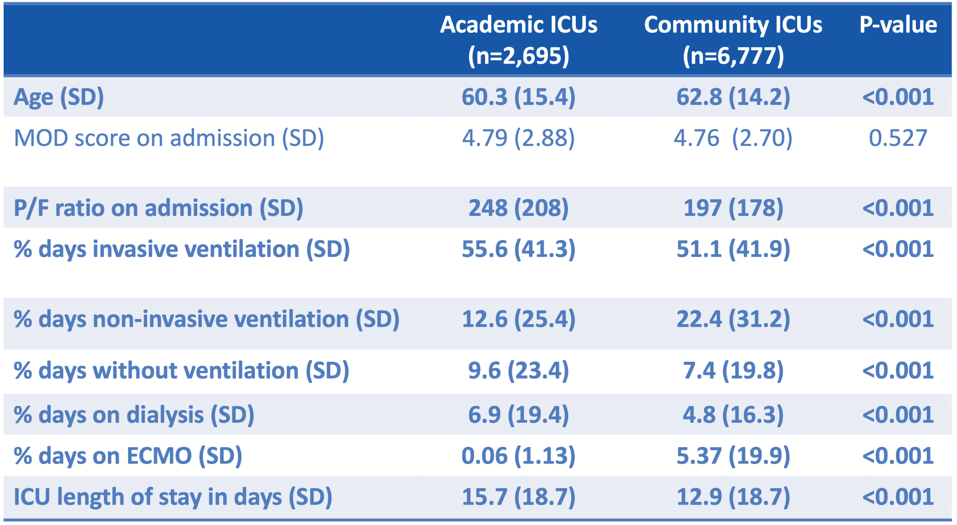
Data
COVID-19 patient populations are different

Slide 10
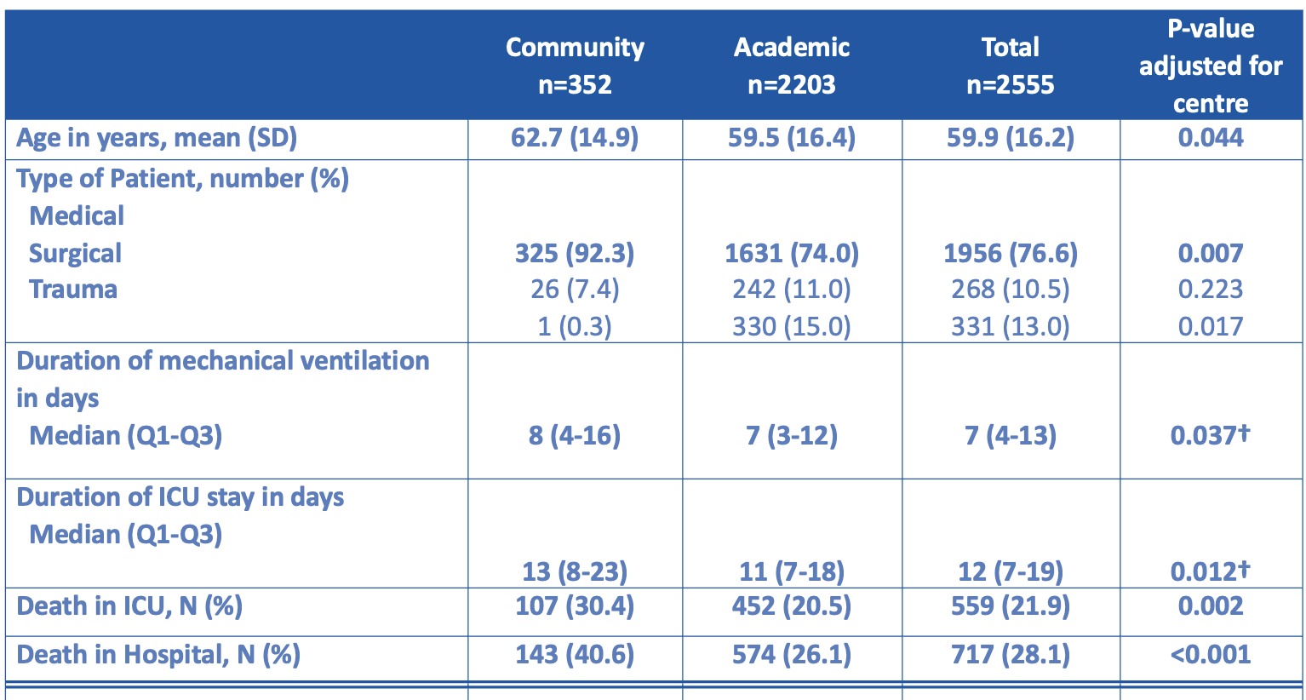
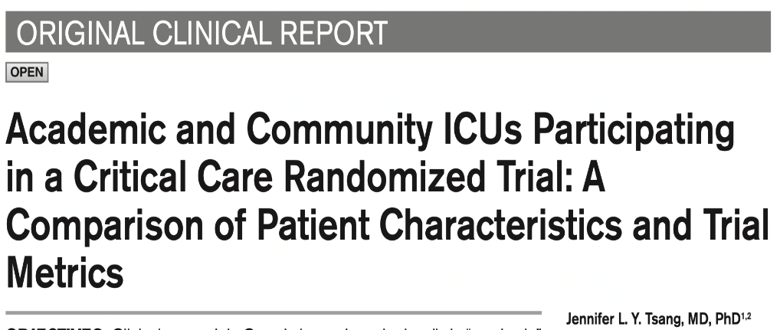
Data
Patient populations are different

Slide 11
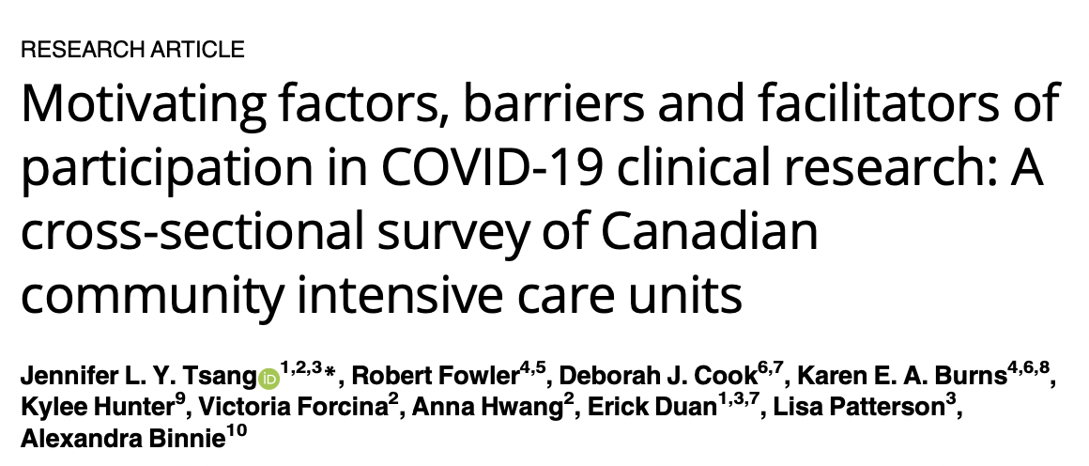
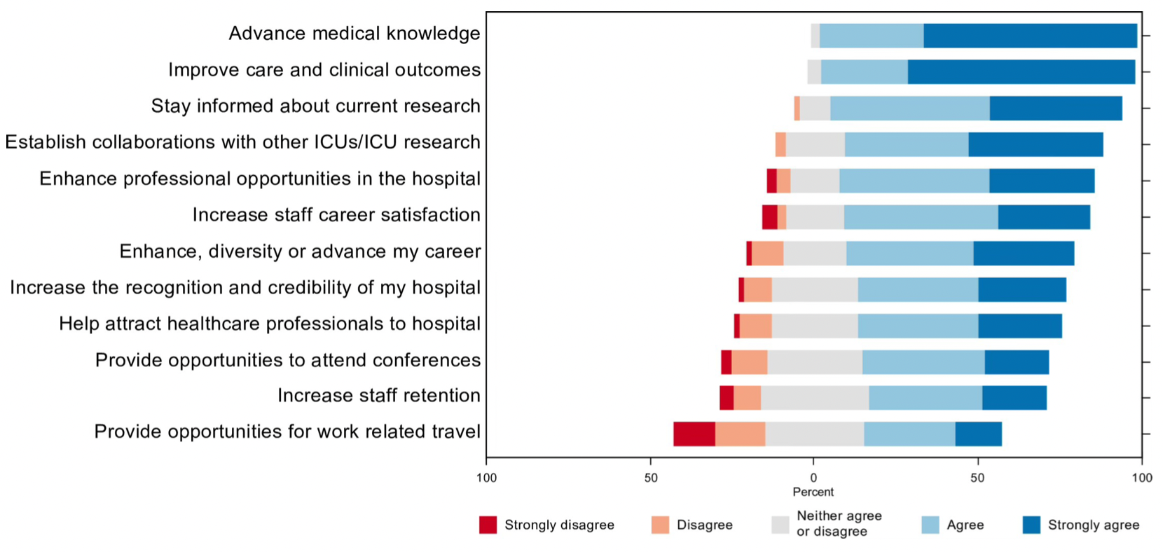
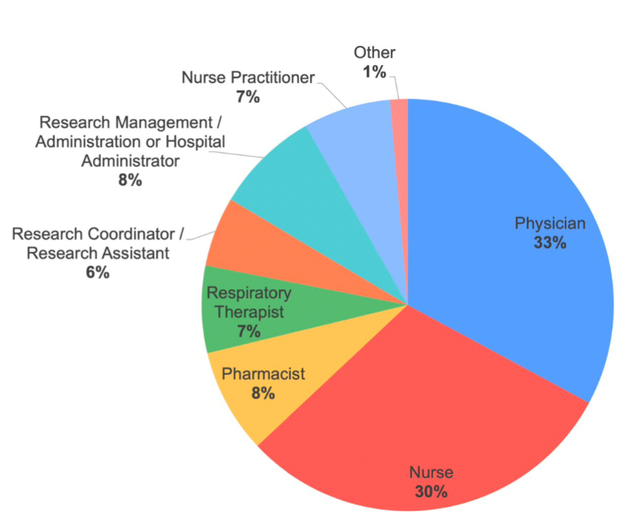
Data
Community hospital professionals are interested in research
N=73

Slide 12
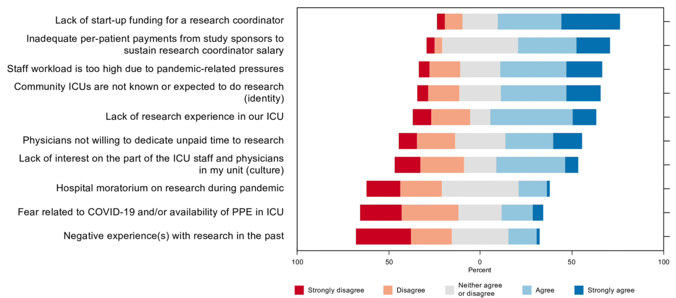
Data
Barriers to research in community hospitals
N=73

Slide 13
Data
Facilitators of research in community hospitals
N=73

Slide 14
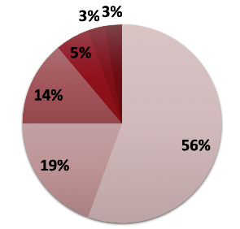
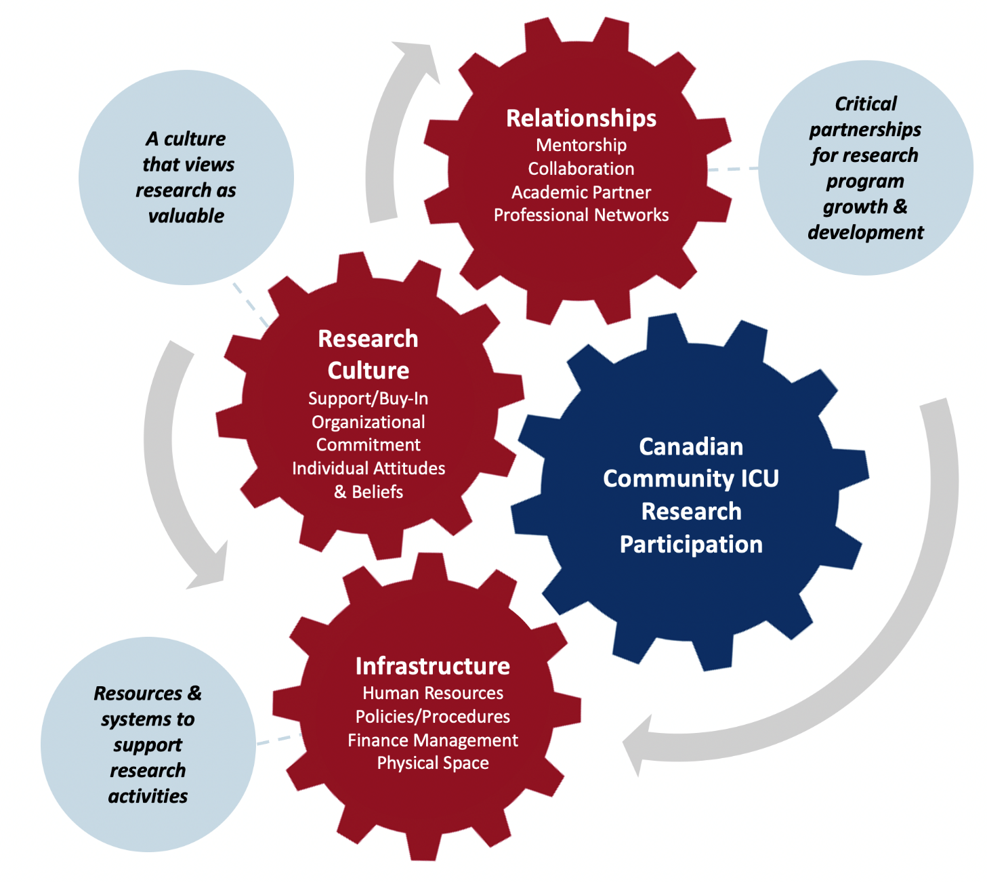
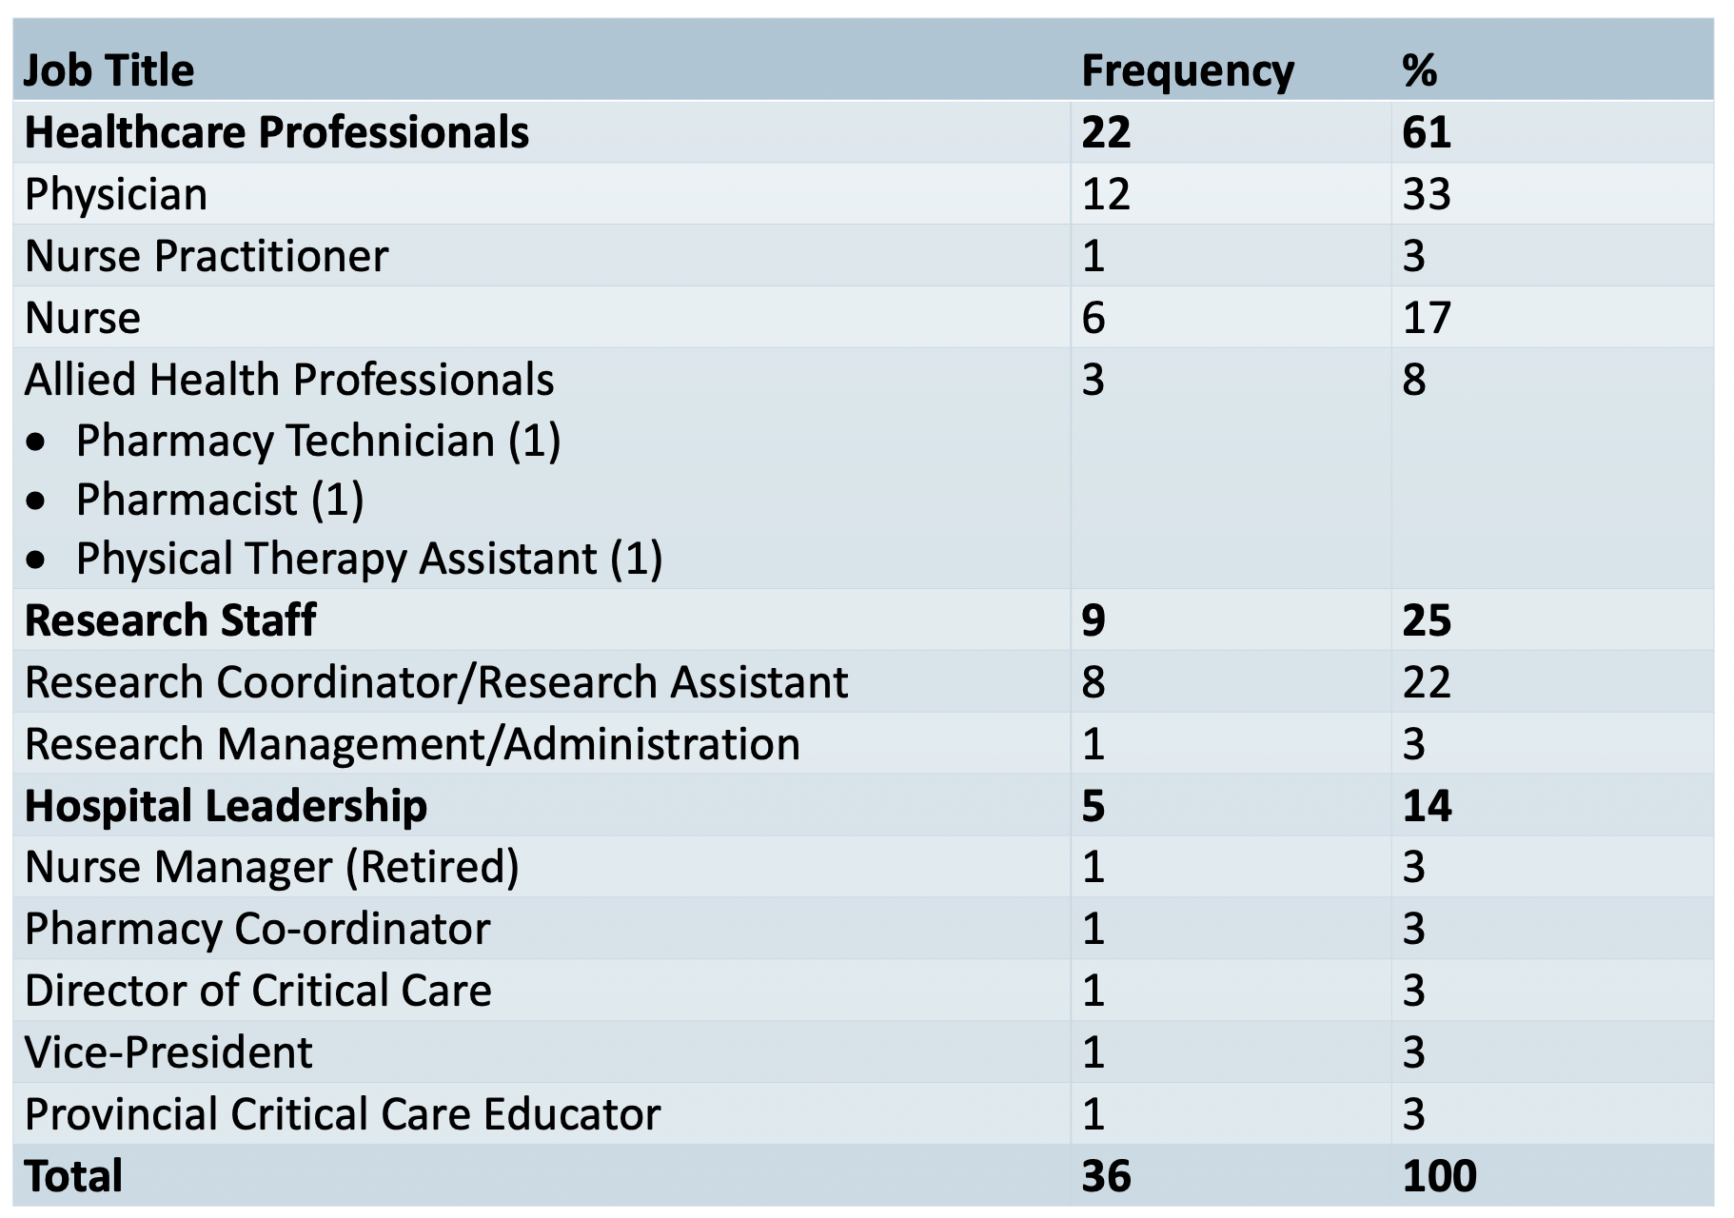
Data
Factors influencing community ICU participating in research

Slide 15
Data
Impact of COVID-19 NoN support on community hospital research capacity
COVID-19 NoN funding was used to:
Recruit new research staff
Sustain research programs that were in deficit
Increase number of clinical trials
Develop research policies and procedures
Uncertainty about the sustainability of research program once funding ceased
COVID-19 Network of Clinical Trials Networks (NoN)

Slide 16
Data
Impact of COVID-19 NoN support on community hospital research capacity
Identify mechanisms to connect community hospitals to share knowledge and experience.
Work with trialists on the design of clinical trials to facilitate implementation in community hospitals.
Create resources to support community ICUs in building and sustaining research programs, including resources to foster research engagement in communities without historic research participation.
Actionable Items
COVID-19 Network of Clinical Trials Networks (NoN)

Slide 17
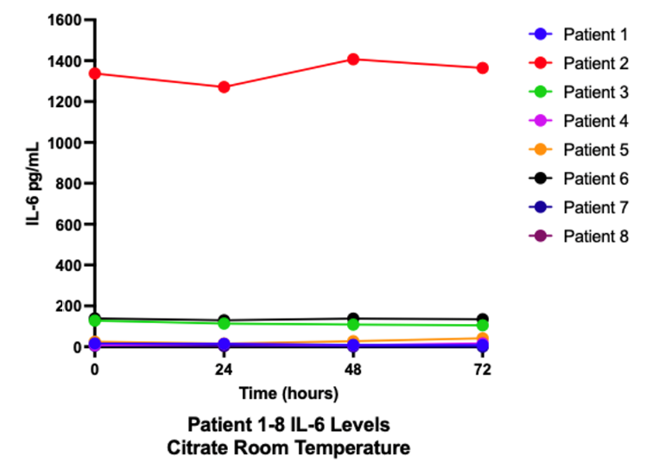
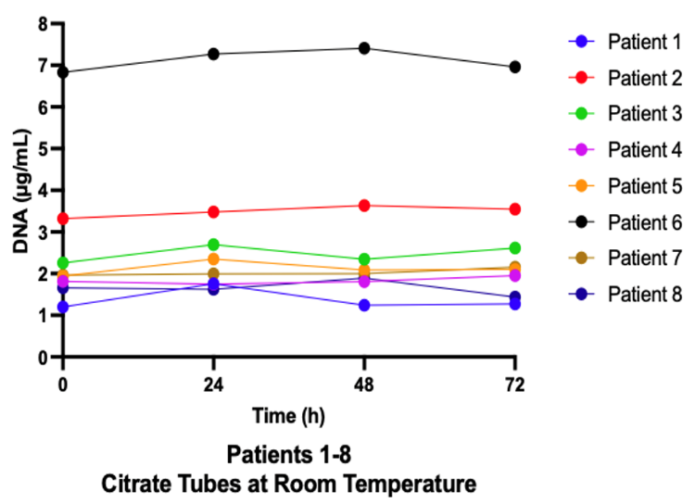
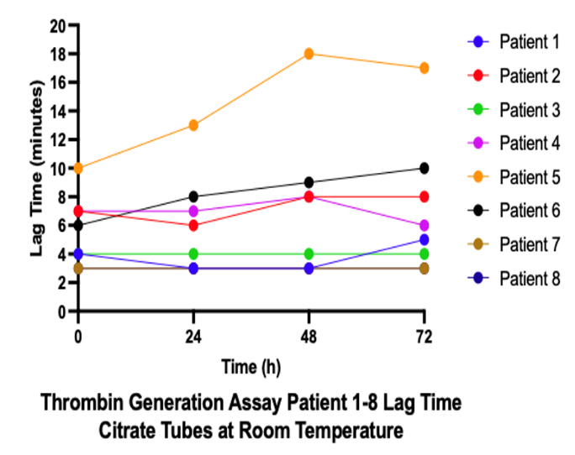
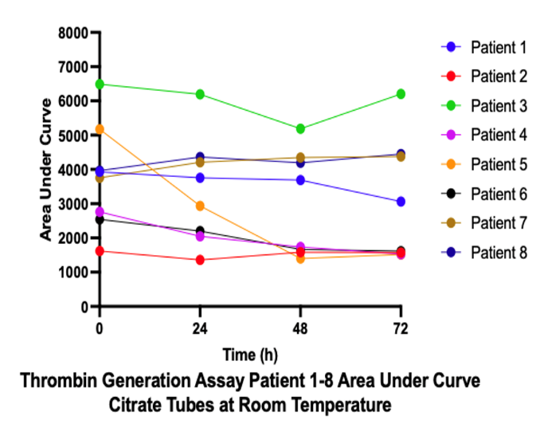
Data
“Simplified biological sample collection” does not result in quality degradation
Interleukin-6 Level
Cell-Free DNA Level
Thrombin Generation
COVID-19 Network of Clinical Trials Networks (NoN)

Slide 18
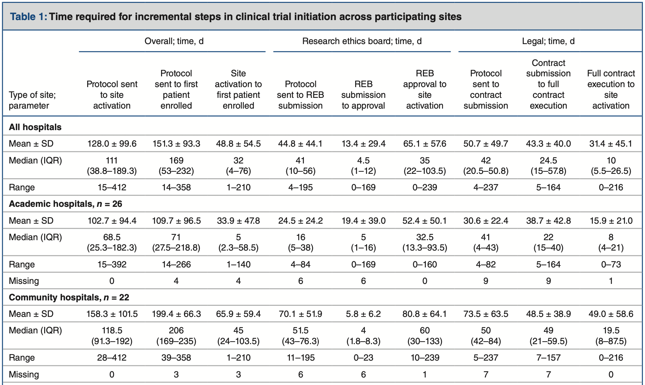
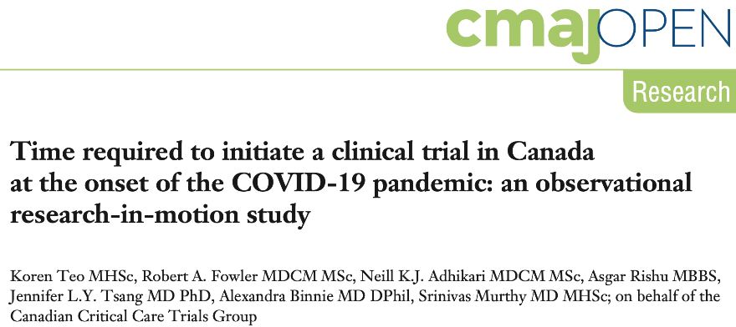
Data
Longer time to clinical trial initiation in community hospitals

Slide 19
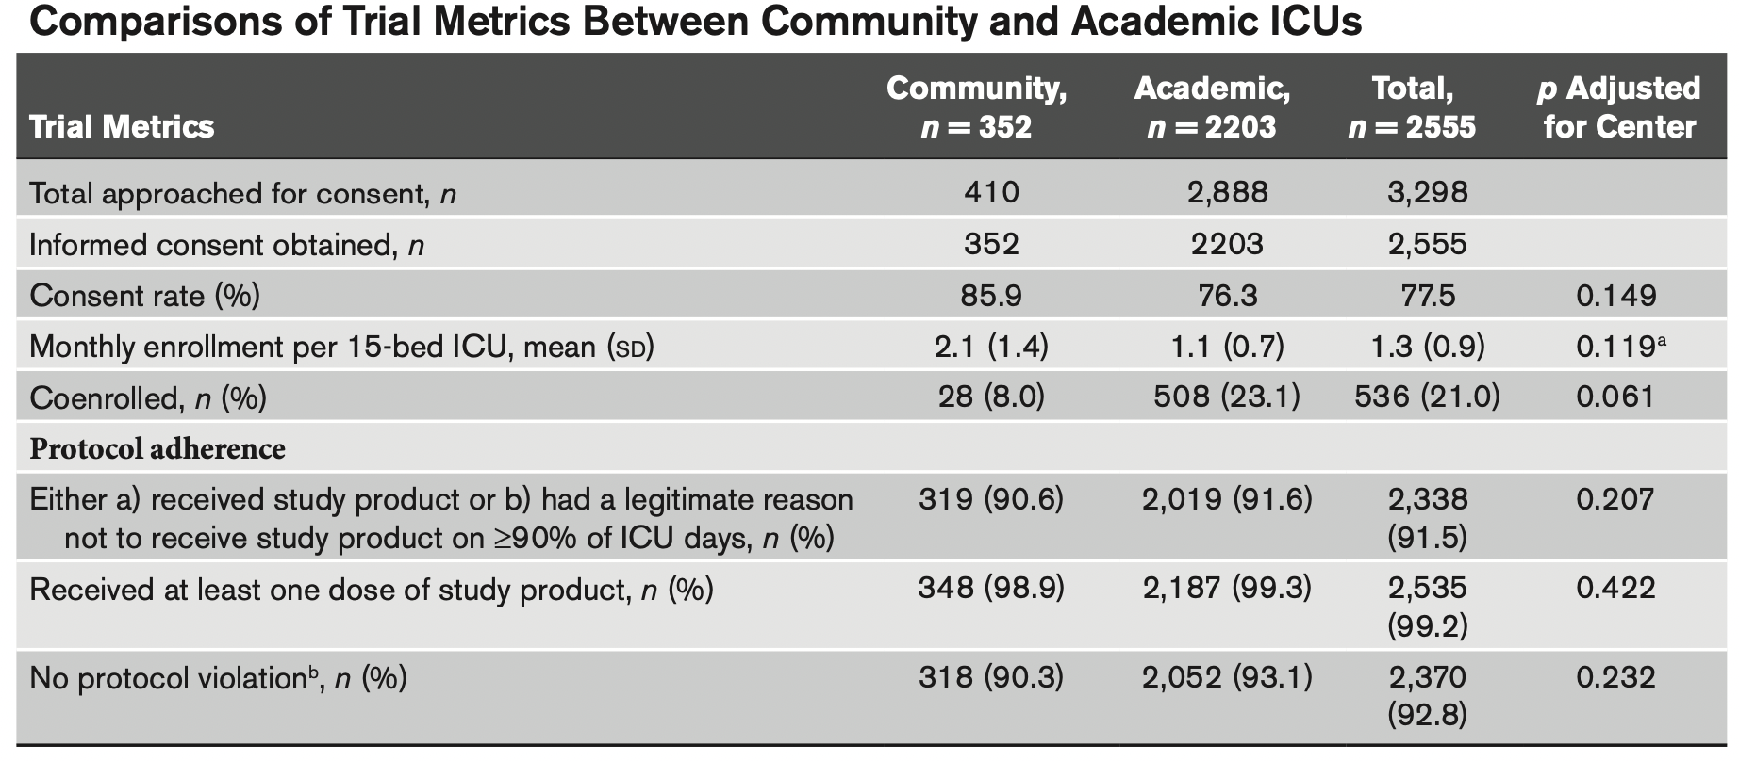
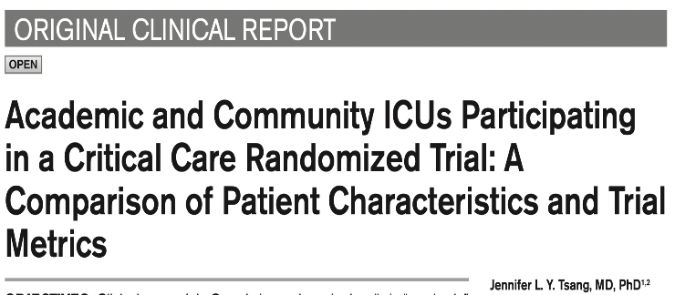
Data
Community hospitals can conduct clinical trials well

Slide 20
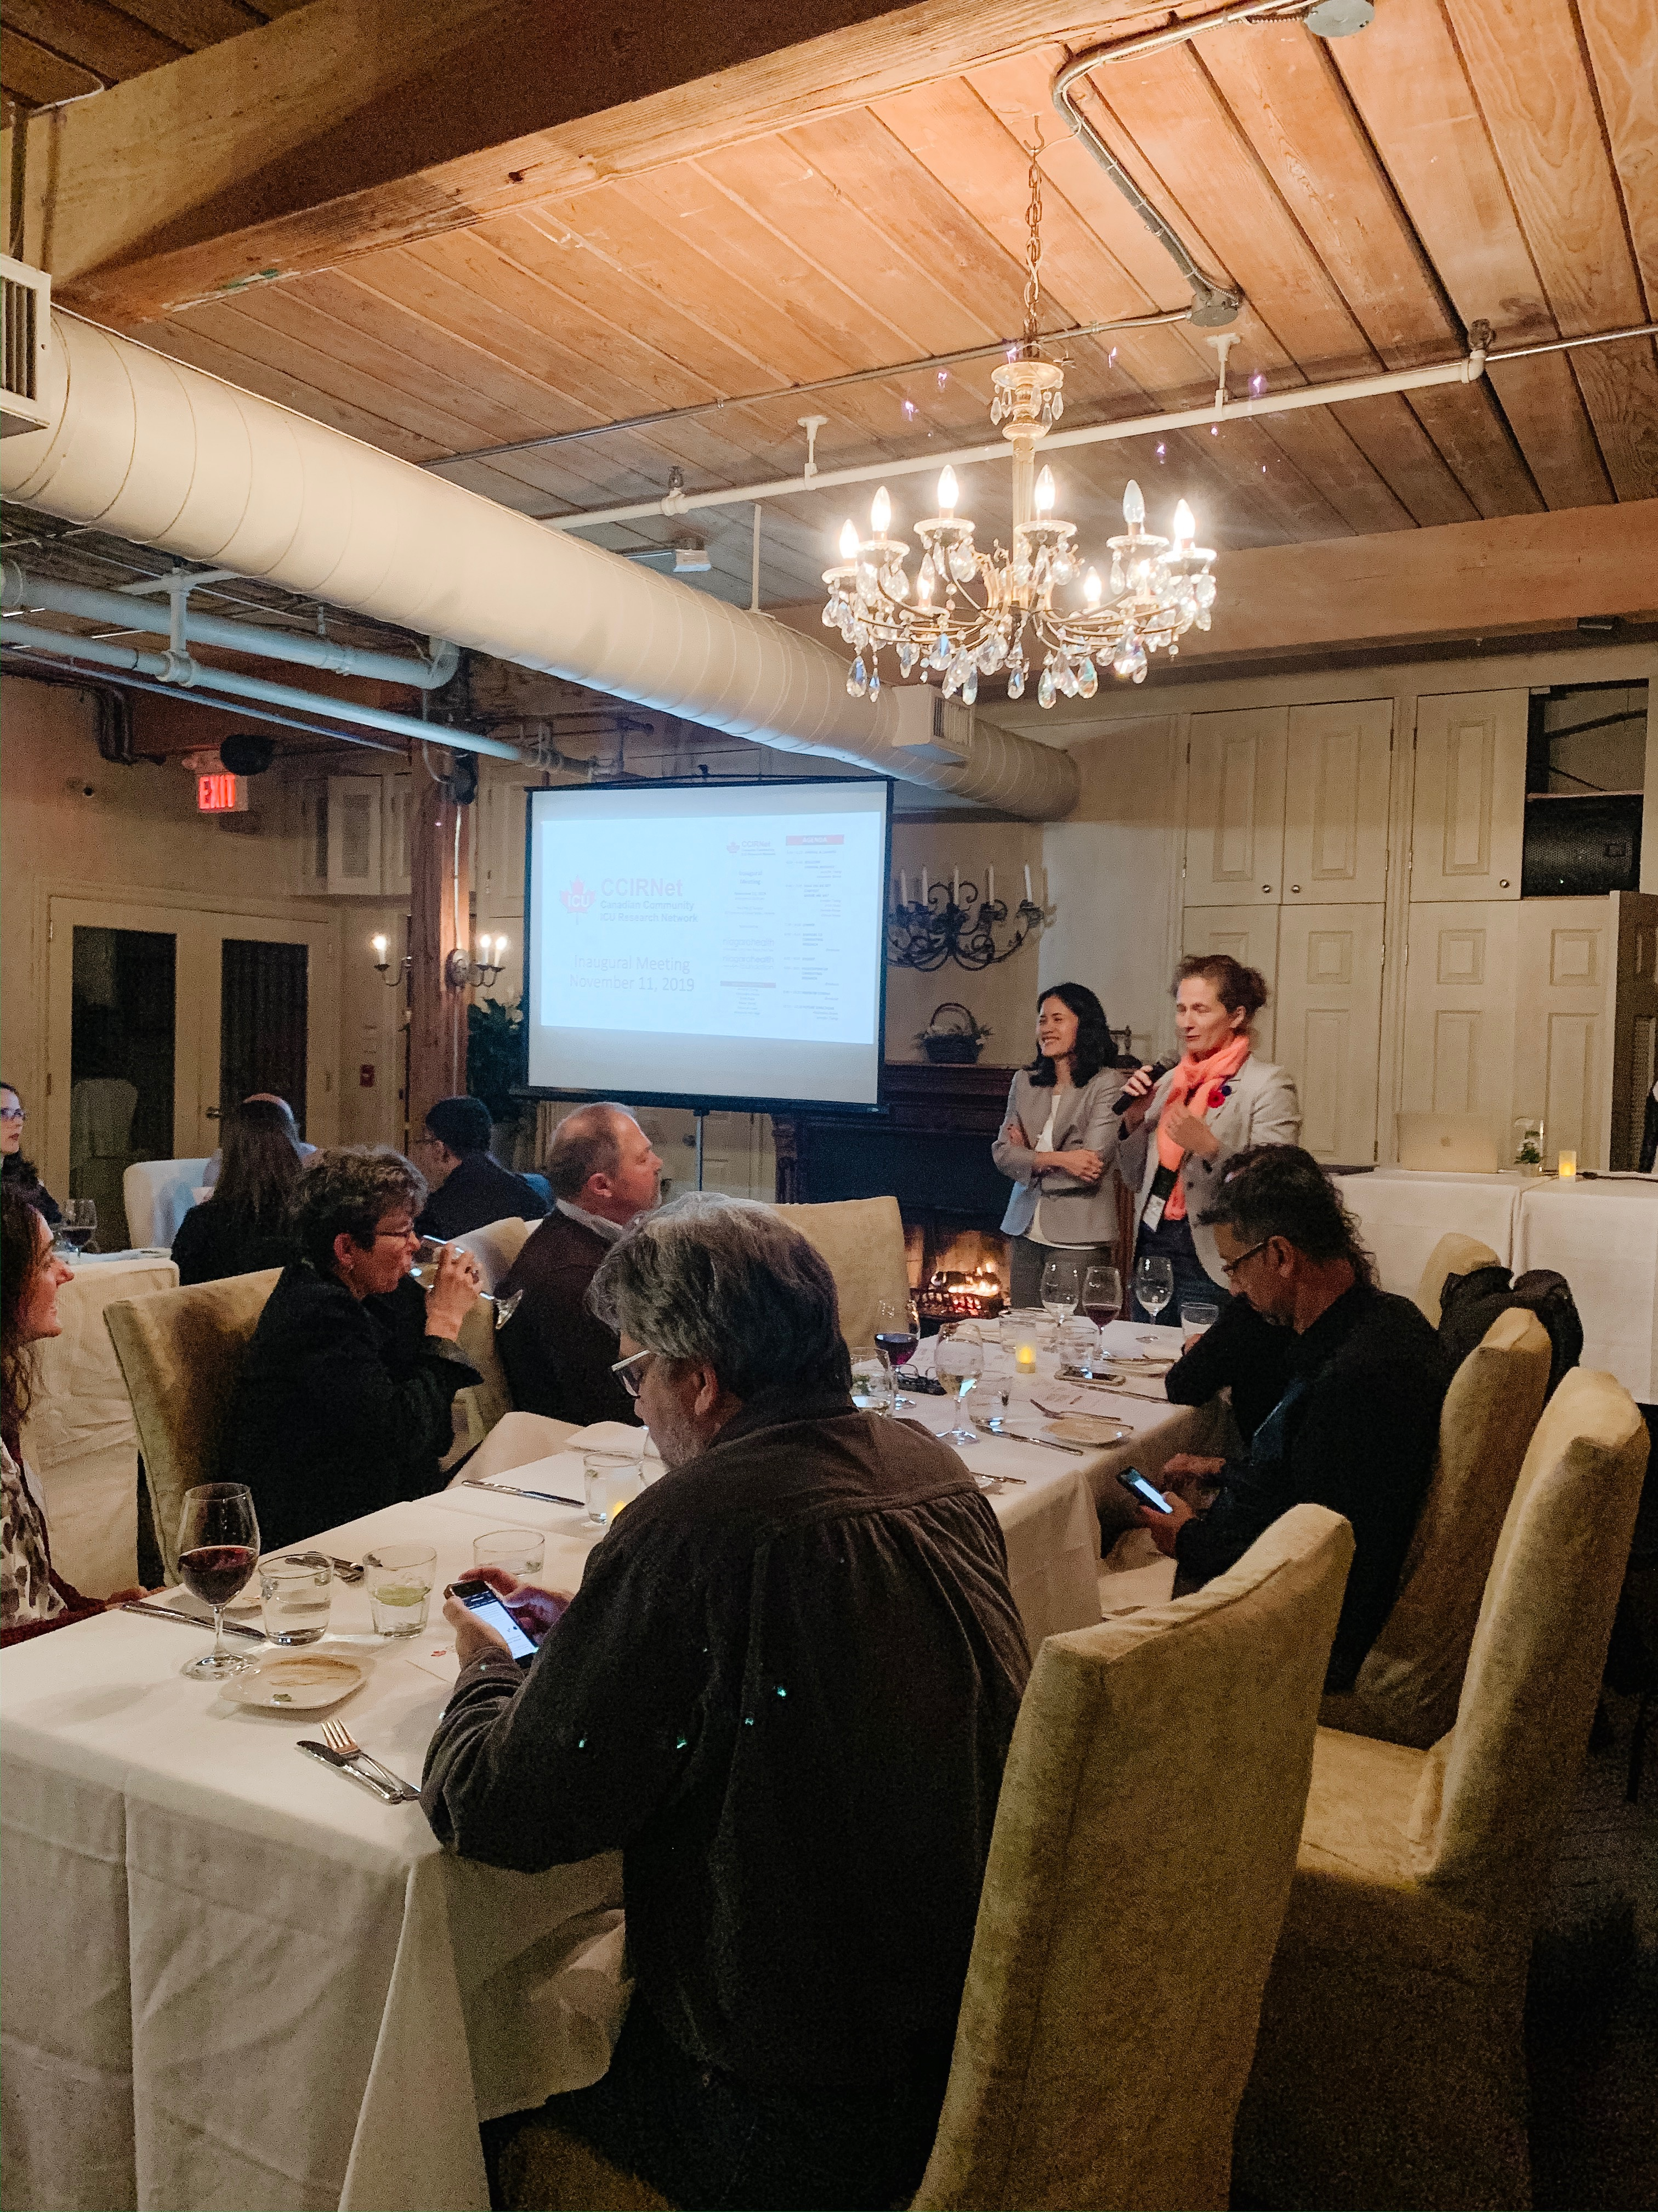
Community of Practice
36 Community Hospitals
Meeting in 2022
Inaugural Meeting 2019
@CCIRNet

Slide 21
Community of Practice
Community Acute and
Critical Care
COVID-19 Network of Clinical Trials Networks (NoN)

Slide 22
Support
17 Community Hospitals
COVID-19 Network of Clinical Trials Networks

Slide 23
Support

Slide 24
Support
20 Community Hospitals

Slide 25
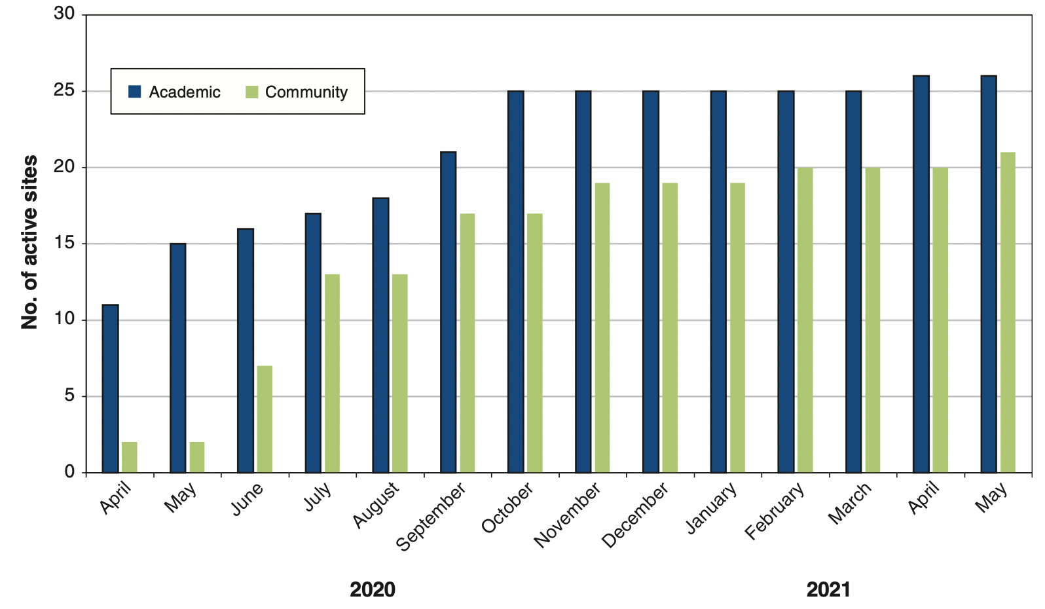
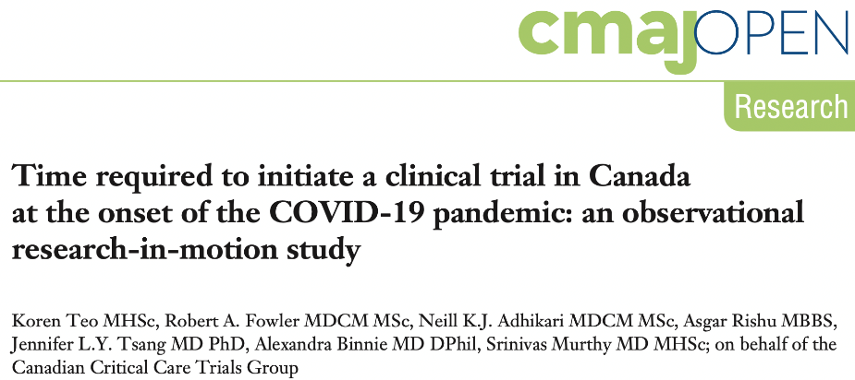
Status
Community hospital involvement in CATCO

Slide 26
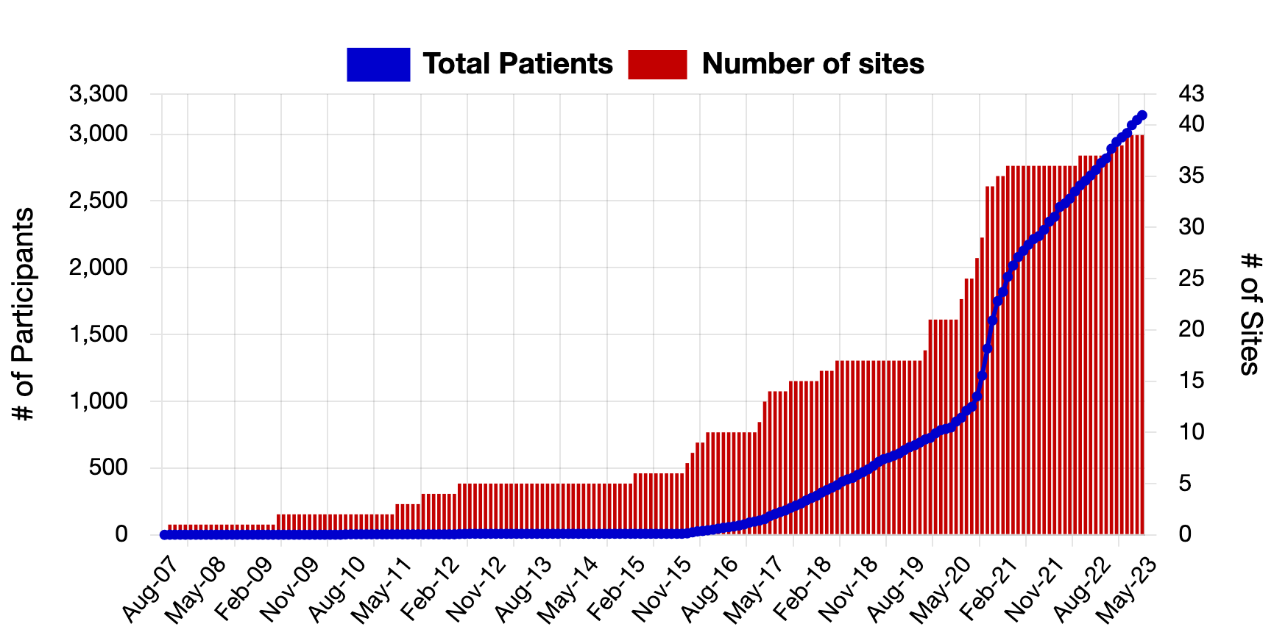
Status
Community hospital involvement in clinical trials

Slide 27
Future Work
Qualitative research study (individual semi-structured interviews) to:
explore patient perspectives about access to and conduct of research in community hospitals
identity system level policies that may increase research capacity in community hospitals
Research in Community Hospitals Continuing Medical Education (RICH-CME) curriculum for community hospitals

Slide 28
Thank you!

