Slide 1
Lessons Learned in
Creating, Implementing, & Running a Single National REB Process for
National Clinical Trial Network Programs
Funded by the US National Cancer Institute

Slide 2
Current NCI Extramural Clinical Trials Networks with full integrated system for trial design, review, conduct, & reporting
Division of Cancer Treatment & Diagnosis (DCTD) Cancer Therapy Evaluation Program (CTEP) Cancer Treatment Networks
Division of Cancer Prevention (DCP) Cancer Control, Screening, & Prevention Networks
Pediatric Early Phase
Clinical Trials Network
(PEP-CTN)
Pediatric
Brain Tumor
Consortia (PBTC)
Cancer Prevention
Clinical Trials Network
(CP-CTNet)
Phase1 and
Phase 2
Experimental
Therapeutics Clinical
Trials Network (ETCTN)
National
Clinical Trials
Network (NCTN)
National
Community
Oncology Research
Program (NCORP)
New! NCI Cancer
Screening
Research Network
(CSRN)
Phase 3

Slide 3
Development of the
NCI Central Institutional
Research Board (CIRB) for CTEP/DCP Clinical Trial Networks
N ≥ 750 Studies in 2021
Background
Unique Aspects of Human Research Protection Plan (HRPP)
Key Features of the NCI CIRB
Overview Current NCI Extramural Human Research Protection Plan (HRPP) – Sept. 2021
> 22,500 Investigators in 2021
> 3,400 CIRB-Enrolled Institutions in 2021

Slide 4
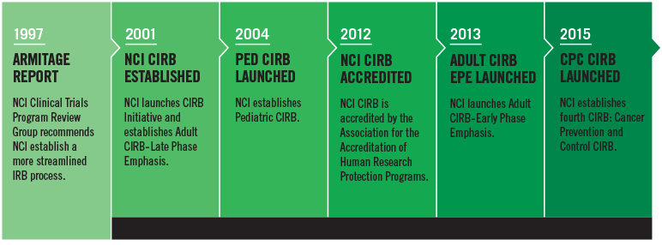
Background on Development of NCI CIRB
AAHRPP Accreditation
Facilitated Review Shared Review with Local Site
for Selected Trials
Pilot of an
Independent
CIRB
Full Transition to an Independent CIRB for
All Trials
NIH Requires Single CIRB for
Multi-Site Research in 2018

Slide 5
Unique Aspects of the NCI Human Research Protection Plan (HRPP)
HRPP is different from other institutions that have been accredited
    Primary focus of a single institution care of patients & research is secondary
    For NCI, clinical research is the primary focus
CIRB model for local context review is different from commercial IRB model
    Not a commercial enterprise but a government entity serving the public
    NCI provides rigorous & comprehensive scientific review prior to CIRB review
    Incorporates aspects of the HRPP to reduce redundancy in review
    Decreases burden on sites participating in the trials & provided at no cost
    Allows timely opening of studies & amendment processing with full help desk
Laura Covington, MS, CIP, NCI CIRB Operations Office

Slide 6
Independent NCI CIRB:
Signatory Institution Steps from Enrollment to Start of Research
Signatory
Institution
Enrolls in the
CIRB
Initiative
Institution
and
Investigator
Submit
Annual
Worksheets
Signatory
Institution
Principal
Investigator
Submits
Study-Specific
Worksheets
CIRB
Approval of
Study-Specific
Worksheets
Research begins at Institution
Laura Covington, MS, CIP, NCI CIRB Operations Office

Slide 7
Key Features of the CIRB: Local Context Review
CIRB is informed of local context considerations via the following:
  Annual Signatory Institution Worksheet
      Contains descriptions of state & local laws, including required boilerplate language
  Annual Principal Investigator Worksheet
      Provides research activity descriptions specific to the PI
Principal investigators open a new study by submitting a Study-Specific Worksheet directly to the CIRB
Laura Covington, MS, CIP, NCI CIRB Operations Office

Slide 8
Key Features of the CIRB Model
CIRB Review of the Consent Form
  CIRB reviews and approves the model consent form as supplied by the Study Chair for initial review and amendment reviews
  Local Context Subcommittee member reviews and approves institution-specific boilerplate language for the consent form
  Principal investigators are responsible for the insertion of CIRB-approved boilerplate language into the CIRB-approved model consent form
Laura Covington, MS, CIP, NCI CIRB Operations Office

Slide 9
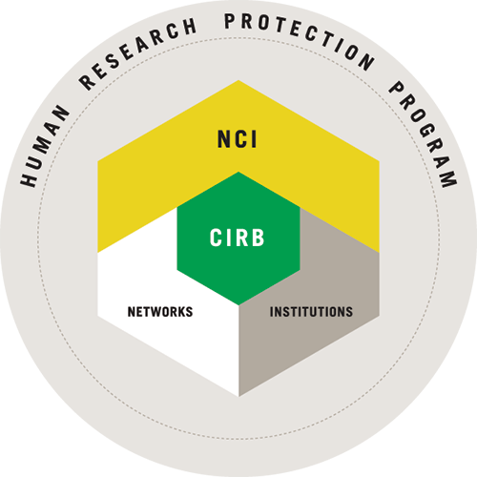
Overview of Current NCI Extramural Human Research Protection Plan (HRPP)
From Presentation:
NCI CIRB Education Days - September 20, 2021
Linda Parreco
7 NCI Research Networks
22,640 Investigators
22,500 Research coordinators/staff
3,477 CIRB-Enrolled Institutions

Slide 10
Remote site visit 10/27/2020
Clear and frequent communication with relying sites
Extensive quality control process
Area of concern: periodic evaluation of board member performance and feedback. Improvements implemented
Approved through 2025!

Slide 11
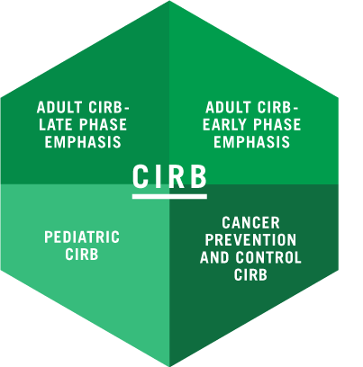
NCI CIRB has
4 Distinct Boards
To Address the
Research Need of the
Extramural Clinical Trials Network Programs Funded by the NCI

Slide 12
CIRB Members
MDs 31
Patient Reps 15
Nurses 6
Pharmacists 5
Ethicists 4
PhD/Scientists 3

Slide 13
750 Studies under CIRB oversight
4 CIRB Boards
CPC: Cancer Prevention & Control CIRB
EPE: Adult CIRB - Early Phase Tx Emphasis
LPE: Adult CIRB - Late Phase Tx Emphasis
Peds: Pediatric CIRB

Slide 14
Full Board Reviews
(8/2020-8/2021)
4 CIRB Boards
CPC: Cancer Prevention & Control CIRB
EPE: Adult CIRB - Early Phase Tx Emphasis
LPE: Adult CIRB - Late Phase Tx Emphasis
Peds: Pediatric CIRB

Slide 15
Expedited Reviews
8/2020-8/2021
4 CIRB Boards
CPC: Cancer Prevention & Control CIRB
EPE: Adult CIRB - Early Phase Tx Emphasis
LPE: Adult CIRB - Late Phase Tx Emphasis
Peds: Pediatric CIRB

Slide 16
Local Context Subcommittee
6,387 Reviews for all 4 Boards
..and speaking of reviews
9/1/2020-8/31/2021

Slide 17
Thank you!
More information on the NCI CIRB is available on its public website at https://www.ncicirb.org/

