Slide 1
Good Clinical Trials Collaborative
Twitter: @GoodTrials
LinkedIn: The Good Clinical Trials Collaborative
E-mail: contact@goodtrials.org
Website & mailing list: www.goodtrials.org
www.goodtrials.org
contact@goodtrials.org

Slide 2
Document structure (79 pages)
Introduction (1 page)
Principles of ICH GCP (5 pages)
Annex 1 (61 pages)
IRB/IEC (4 pages)
Investigator (11 pages)
Sponsor (21 pages)
Data Governance – Investigator & Sponsor (6 pages)
Glossary (9 pages)
Appendix A: Clinical Trial Protocol & Protocol Amendment(s) (4 pages)
Appendix B: Essential Records for the Conduct of a Clinical Trial (6 pages)

Slide 3
Principles first: A significant improvement (but requires some modifications)

Slide 4
The Good News
Revision 3 is a substantial advance on previous versions
The new structure of Introduction -> Principles -> Annexes supports critical application and can help shape more flexible and proportionate implementation
However, further modifications are needed to ensure that the Annexes are seen as implementation guides (not rules) and that alternative approaches to delivering the Principles are acceptable (e.g. to meet the specific context)

Slide 5
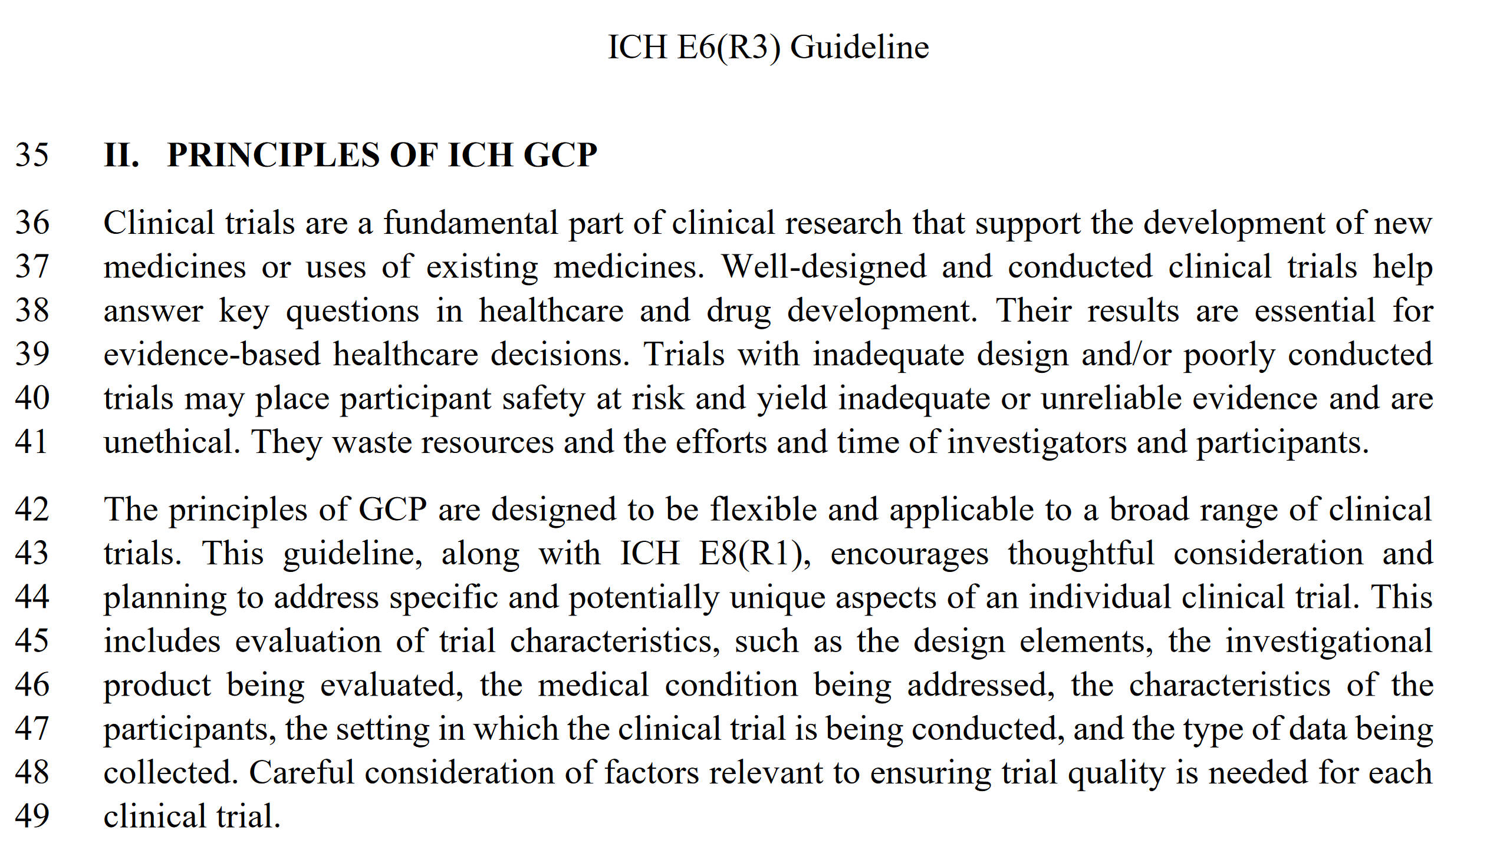

Slide 6
Introduction to the Principles is very strong:
Opening paragraph:
Clinical trials are a fundamental part of clinical research that support the development of new medicines or uses of existing medicines.
Well-designed and conducted clinical trials help answer key questions in healthcare and drug development. Their results are essential for evidence-based healthcare decisions.
Trials with inadequate design and/or poorly conducted trials may place participant safety at risk and yield inadequate or unreliable evidence and are unethical. They waste resources and the efforts and time of investigators and participants.

Slide 7
Introduction to the Principles is very strong:
Example statements:
The principles of GCP are designed to be flexible and applicable to a broad range of clinical trials.
The principles are intended to support efficient approaches to trial design and conduct.
The use of innovative clinical trial designs and technologies may help include diverse patient populations, as appropriate, and enable wider participation.
The design of the trial, to ensure appropriate quality and meaningful trial outcomes, may be supported by the perspectives of stakeholders; for example, patients and/or healthcare providers.
Clinical trials should be designed to protect the rights, safety and well-being of participants and assure the reliability of results.
The overarching principles provide a flexible framework for clinical trial conduct.

Slide 8
The 11 Principles are generally sound although there is room for some improvement
For example:
There is no mention of involvement of patients, public, or the community in trial design and conduct
There is no requirement to make the results of trials publicly available
The ordering is difficult to follow and there is some repetition
There are lots of sub-principles, many of which could be omitted without loss of impact or would be better put in the Annex as implementation guides
There are also some that are not appropriate or workable

Slide 9
The Concern
Users (sponsors, investigators, funders, trial staff, clinical operations, trainers, monitors, QA, auditors, inspectors, etc.) will go straight to Annex-1 as the “enforceable” part rather than be guided by the principles
Some details in Annex-1 are unduly specific
Rigid interpretation will prevent appropriate flexibility & innovation, impair feasibility, and reduce quality of participant experience and information generated for future patients

Slide 10
The Principal/Principle Remedy
A few simple changes in structure could mitigate this and help the renovation achieve its full potential
Will help E6 R3 stand the test of time and remain applicable even in a fast-changing trial environment

Slide 11
Modifications proposed
Group principles into overarching themes to
increase logical flow
help understanding and internalization

Slide 12
Regrouping the Principles
Clinical Trials are Ethical
Principle 1 – Rights and Well-being
Principle 2 – Informed, Voluntary Consent
Principle 3 – IRB/IEC
Clinical Trials are Informative and Relevant
Principle 4 – Scientifically Sound
Principle 9 – Generate Reliable Results
Clinical Trials are Appropriate for their Context
Principle 7 – Risk Proportionate
Clinical Trials are well designed and conducted, by qualified people
Principle 6 – Quality
Principle 8 – Protocol
Principle 5 – Qualifications
Principle 10 – Roles and Responsibilities
Clinical Trials meet Good Manufacturing Practice (GMP) standards
Principle 11 - GMP

Slide 13
Modifications proposed
Group principles into overarching themes to
increase logical flow
help understanding and internalization
Restructure each principle as
a primary statement
supported by a rationale
and listing key requirements

Slide 14
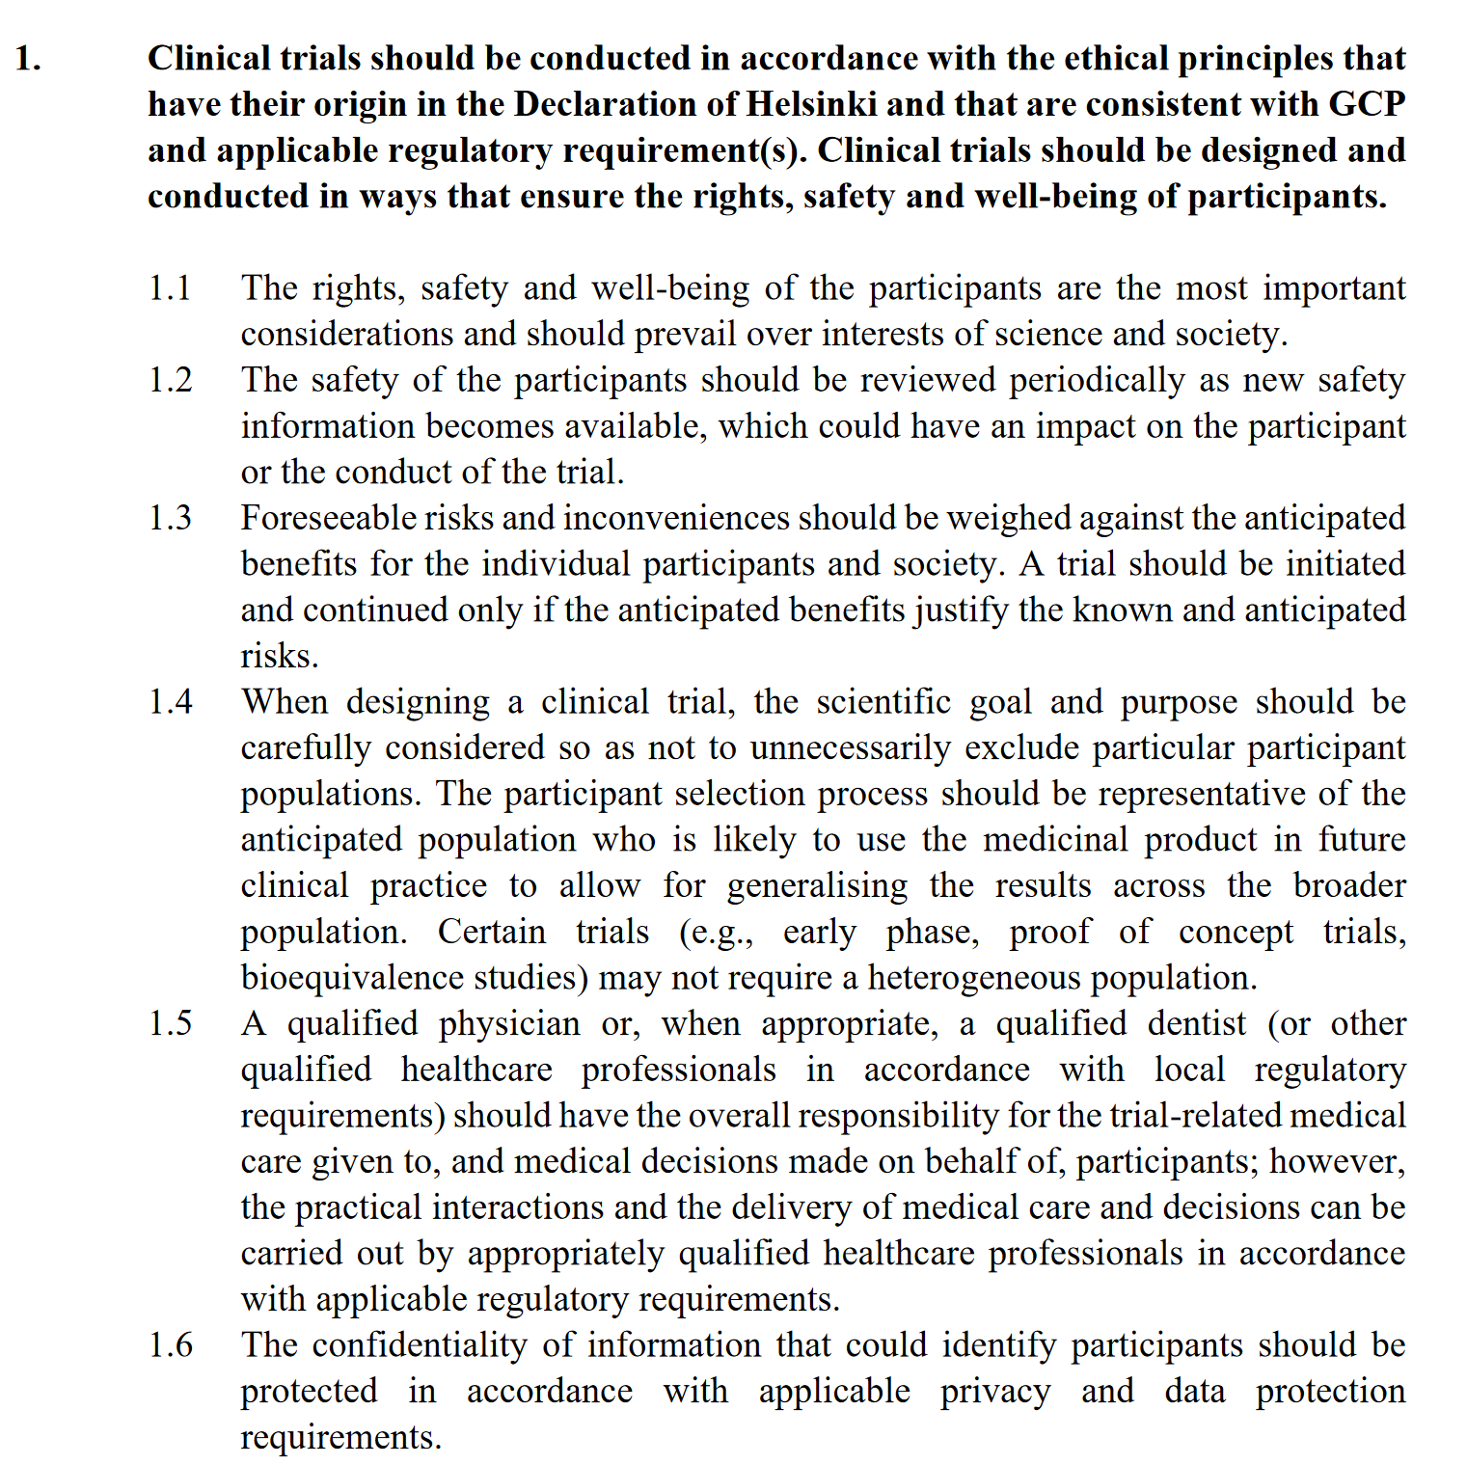

Slide 15
Example of restructuring: Principle 1
Statement
Clinical trials should be designed and conducted in ways that ensure the rights, safety and well-being of participants.
Rationale
The rights, safety and well-being of the participants are the most important considerations and should prevail over interests of science and society.
Requirements
Clinical trials should be conducted in accordance with the ethical principles that have their origin in the Declaration of Helsinki and that are consistent with GCP and applicable regulatory requirement(s).
The safety of the participants should be reviewed periodically as new safety information becomes available, which could have an impact on the participant or the conduct of the trial.
Foreseeable risks and inconveniences should be weighed against the anticipated benefits for the individual participants and society. A trial should be initiated and continued only if the anticipated benefits justify the known and anticipated risks.
Etc.

Slide 16
Modifications proposed
Group principles into overarching themes to
increase logical flow
help understanding and internalization
Restructure each principle as
a primary statement
supported by a rationale
and listing key requirements
Explicitly cross-reference Principles in Annex-1 to make sure users can easily link the implementation examples with the underlying principles

Slide 17
Excessive new details on data, records & computer systems (Lacks proportionality, encourages over-interpretation, likely to stifle innovation & quality, and unlikely to stand test of time)

Slide 18
Other errors, omissions and missed opportunities (that are likely to encourage over-interpretation, stifle innovation, reduce trial quality, and rapidly become obsolete by advances in healthcare and technology)

Slide 19
Examples of other issues
Many of which could be rectified by emphasising the primacy of the principles and/or providing context or explanation as to their impact, e.g.
Repeated referral to compliance with GCP as opposed to with the Principles of GCP
Premature unblinding or site termination: nothing about the harm (to individuals, other participants, or future patients)
IRB excesses: no obligation for the IRB to ensure that anything they insist on adding to the consent form or participant-facing material is “mindful of the principle that the information should be concise and understandable [Principle 2.2]
There is nothing in Sponsor responsibilities about publishing the results or putting them in a public registry

Slide 20
Next steps
GCTC has published detailed comments at www.goodtrials.org
We encourage others to submit responses to the public consultation, whether based on our comments or your own.
Please register to be receive updates from GCTC:
goodtrials.org/newsletter
www.goodtrials.org
contact@goodtrials.org

