Slide 1
Harmonizing Good Clinical Practice Guidelines ICH E6(R3) – GCP
M. Khair ElZarrad
Director, Office of Medical Policy
Center for Drug Evaluation and Research
US Food and Drug Administration
Sep 2023
Notes:
Problems and in the intro

Slide 2
Summary
Modernizing the clinical trial enterprise
The importance of global harmonization
Process of developing ICH E6(R3)
What is new?
What is next?

Slide 3
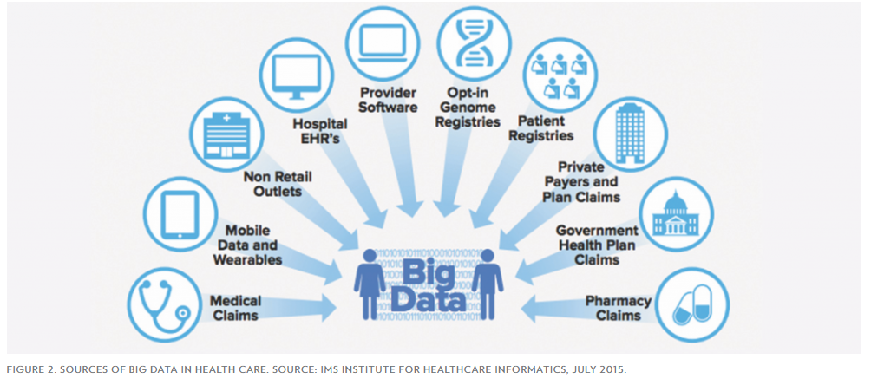
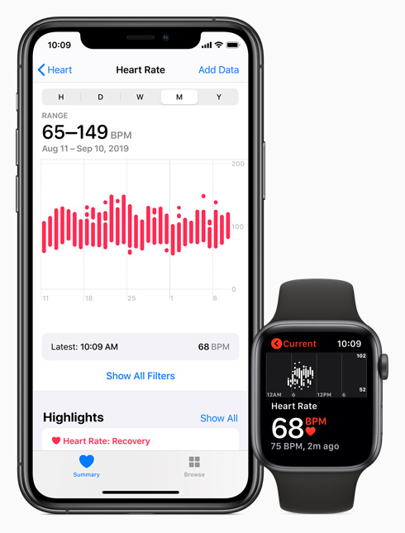
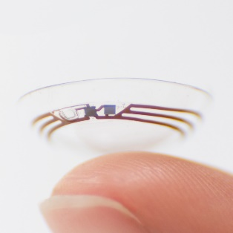
Facilitating Rapidly Evolving Ecosystem
Advancing Evidence Generation Paradigm*
Increasingly Digital World & Data Availability*
Innovative Clinical Trial Designs*
*Samples
* Examples – not fully inclusive

Slide 4
ICH Members and Observers
Members
Standing Regulatory Members
Health Canada, Canada
Swissmedic, Switzerland
Regulatory Members
ANVISA, Brazil
COFEPRIS, Mexico
EDA, Egypt
Regulatory Members
HSA, Singapore
MFDS, Republic of Korea
MHRA, UK
NMPA, China
SFDA, Saudi Arabia
TFDA, Chinese Taipei
TITCK, Turkey
Industry Members
BIO
Global Self-Care
Federation
IGBA
Founding Regulatory Members
EC, Europe
FDA, US
MHLW/PMDA, Japan
Founding Industry Members
EFPIA
PhRMA
JPMA
Observers
Standing Observers
IFPMA
WHO
Legislative or Administrative
Authorities
AEC, Azerbaijan
ANMAT, Argentina
ANPP, Algeria
CDSCO, India
CECMED, Cuba
CPED, Israel
DPM, Tunisia
Indonesian FDA, Indonesia
Legislative or Administrative
Authorities
INVIMA, Colombia
JFDA, Jordan
MMDA, Moldova
MOPH, Lebanon
NAFDAC, Nigeria
National Center, Kazakhstan
NPRA, Malaysia
NRA, Iran
Roszdravnadzor, Russia
SAHPRA, South Africa
SCDMTE, Armenia
SECMOH, Ukraine
TGA, Australia
Regional Harmonization
Initiatives
APEC
ASEAN
EAC
GHC
PANDRH
SADC
Int’l Pharmaceutical
Industry Organizations
APIC
Int’l Orgs regulated by or
affected by ICH guidelines
Bill & Melinda Gates
Foundation
CIOMS
EDQM
IPEC
PIC/S
USP
Notes:
The International Council for Harmonisation of Technical Requirements of Pharmaceuticals for Human Use (ICH) is a unique harmonization organisation involving regulators & the pharmaceutical industry.
Launched in 1990 by the US, EU, and Japan.
Well-defined objectives:
To improve efficiency of new drug development and registration processes
To promote public health, prevent duplication of clinical trials in humans and minimize the use of animal testing without compromising safety and effectiveness
As mentioned, a driving factor of its organisational changes was to make ICH a truly global initiative and enable an expanded forum for dialogue on scientific issues
ICH has grown to include 17 regulatory and industry association Members spanning four continents
And 32 observers including:
Regulatory authorities,
Regional Harmonisation Initiatives
International industry pharmaceutical organisations; and
others affected by ICH guidelines
Last year, Turkey became ICH’s newest regulatory Member and Lebanon its newest regulatory Observer.

Slide 5
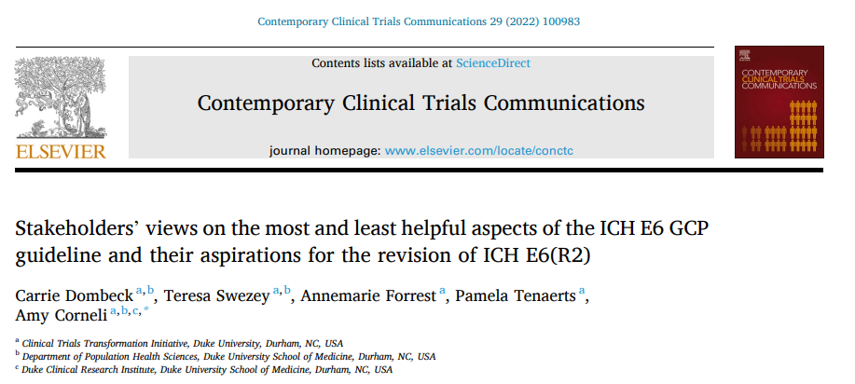
Background to E6(R3) Renovation
Gap analyses & Engagements
Stakeholder Comment Analysis
Literature review
Open letter to EMA & ICH
Published articles
Relevant guidelines
Clinical Trial Transformation Initiative’s (CTTI) survey and interviews
E6 is widely applied to non-regulatory clinical trials, despite being intended for trials supporting regulatory submission (applicability to observational studies)
Concerns that funders’ “reflexive requirement” stifles non-regulatory research, especially in under-resourced areas (not supporting risk-based approach, “one-size-fits-all” approach, written as an inspection check list…)
Concerns about ability to meet all GCP requirements in different situations (e.g., during public health emergencies)
https://www.ncbi.nlm.nih.gov/pmc/articles/PMC9468347/pdf/main.pdf

Slide 6
What is unique about E6(R3) development process
Engagement with academic stakeholders
New approaches to enhance transparency (published draft principles in April 2021 and conducted two workshops)
Extensive training program will be developed with use-cases focused on trial designs that may encounter difficulties in the application of GCP guidelines

Slide 7
What is unique about E6(R3) structure and content?
New structure to provide clarity and better readability
Principles to remain relevant as technology, methods, and trial design evolve
Annexes and appendices (better flow and a strategy intended to enable easier and faster updates in the future)
Focused scope
Language to facilitate innovations in trial design & technology
Enabling DCTs and PoCs among other design elements
Expect the use of DHTs, healthcare infrastructure, and other design elements & tools to recruit/retain, capture data, monitor, and to analyze results

Slide 8
Revised Structure
E6 (R3) Draft Guideline
E6 (R3) draft guideline subject to public consultation consists of parts I, II, III ( composed of 4 sections), glossary, and appendices.
INTRODUCTION
PRINCIPLES OF ICH GCP
ANNEX 1
Institutional Review Board/Independent Ethics Committee (IRB/IEC)
Investigator
Sponsor
Data Governance – Investigator and Sponsor
GLOSSARY
APPENDICES
Appendix A. Investigator’s Brochure
Appendix B. Clinical Trial Protocol and Protocol Amendment(s)
Appendix C. Essential Records for the Conduct of a Clinical Trial
Open for public consultation now

Slide 9
What is unique about E6(R3) structure and content?
Overall themes
Set a foundation for practical/feasible expectations around the responsibilities from sponsor and investigator in a digital ecosystems
Proportionality and risk-based approaches with a focus on quality while keeping the emphases and focus on participants’ safety and reliability of trial results
Thoughtfulness in the design and conduct
Encourage a fit-for-purpose approaches
Incorporate learning from innovative trial designs and lessons from public health emergencies/pandemics
Encourage a focus (of efforts and resources) on what matters most (areas of relevance to participants safety and results reliability)
Encourage trial registration and result reporting
Encourage better informed consent process

Slide 10
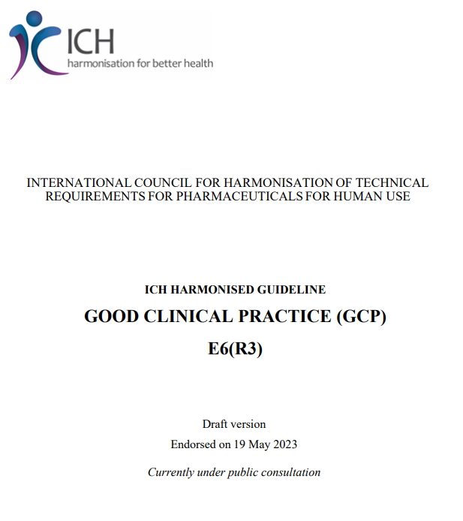
Facilitating the Conduct of Clinical Trials with Innovative Design Features (DCTs & the Use of DHTs
Adequate measures to ensure that the investigational product is handled and shipped appropriately should be implemented.
Measures should be in place to ensure that the investigational product provided to trial participants retains its quality.
Data Acquisition Tool (DAT) & media neutrality
E-Consent
https://database.ich.org/sites/default/files/ICH_E6%28R3%29_DraftGuideline_2023_0519.pdf

Slide 11
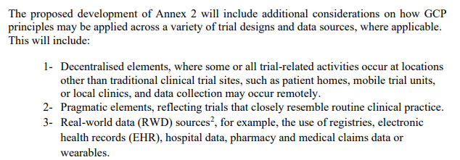
Work Started on E6(R3) Annex-2
What is next?

Slide 12
It will take a village – the case for thoughtful global collaboration
E6(R3) provides a foundation for responsive and proportionate GCP expectations. However, guidelines alone are not adequate in addressing all scenarios and evolving innovations. We will need to:
Collaborate on implementation and capacity building, which are critical with increasingly global clinical trials
Develop responsive and accessible training with the global community in mind
Avoid an all-or-nothing approach to innovative designs and technologies – thoughtfulness is needed (hybrid designs utilizing fit-for-purpose tools and technologies may be most efficient)
Many remaining challenges require the global community’s collaboration to address:
How to bridge healthcare and research from data adequacy, flow, and interoperability perspectives?
How to utilize the global healthcare infrastructure and regional resources effectively?

Slide 13
ICH E6(R3) Expert Working Group
https://ich.org/page/efficacy-guidelines

