Slide 1


RAFF4 Trial: Vernakalant vs. Procainamide for Acute Atrial Fibrillation in the ED
September 21, 2023

Slide 2

Study Objectives
Our goal is to compare IV vernakalant to IV procainamide for the ED management of acute AF patients
Our hypothesis is that IV Vernakalant will perform better with higher conversion rates, faster conversion, and fewer adverse events
Our primary objective is to compare conversion to normal sinus rhythm between the two drugs

Slide 3


RAFF4 Co-Investigators
Methodologist: Monica Taljaard
Emergency Physicians:
Ian Stiell, Jeff Perry, Debra Eagles, Marco Sivilotti, Alain Vadeboncoeur, Judy Morris, David Pare, Corinne Hohl, Patrick Archambault, Marcel Emond, Eric Mercier, Samuel Campbell, Mary-Lynne Watson, Andrew McRae, Kerstin deWit, Alexis Cournoyer
Cardiologists: Laurent Macle, Ratika Parkash, David Birnie

Slide 4
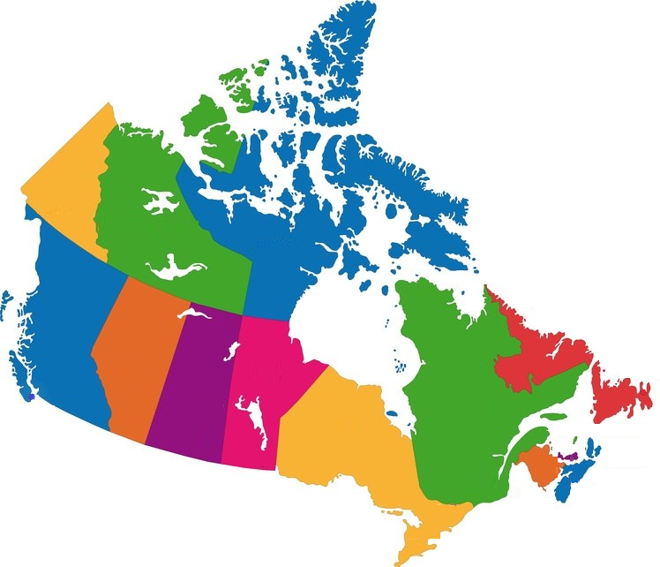







Participating Sites
Ottawa: The Ottawa Hospital Civic and General
Calgary: Foothills MC
Kingston: Kingston HSC
Vancouver: Vancouver GH
Montreal: Montreal Heart Institute, Sacré-Coeur
Halifax: Queen Elizabeth II
Quebec City: Hôtel-Dieu de Lévis, Enfant Jesus, Quebec Heart and Lung Institute

Slide 5



Funding
CIHR Foundation Awards held by Ian Stiell and Jeff Perry
CIHR Project Grant (2023 Ian Stiell)
ACT Consortium (2023 Ian Stiell)
Cipher Pharmaceuticals Inc. (Canada) provides Vernakalant for all sites through an unrestricted research grant

Slide 6
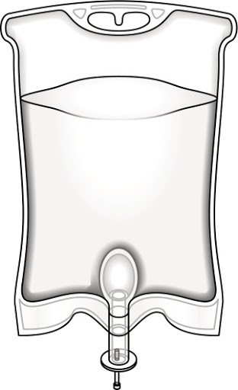
Methods:
Study Design
Open label, pragmatic, randomized controlled trial will compare IV Vernakalant and IV Procainamide
N = 340
Both drugs are available for use in Canada and we want to compare their performance mirroring actual clinical use
PROCAINAMIDE
VERNAKALANT

Slide 7
Enrolments and Screening by Site
Site | Start Date | Enrolled | Missed | Excluded | Off Hours | Refused - To MD | Refused - To RA | Total Screened
Civic | 14-Jun-21 | 71 | 4 | 2200 | 405 | 155 | 32 | 2867
General | 14-Jun-21 | 30 | 1 | 1486 | 309 | 83 | 20 | 1929
HSC | 4-Oct-21 | 9 | 0 | 937 | 428 | 9 | 7 | 1390
MHI | 12-Oct-21 | 20 | 7 | 532 | 322 | 33 | 13 | 927
QHLI | 18-Oct-21 | 30 | 43 | 484 | 647 | 3 | 3 | 1210
HEJ | 8-Nov-21 | 20 | 2 | 428 | 54 | 3 | 1 | 508
Kingston | 6-Dec-21 | 17 | 31 | 573 | 163 | 4 | 1 | 789
QEII | 13-Dec-21 | 18 | 112 | 187 | 209 | 10 | 9 | 545
Levis | 22-Feb-22 | 0 | 4 | 146 | 57 | 1 | 21 | 229
VGH | 3-Oct-22 | 19 | 0 | 207 | 61 | 19 | 21 | 327
Foothills | 25-Aug-23 | 0 | 0 | 0 | 0 | 0 | 0 | 0
Total |  | 234 | 204 | 7180 | 2659 | 320 | 128 | 10725

Slide 8
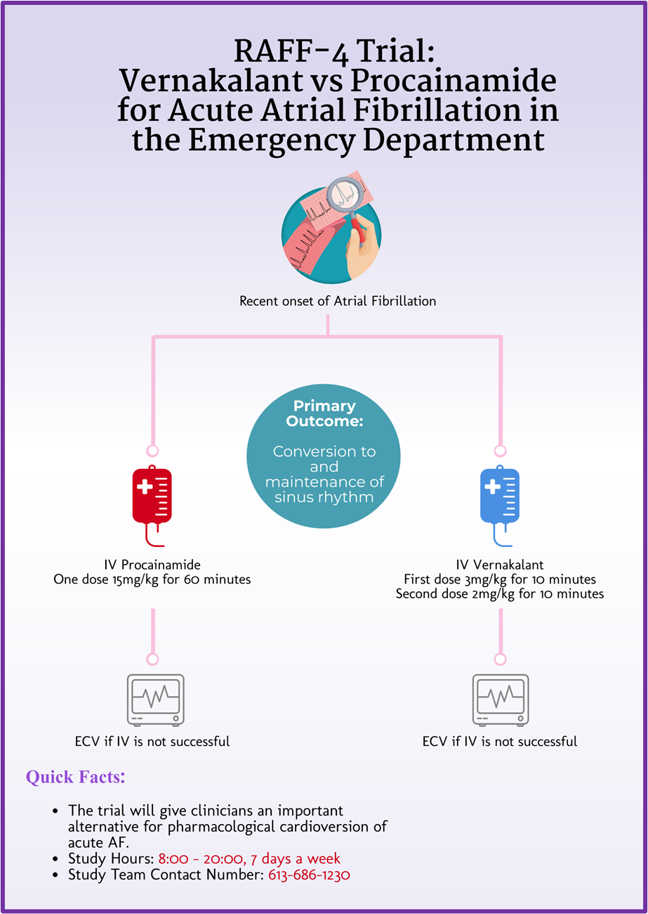
Enrolment Strategies
Launch a new promotion campaign in September 2023

Slide 9
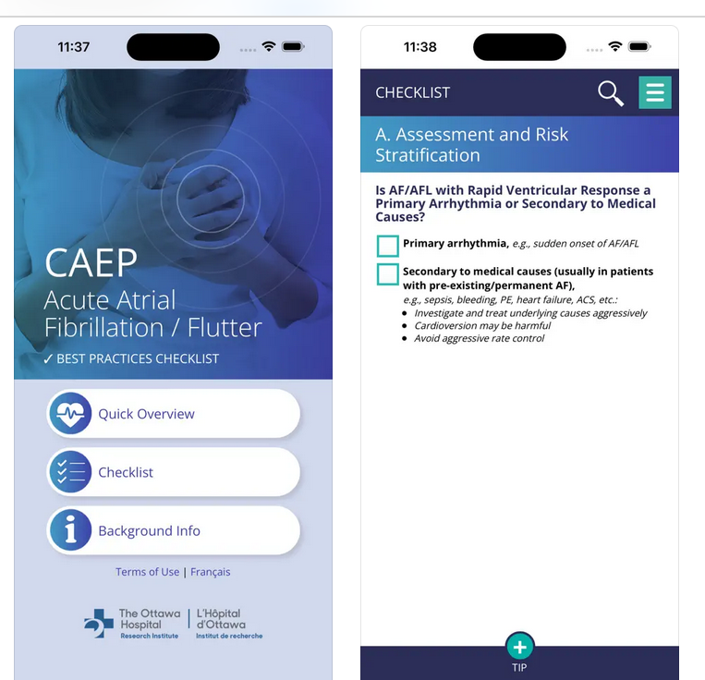
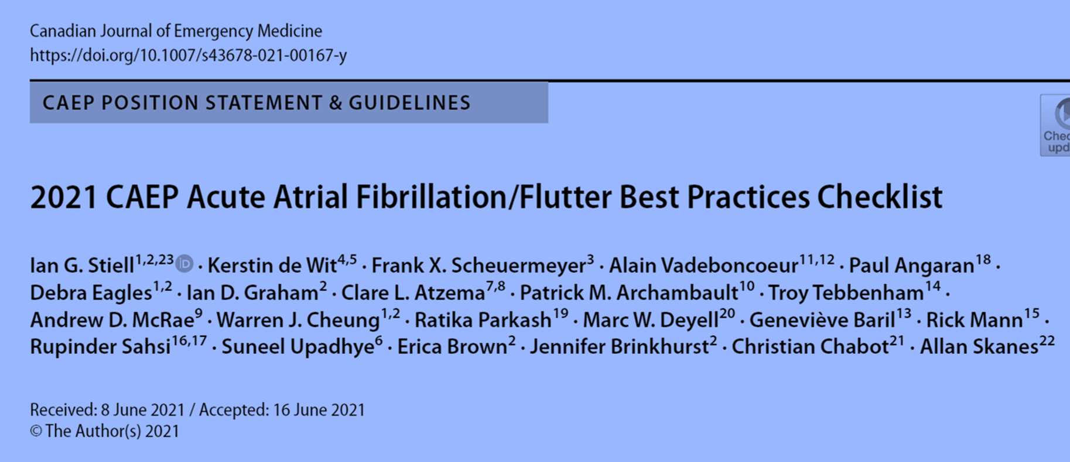
Enrolment Strategies
Encourage use of the free App: CAEP Atrial Fibrillation Guide

Slide 10

RAFF4 Trial: Vernakalant vs. Procainamide for Acute Atrial Fibrillation in the ED
September 11 & 14, 2023

