Slide 1

COP-AF
Colchicine for the prevention of peri-operative atrial fibrillation after major thoracic surgery
David Conen (PI)
PJ Devereaux (chairman)

Slide 2

Research Question
To evaluate in patients undergoing major noncardiac thoracic surgery the effect of oral colchicine on occurrence of the co-primary outcomes
  Clinically important perioperative AF
  MINS

Slide 3

Design
Patients aged ≥55 years undergoing major noncardiac thoracic surgery
Patients with previous AF were excluded
Colchicine 0.5mg or matching placebo administered within 4 hours before surgery
study medication was given twice daily for total of 10 days
Mandatory troponin measurements for 3 days
Total follow-up 14 days

Slide 4
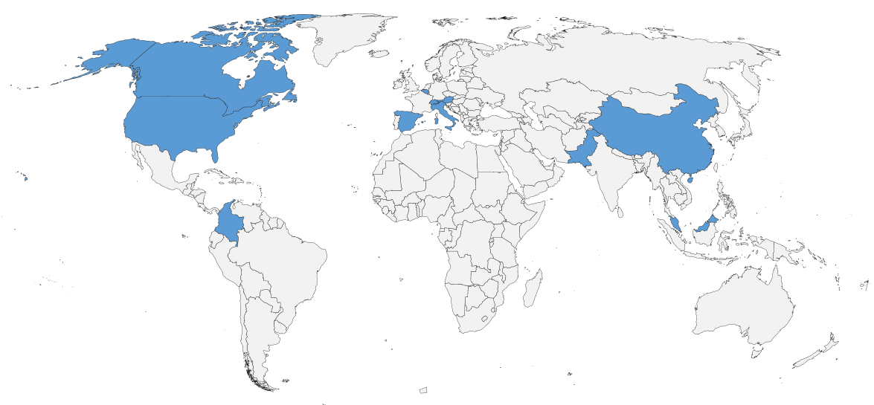
3209 patients randomized at 45 sites in 11 countries
24
1333
110
32
355
287
765
196
25
54
28
3208 (>99.9%) patients with complete 14-day follow-up

Slide 5
Co-primary outcomes
 | Colchicine (N=1608) | Placebo (N=1601) | Hazard Ratio (95% CI) | P Value
Clinically important perioperative AF | 103 (6.4) | 120 (7.5) | 0.85 (0.65-1.10) | 0.22
Myocardial injury after noncardiac surgery | 295 (18.3) | 325 (20.3) | 0.89 (0.76-1.05) | 0.16

Slide 6
Post-hoc analyses
 | Colchicine (N=1608) | Placebo (N=1601) | Hazard Ratio (95% CI) | P Value
Post-hoc outcomes – N (%) Composite of MINS and clinically important AF Composite of vascular mortality, nonfatal MINS, nonfatal stroke and clinically important AF | 360 (22.4) 364 (22.6) | 415 (25.9) 422 (26.4) | 0.84 (0.73-0.97) 0.83 (0.72-0.96) | 0.02 0.01

Slide 7
Conclusion
In patients undergoing major noncardiac thoracic surgery administration of colchicine did not significantly reduce incidence of co-primary outcomes clinically important AF or MINS
Colchicine increased risk of mostly benign non-infectious diarrhoea
Encouraging and consistent trend of fewer cardiovascular events with colchicine that requires further research

Slide 8
Publication
The full publication is available at https://www.thelancet.com
Grant approval to publication in 3 months and 8 days!

