Slide 1
Aldosterone bloCkade for Health Improvement EValuation in End-stage renal disease
Michael Walsh for the ACHIEVE Investigators

Slide 2
Research Question
Kidney failure has poor outcomes
3 year median survival
>40% death and hospitalizations CV
Heart failure & sudden death pathology
Aldosterone contributing cause
Associated with sudden death and heart failure
Elevated in kidney failure
Blockade prevents heart failure and death in non-dialysis
Small trials in kidney failure promising

Slide 3
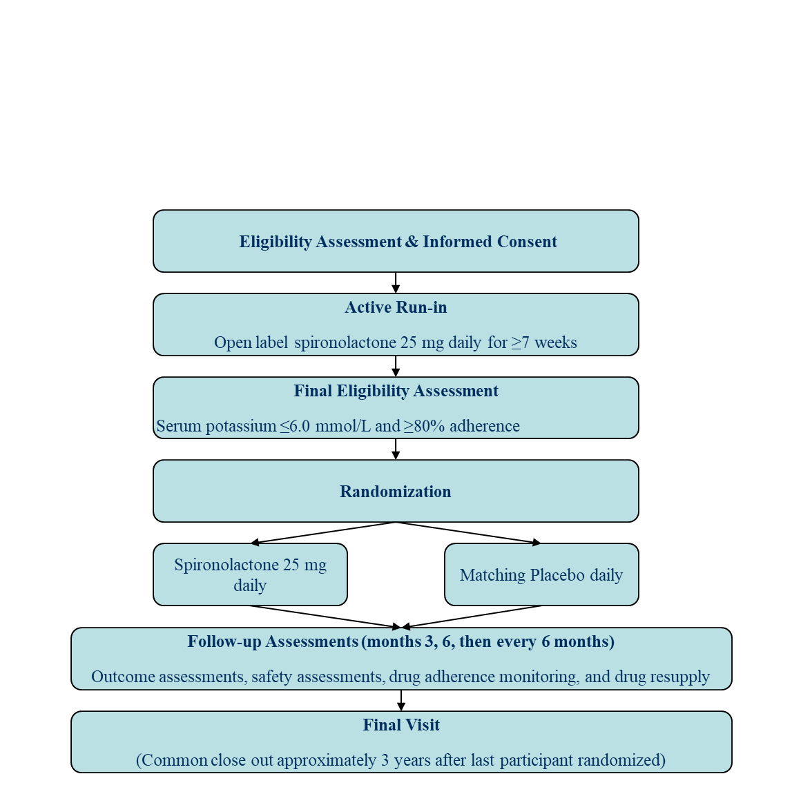
Design
~2500 patients
Follow-up ~ 1 to 7 years
650 primary outcome events (CV death and HF hospitalization)
90% power for HR 0.75

Slide 4
Timeline
Recruitment
Closing Dec 31, 2023
Treatment
Ending ~ Dec 2024
Analysis
Jan 2025

Slide 5
Recruitment by Country
Country | Run-in | Run-in Failures | Randomized | Goal
Canada | 787 | 243 (31%) | 517 | 550
Australia | 122 | 30 (25%) | 91 | 100
Uruguay | 63 | 8 (13%) | 54 | 50
Brazil | 574 | 173 (30%) | 387 | 450
India | 372 | 134 (36%) | 221 | 250
Philippines | 26 | 17 (65%) | 9 | 9
Malaysia | 330 | 41 (12%) | 288 | 300
New Zealand | 121 | 26 (22%) | 84 | 100
Ecuador | 91 | 8 (9%) | 83 | 100
UK | 249 | 70 (28%) | 136 | 250
China | 244 | 50 (16%) | 177 | 300
Turkey | 2 | 0 | 0 | 50
Total | 2980 | 801 (27%) | 2047 | 2500
New Canadian Centres Starting with ACT support!

