Slide 1
Guidance for Good Randomized Clinical Trials
Nick Medhurst
Twitter: @GoodTrials
LinkedIn: The Good Clinical Trials Collaborative
E-mail: contact@goodtrials.org
Website & mailing list: www.goodtrials.org
www.goodtrials.org
contact@goodtrials.org

Slide 2
Good Clinical Trials Collaborative
Focused on developing and promoting new guidance to enable better randomized controlled trials (RCTs) globally
Hosted by Protas (a non-profit organization)
Funded by Wellcome and the Bill & Melinda Gates Foundation
Broad-based, international, diverse stakeholder network
Steering Committee of senior & experienced stakeholders

Slide 3
Clinical trials in crisis
Many trials are doomed to fail through bad design
in registered trials for COVID-19, only 5% of 2900 trial arms (enrolling ~25% of trial participants) were randomized and adequately poweredª
Most trials fail to recruit
  ~85% trials fail to recruit to time and target
Operational cost and complexity is out of control
  CRO industry growing exponentially: $30bn in 2015 and rising 10% per year^{b}
Clinical trials are now excessively costly and burdensome
  $1bn for a typical commercial trial of a new vaccine or a new cardiovascular treatment
ª Bugin & Woodcock Nature Reviews Drug Discovery 2021; ^{b} Roberts et al Cancer 2016

Slide 4
Underpinning concepts
RCTs are essential for evaluating the benefits and harms of most health interventions
Ethical medical research advances the common good by improving the health and health care of individuals and populations.
Delivery of a high-quality trial rests on good design and adherence to the protocol.
Trials are interdependent with the communities and contexts they take place in.

Slide 5
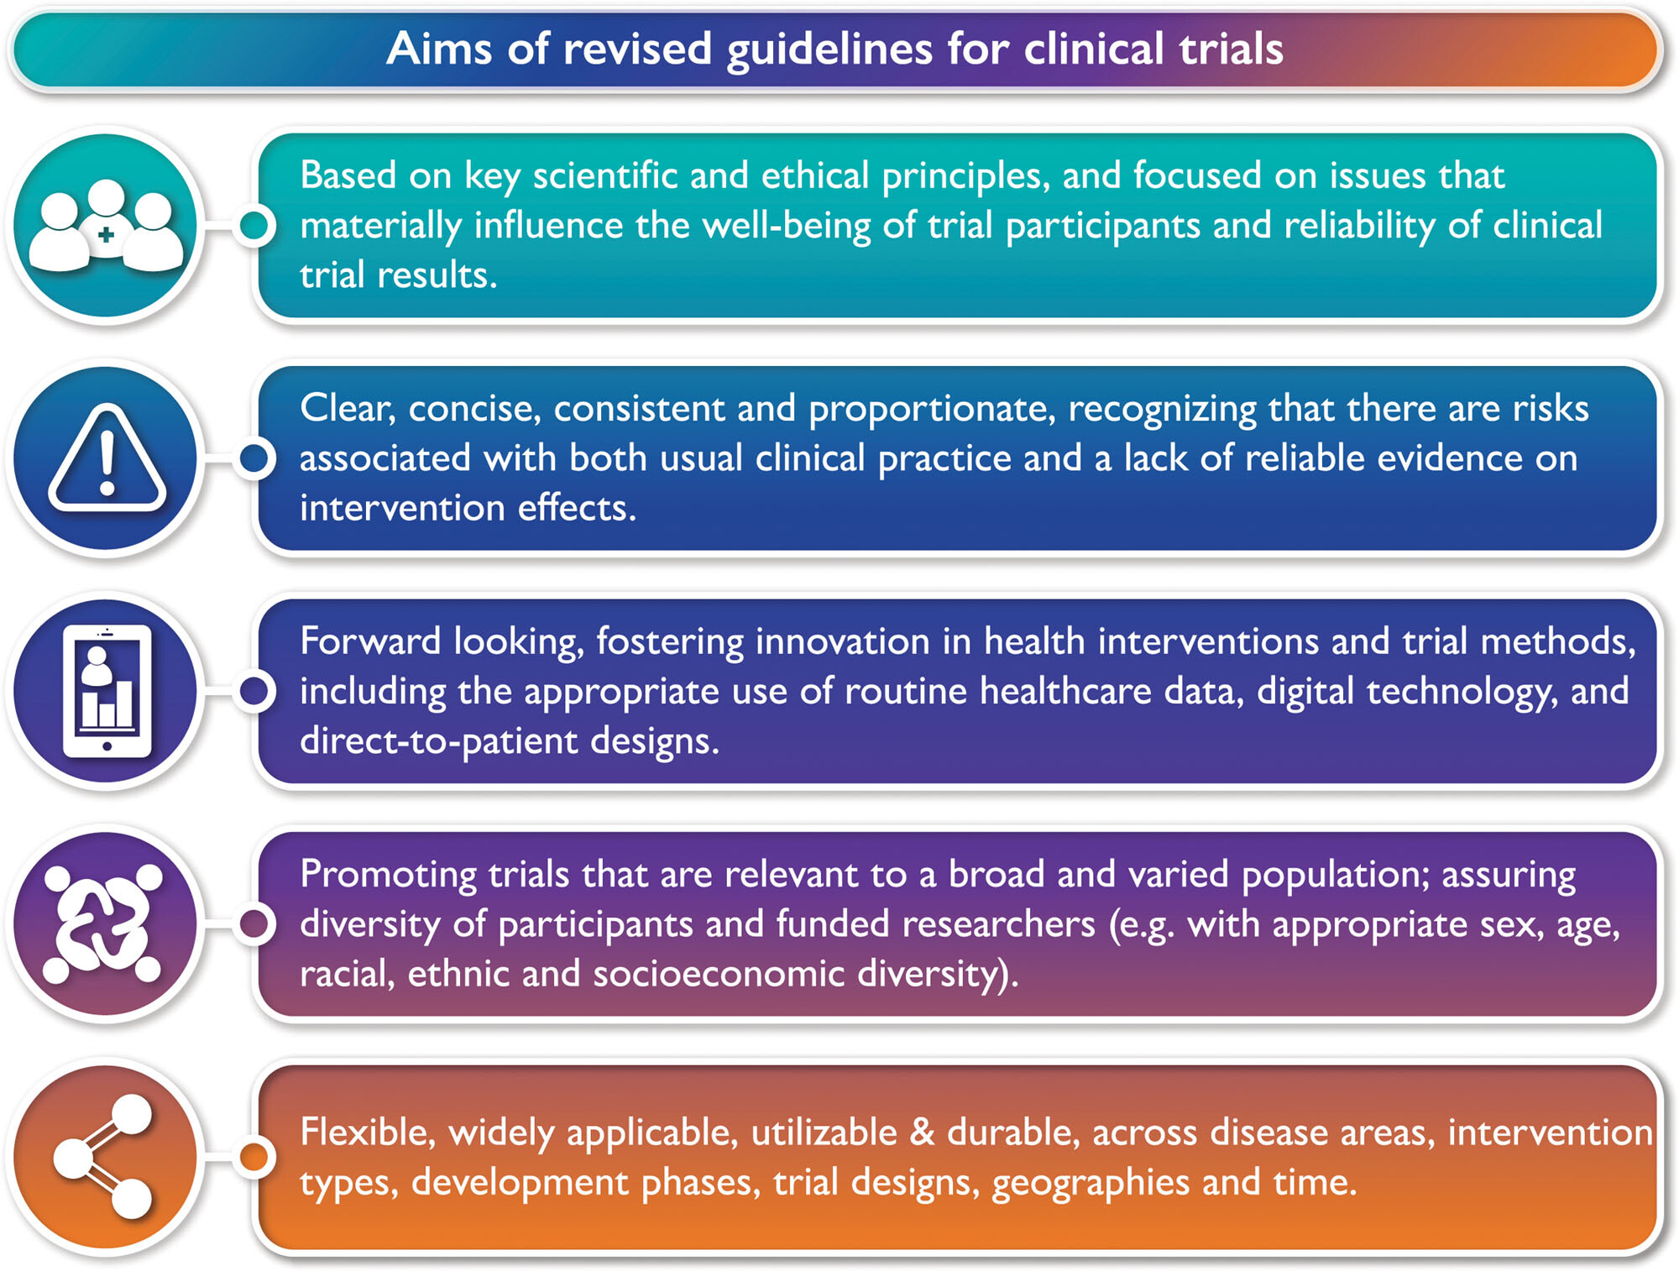

Louise Bowman. Circulation. Randomized Trials Fit for the 21st Century: A Joint Opinion From the European Society of Cardiology, American Heart Association, American College of Cardiology, and the World Heart Federation, Volume: 147, Issue: 12, Pages: 925-929, DOI: (10.1161/CIRCULATIONAHA.122.063378)

Slide 6


Common purpose and goals
Derived from common understanding of key principles and priorities
Shared responsibility
Enacted by, across and for all actors and the whole system
Flexibility and proportionality
Recognition that methods and approaches will differ in small or large ways from trial to trial

Slide 7
Focused on ‘why?’
…not who, what, where, or how
    Emphasize the principles
    Recognize that many trials pose little or no additional risk to participants compared to normal clinical practice
    Build on the strengths of the routine healthcare system and the standards to which organizations and individuals are held
    Allow trialists to determine efficient and effective solutions
    Discourage excessive or defensive practices
    Note that documentation is not the same as quality

Slide 8




What does good guidance look like?
Good science & ethics
  Focused on issues that materially influence the well-being of trial participants & reliability
  of the results
Clear and
concise
  Promotes critical
  thinking and application through accessibility
  and decision-making support.
Inclusively developed
  Co-developed with regulators, funders, commercial & academic trialists, clinicians, patients & public.
Progressive & durable
  Forward looking and applicable across disease areas, intervention types, development phases, trial designs, geographies
  & time.

Slide 9
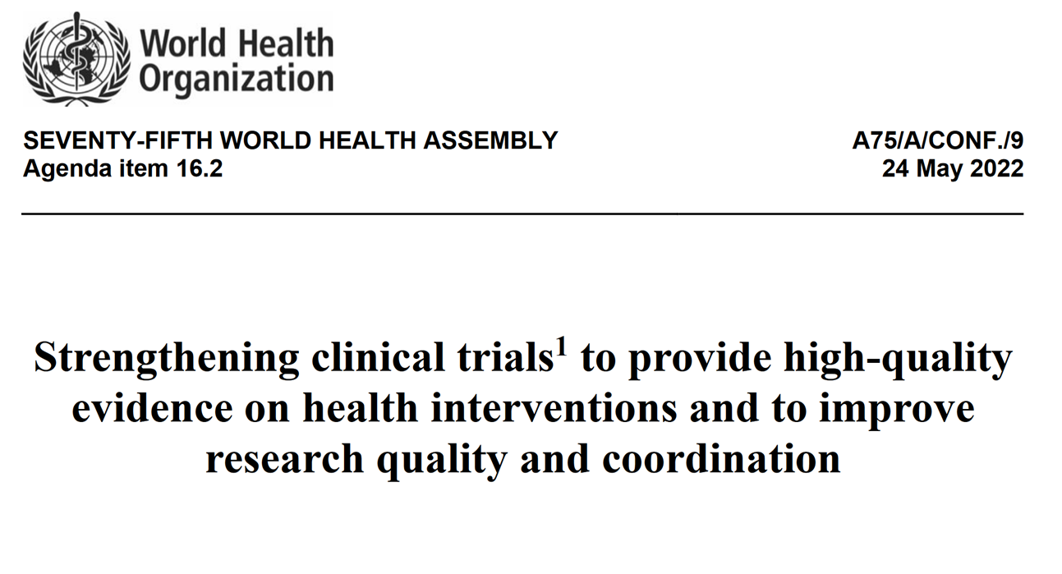
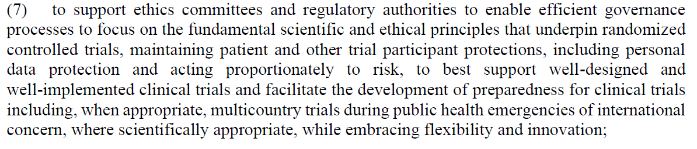

Slide 10

G7 Clinical Trials Charter
Therapeutics and Vaccines Clinical Trials Charter
Clinical trials are the primary way to generate actionable evidence, informing which vaccines and therapeutics are safe and effective
Many therapeutic trials, however, have been inadequate in size, design and conduct, failing to generate the evidence needed for decision making and to drive practice change.
By working together, as the G7 and with multilateral organisations and relevant authorities, we will endeavour to implement these principles in our own countries and with partners around the world.
https://www.gov.uk/government/publications/g7-health-ministers-meeting-june-2021-communique/g7-therapeutics-and-vaccines-clinical-trials-charter

Slide 11
11. Transform the approach to clinical trial regulation, shortening the time to authorise trials and streamlining the requirements and guidelines relating to trial conduct.
We should refocus regulatory guidelines on the fundamental scientific and ethical principles that underpin randomised trials, whilst embracing flexibility and innovation across a range of health threats and technologies...
The Good Clinical Practice for clinical trials guidance should be revised to focus on what matters for the generation of actionable information about effects of an intervention, rather than what is easy to check but less relevant, placing an emphasis on principles and purpose rather than process.
https://www.g7uk.org/g7-discuss-100-days-mission-to-improve-readiness-for-future-pandemics/

Slide 12
Good Randomized Controlled Trials
Good Trials: Produce a scientifically sound answer to a relevant question
Principle 01
Informative
and relevant
Principle 05
Principle 02
Efficient and well managed
Respectful of participants
Principle 04
Principle 03
Feasible for their context
Collaborative
and transparent

Slide 13





Five Principles of Good Randomized Clinical Trials
https://www.goodtrials.org/guidance
Good RCTs are designed to produce scientifically sound answers to relevant questions: RCTs should help resolve important uncertainties about the effects of health interventions. This requires the combination of key design features such as proper randomisation to avoid selection bias, adequate sample size to minimise the play of chance, unbiased assessment of outcomes, and intention-to-treat analyses.
Good RCTs respect the rights, safety, and wellbeing of participants: Ethical clinical trials combine seeking answers to important questions with scientific validity and appropriate protection and respect for all involved, especially participants. Independent review of proposals for new research, through a research ethics committee (or equivalent), is an important governance tool and can help ensure appropriate steps are taken to protect the rights and welfare of participants. Accessible, clear communication and relevant consent at all stages of an RCT are at the heart of this principle.

Slide 14



Five Principles of Good Randomized Clinical Trials
https://www.goodtrials.org/guidance
Good RCTs are collaborative and transparent: All those involved in RCTs share responsibility for building and sustaining the trust of collaborating partner organisations and clinical communities, participants, and the wider public. Trust is undermined by lack of relevance or transparency and lack of respect for the rights and values of participants and those whose care will be influenced by the results.
Good RCTs are designed to be appropriate for their context: Ensuring that a trial is set up to be practicable and produce reliable, actionable results is an important scientific and ethical duty. Consideration of context and existing resources in a proposed trial setting can better inform effective trial design.
Good RCTs manage quality effectively and efficiently: Delivery of a high-quality trial requires competent decision making and coordinated execution. Good governance and good trial quality management can help achieve these features. The focus should be on adopting risk-based proportionate approaches, identifying the key issues that would have a meaningful impact on participant wellbeing and safety or on decision making based on the trial results.

Slide 15
27 topics addressed under five principles
Produces a scientifically sound answer to a relevant question
Respects the rights & well-being of participants
Collaborative and transparent
Feasible for
the context
Manages quality effectively and efficiently
Trial population
Allocation
Adequate size
Blinding
Adherence
Follow-up
Measuring outcomes
Data capture
Ascertainment
Statistical analysis
Assessing effects
Emerging information
Appropriate participant communication
Relevant consent
Changing consent
Implications of changing consent
Safety of individual participants
Communication of new information
Working in partnership with patients and communities
Collaboration among organizations
Transparency
Setting and context
Use of existing resources
Competent advice and decision-making
Protecting trial integrity
Planning for success and focusing on issues that matter
Monitoring, auditing and inspection of study quality

Slide 16
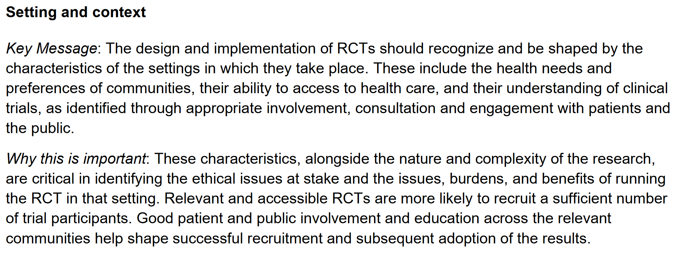
Good RCTs are designed to produce scientifically sound answers to relevant questions

Slide 17
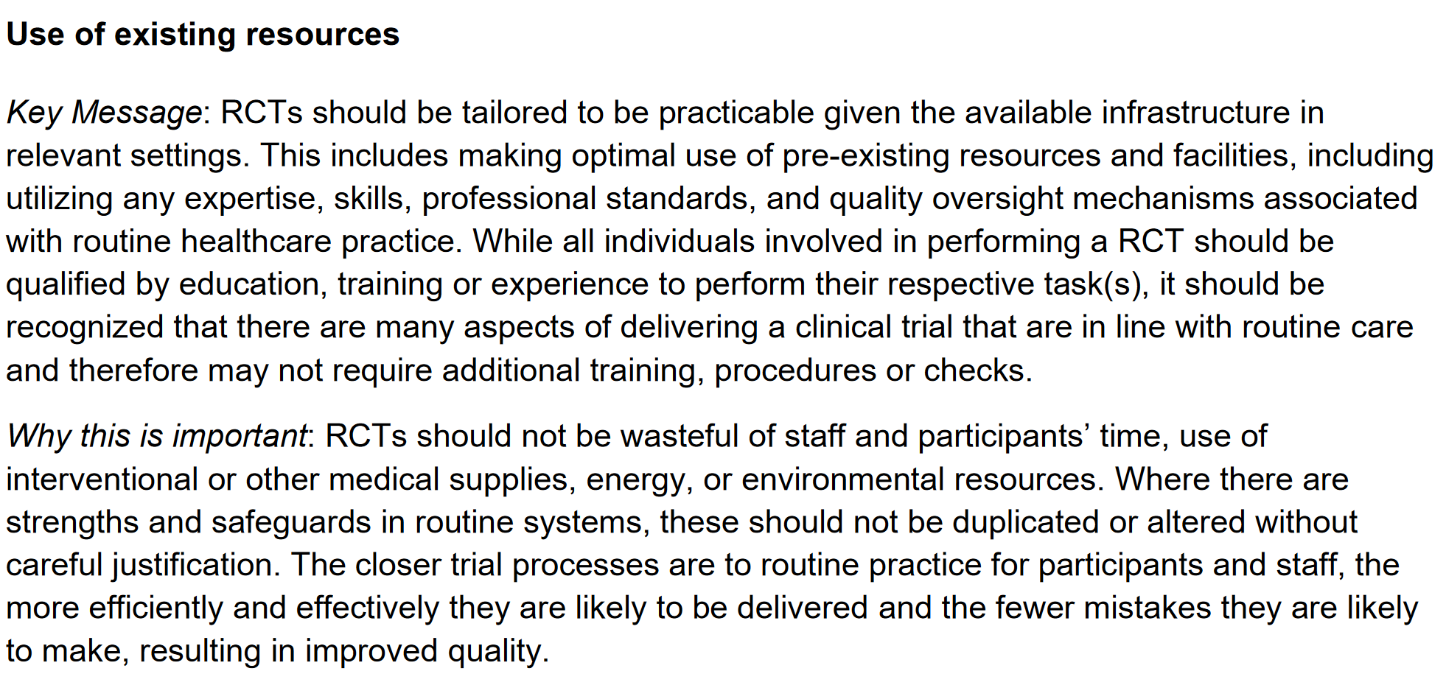
Good RCTs are designed to be feasible for their context

Slide 18
Good Randomized Controlled Trials
Good Trials: Produce a scientifically sound answer to a relevant question
Principle 01
Informative
and relevant
Principle 05
Principle 02
Efficient and well managed
Respectful of participants
Principle 04
Principle 03
Feasible for their context
Collaborative
and transparent

Slide 19
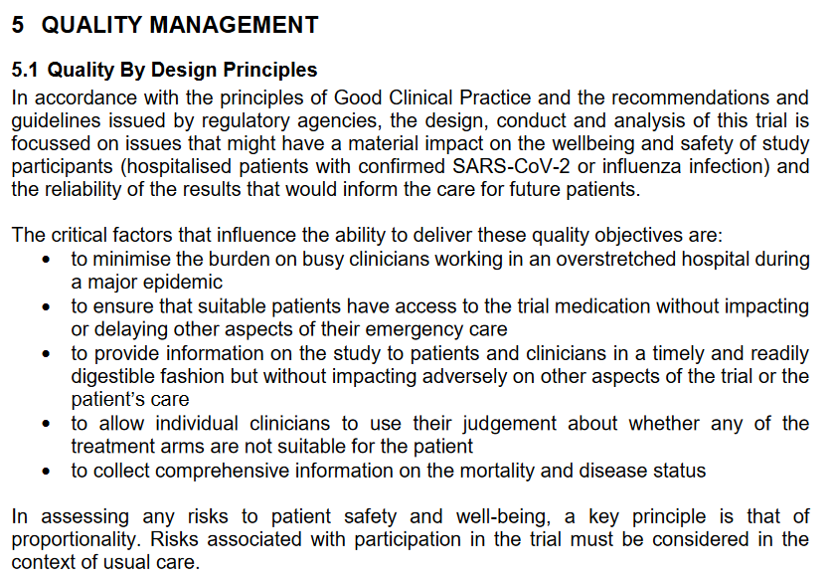
Quality by Design… in practice

Slide 20
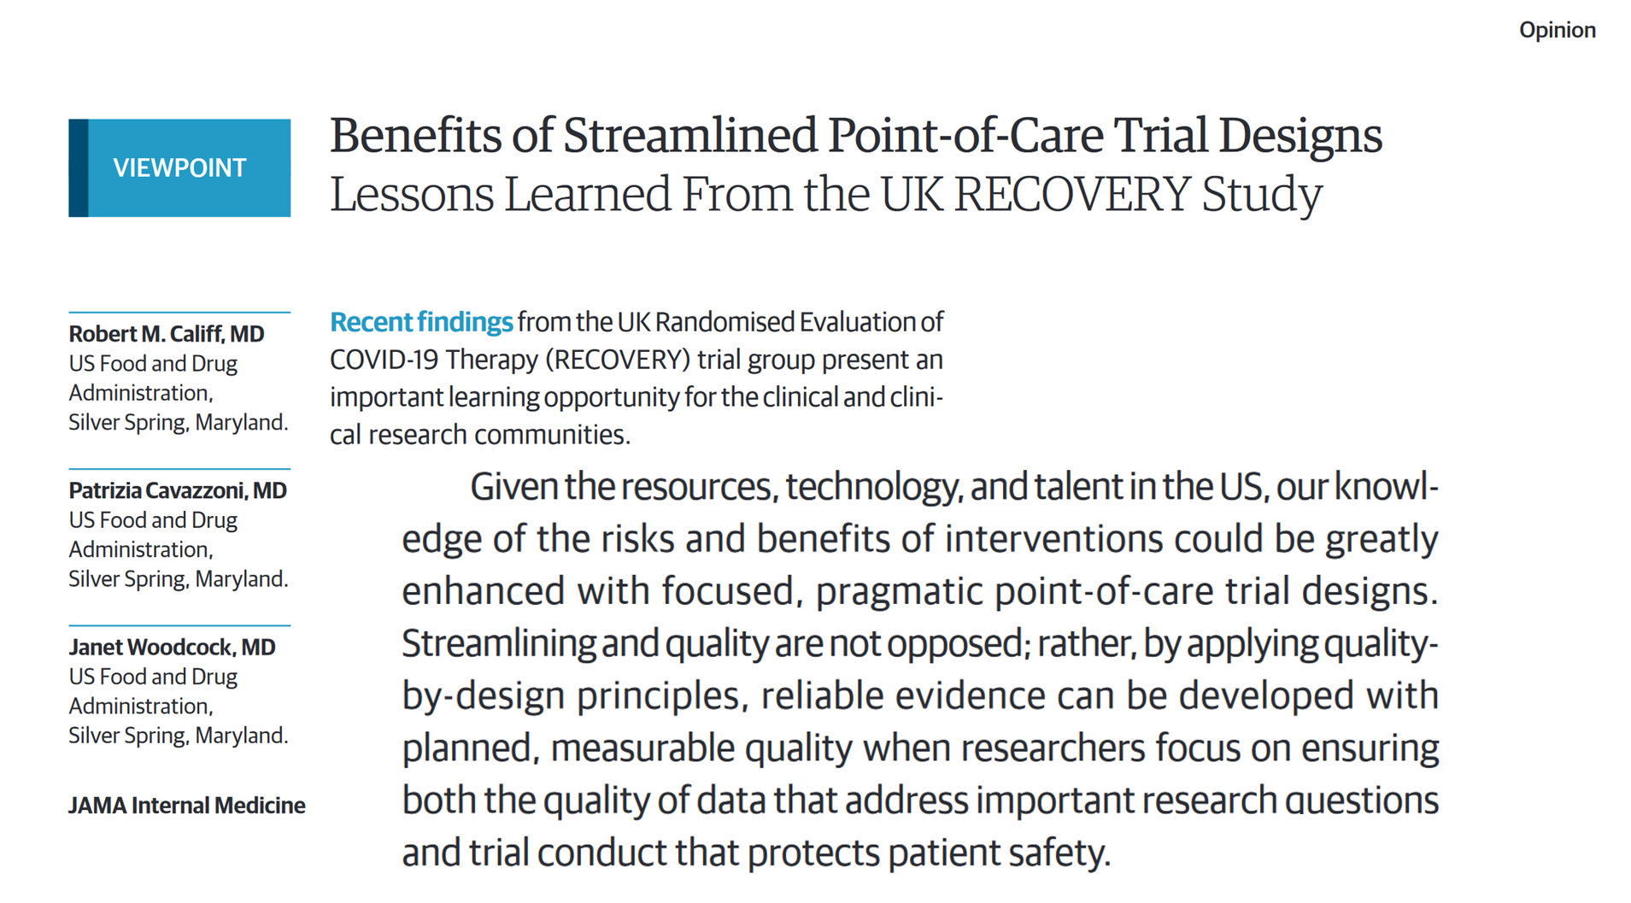

Slide 21
Good Clinical Trials Collaborative
Twitter: @GoodTrials
LinkedIn: The Good Clinical Trials Collaborative
E-mail: contact@goodtrials.org
Website & mailing list: www.goodtrials.org
www.goodtrials.org
contact@goodtrials.org

