Slide 1
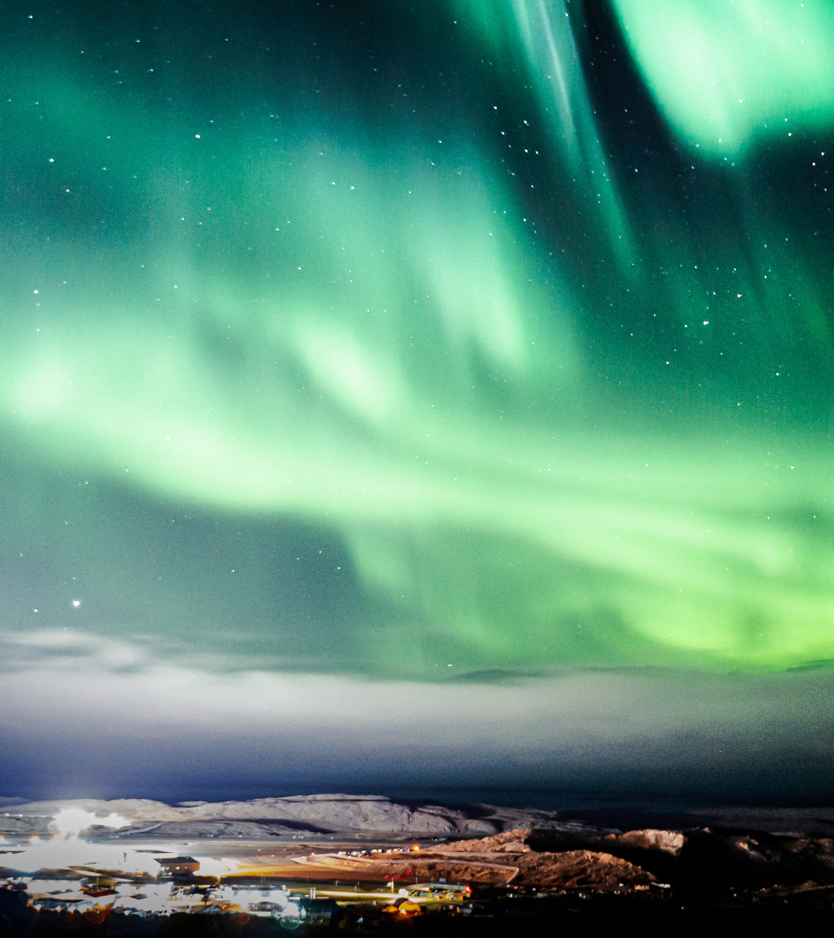
Qikiqtani General Hospital Iqaluit, Nunavut
Co-Champion:
Dr. Holden Sheffield
Co-Champion:
Dr. Aubrey Litvack
Territorial Chief of Staff:
Dr. Francois De Wet

Slide 2
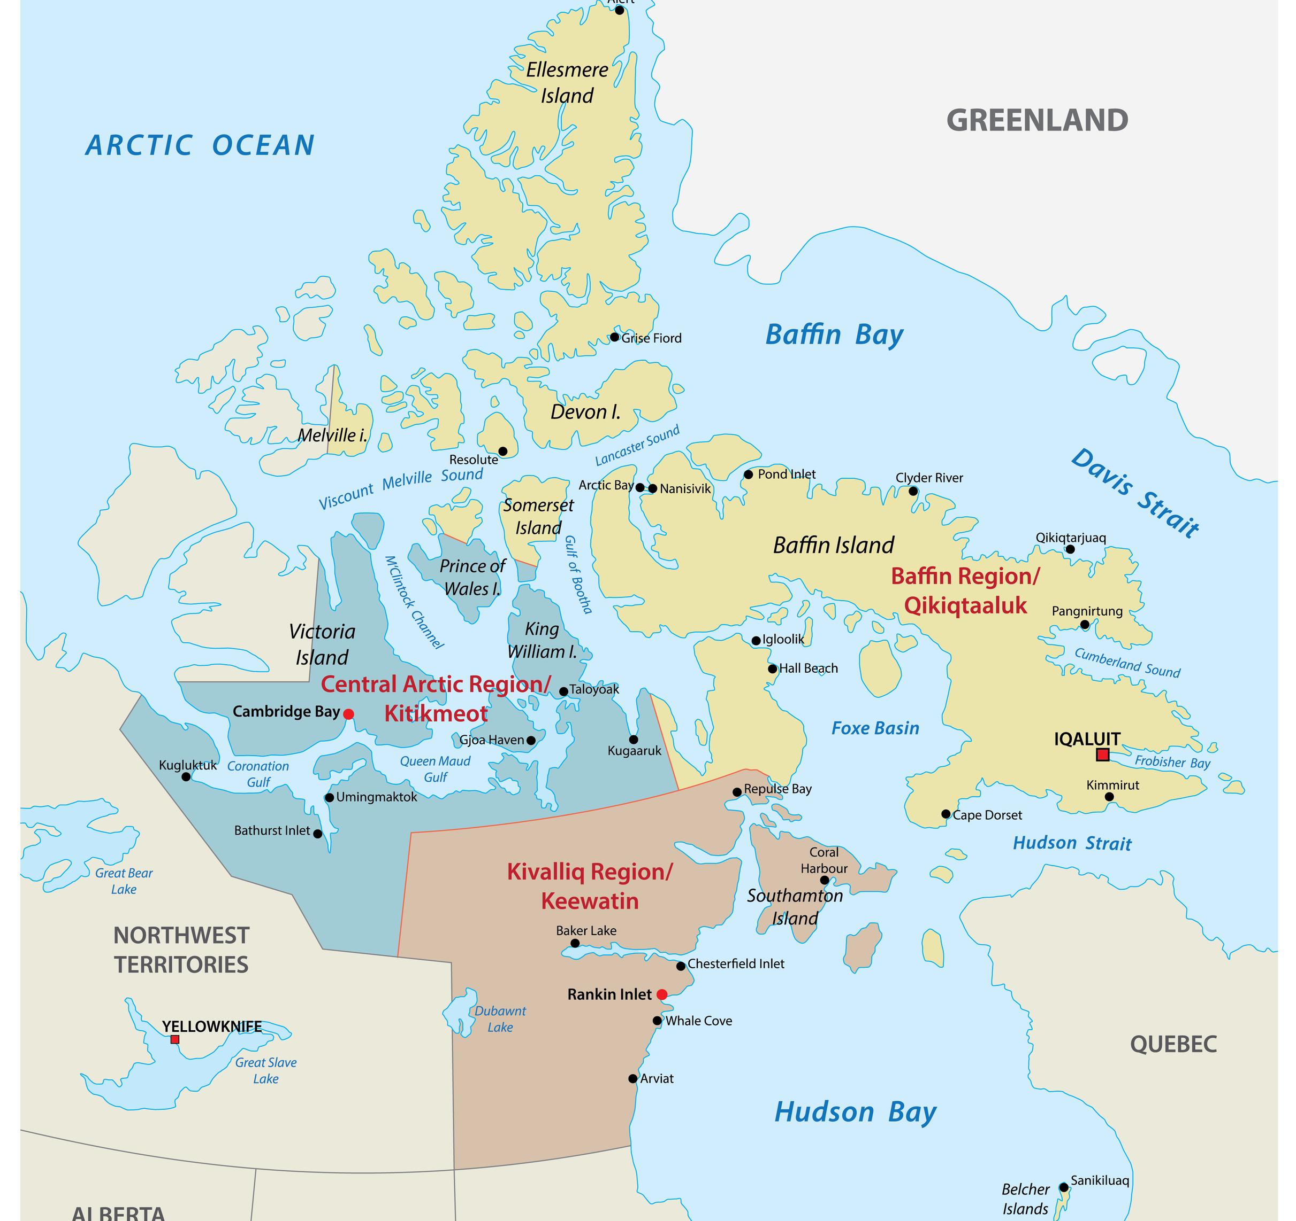
Geography

Slide 3
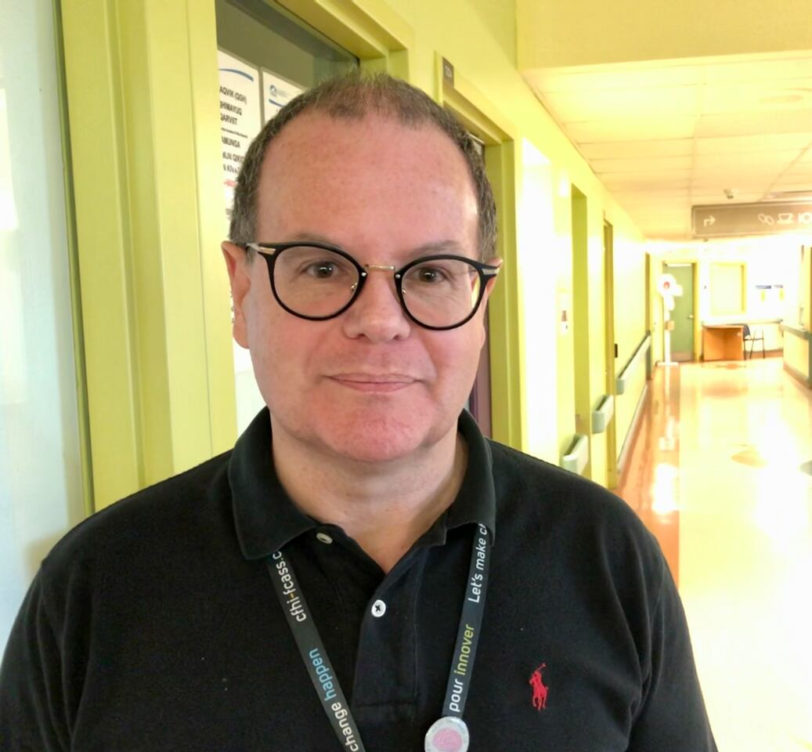
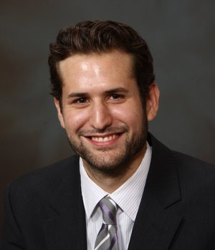
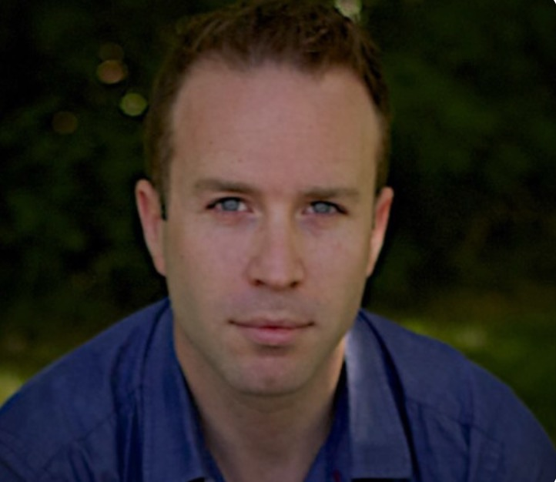
Key Players Francois De Wet -Territorial Chief of Staff Holden Sheffield -Territorial Chief of Pediatrics Aubrey Litvack -Surgeon

Slide 4
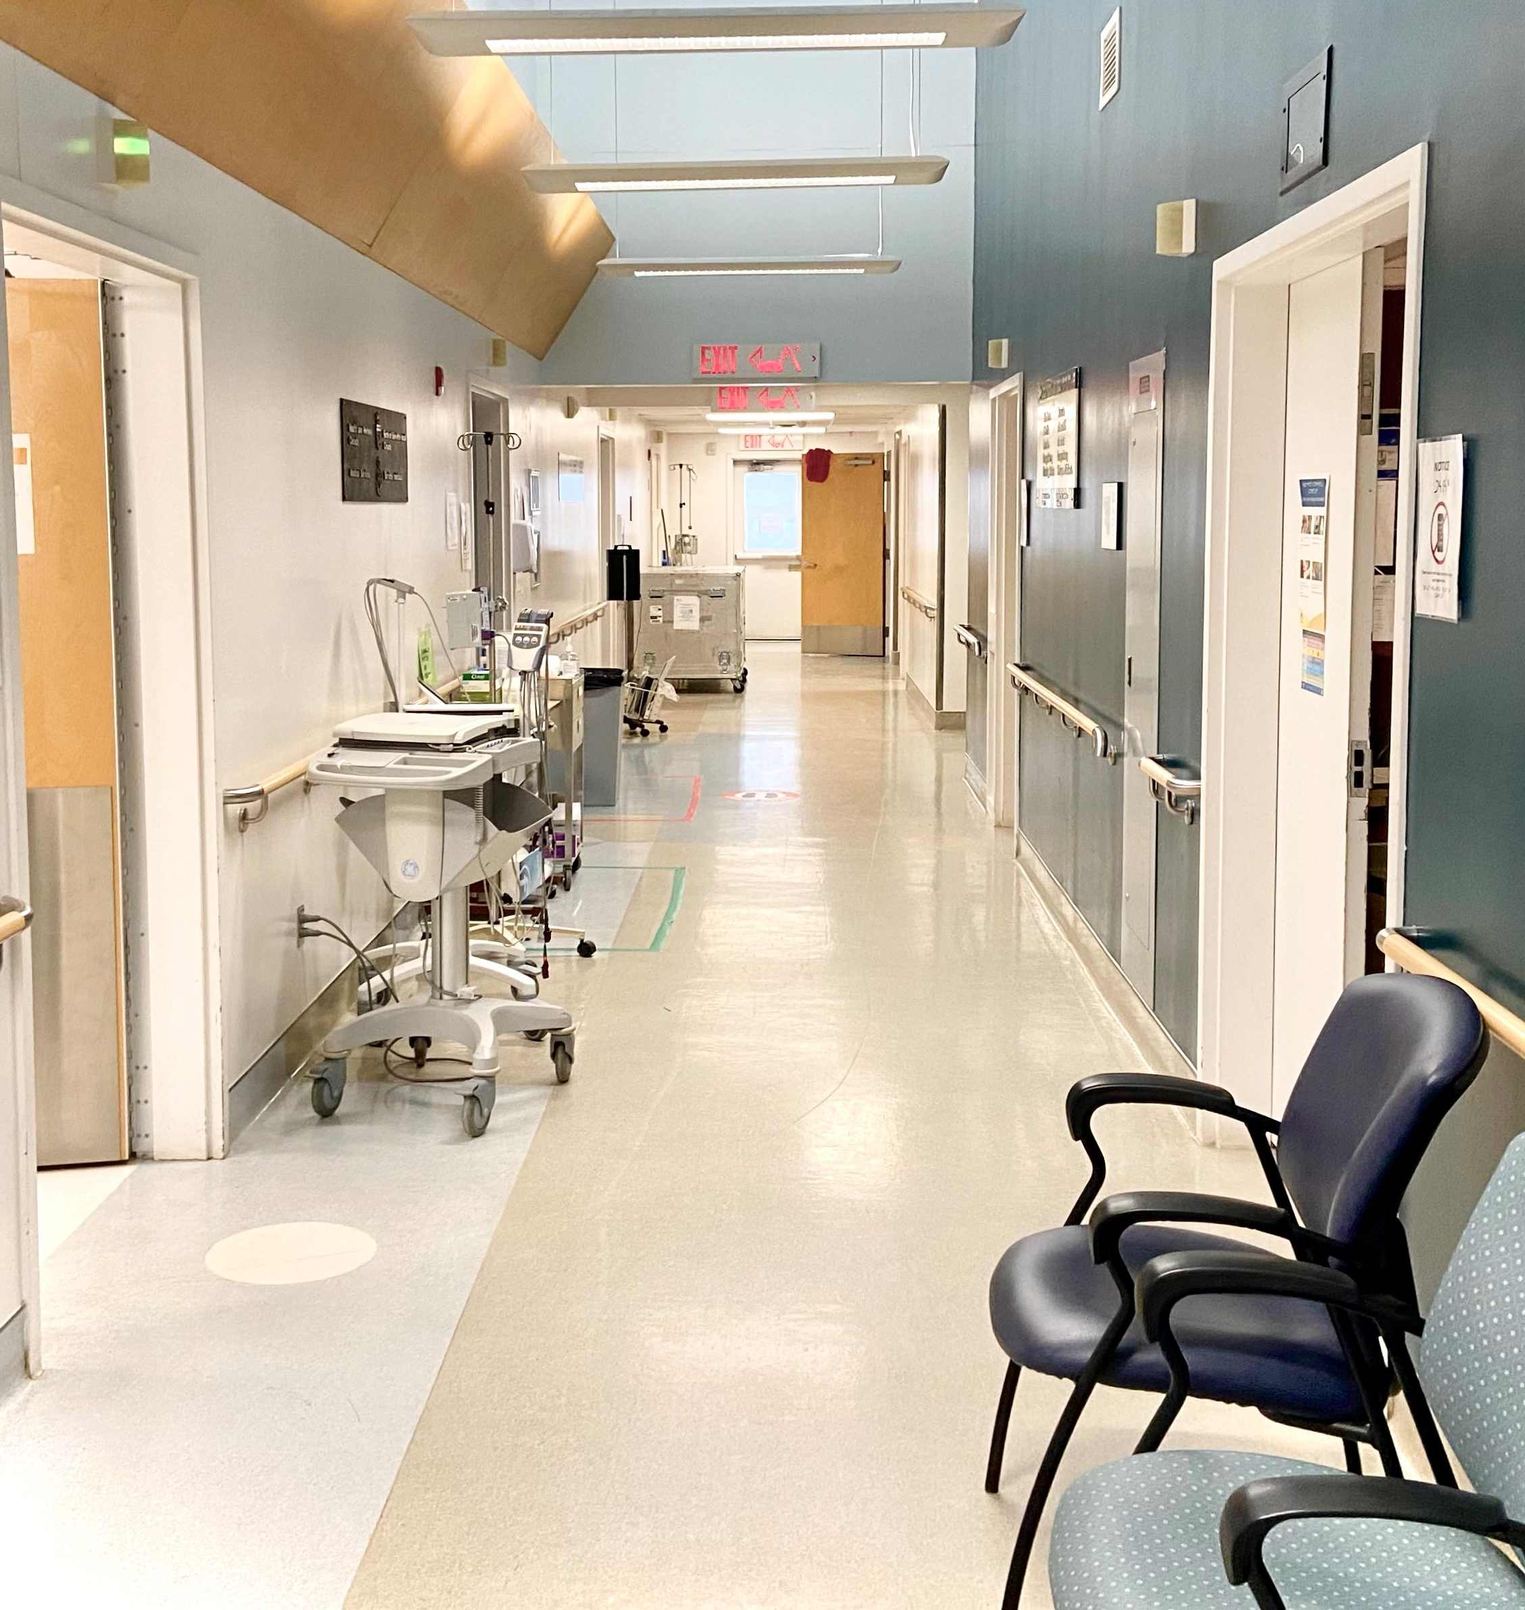
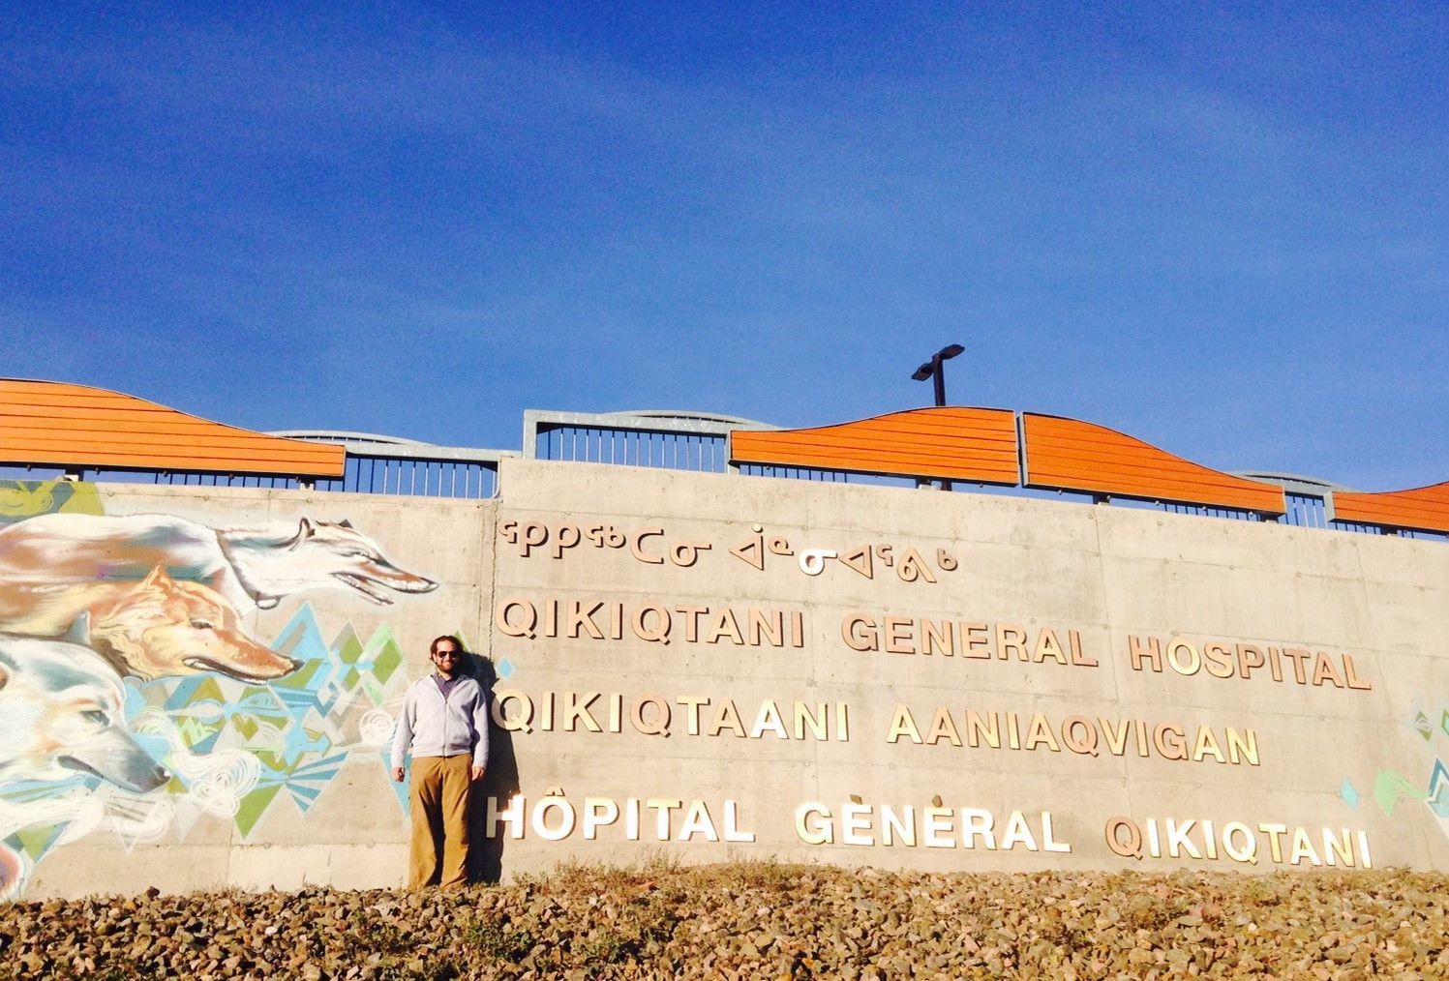
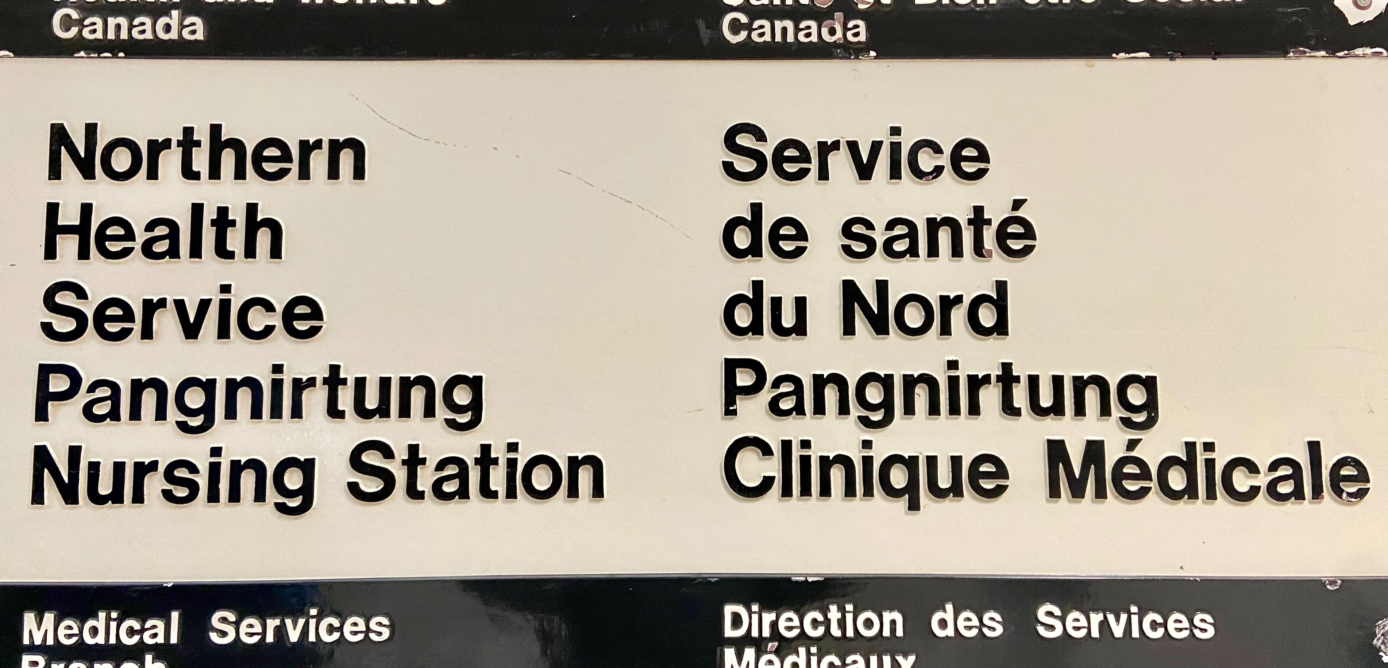
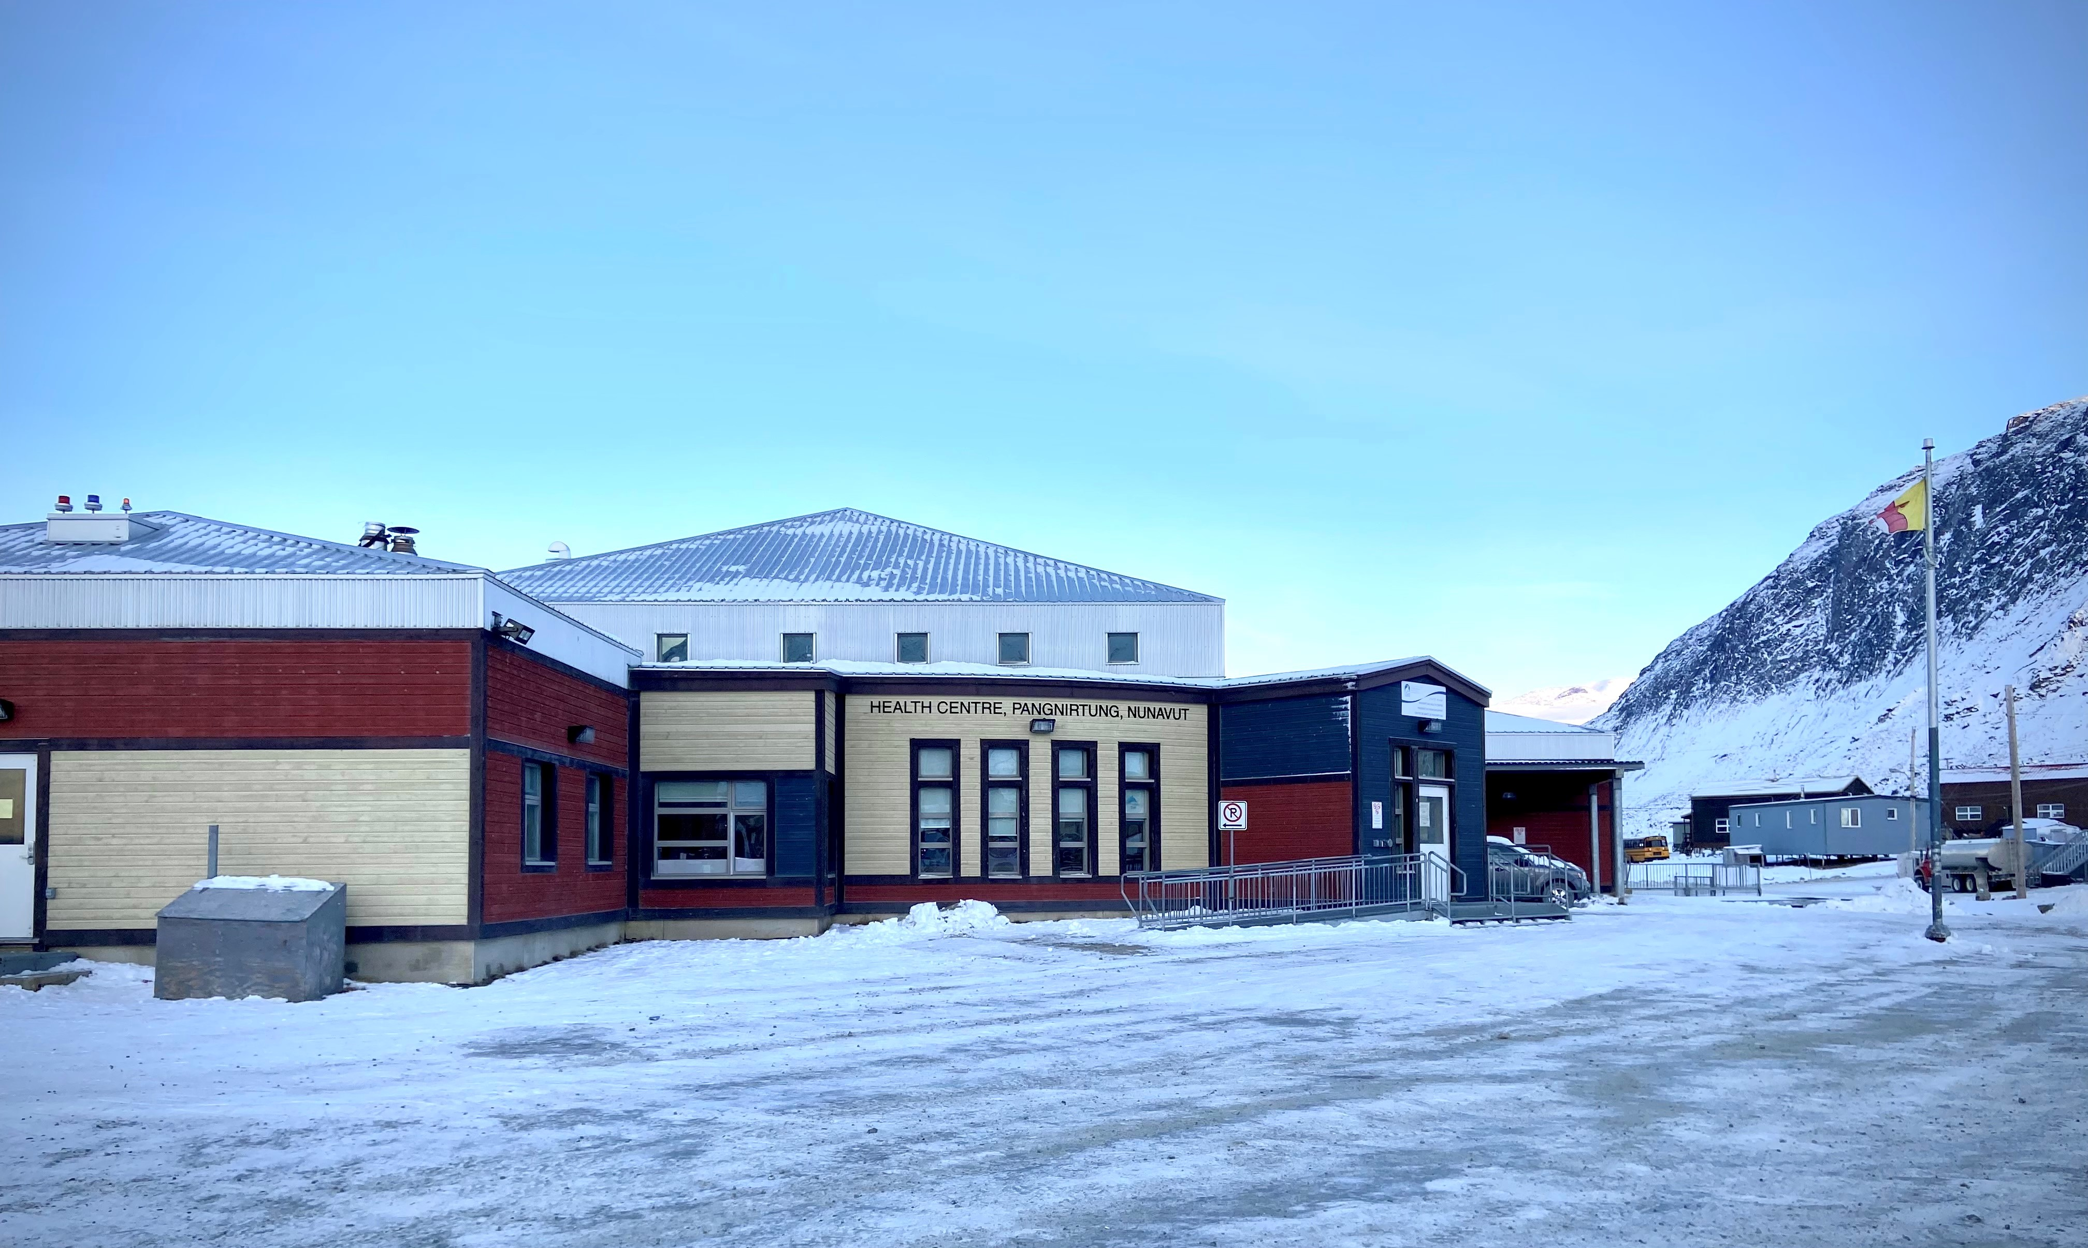
Site Details
-20 bed hospital -Only hospital in the territory -Mainly serve Qikiqtaaluk region -ER, in-patient, OB, pediatrics, surgery, obs/gyne, internal medicine -Youngest patient population in the country

Slide 5
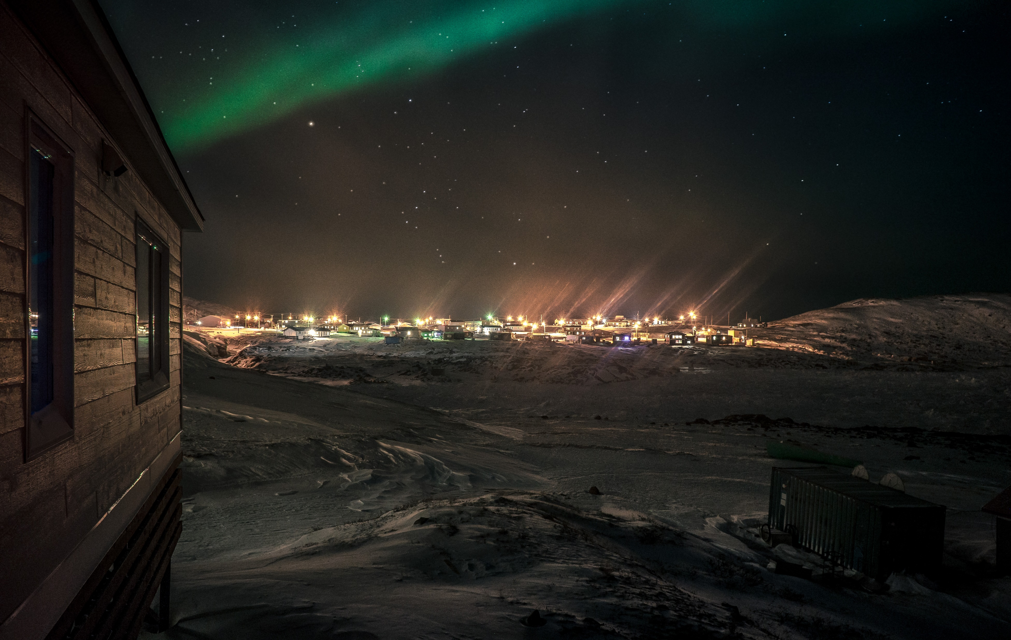
Current Research
-Utilization of non-invasive ventilation on pediatric air transport
-Patient population view on new vaccines
-program design and development
-Telemedicine
-Pediatric respiratory disease

Slide 6
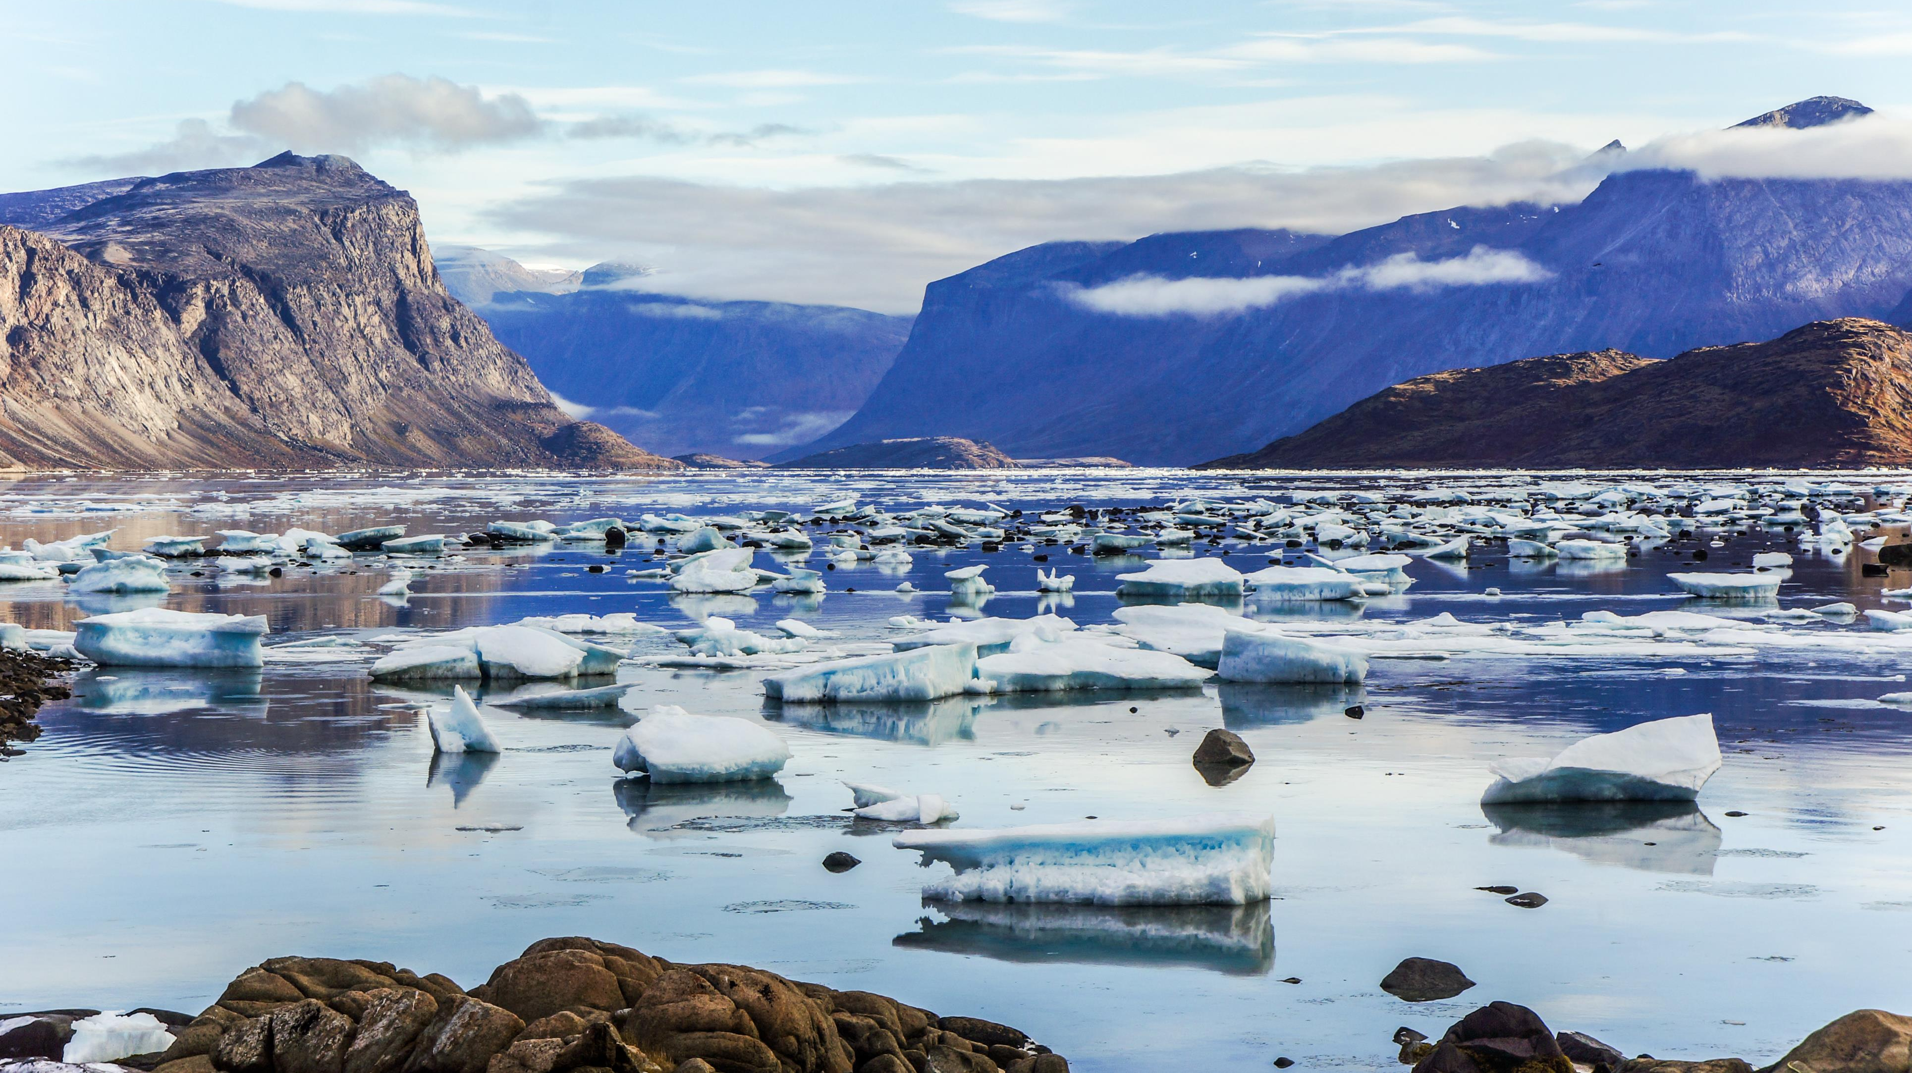
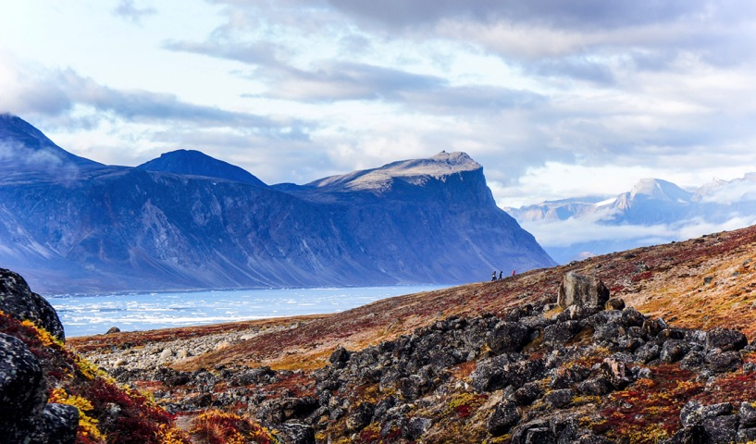
Thank you

