Slide 1
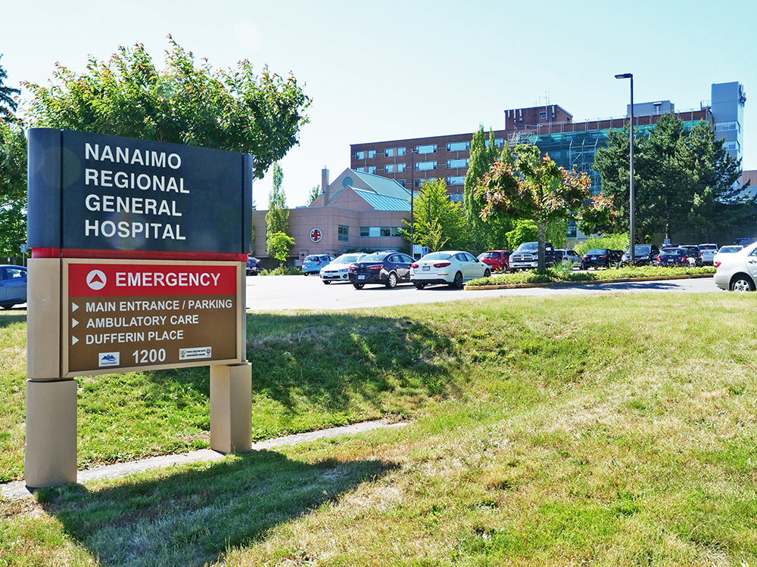
Nanaimo Regional General Hospital Nanaimo, BC
Co-champion:
Dr. David Forrest
Co-champion:
Dr. Mark James
Co-champion:
Dr. Alastair Teale
Research Coordinator:
Linh Vu
Image from The City of Nanaimo
Notes:
Situated on Vancouver Island, Nanaimo is a growing coastal community and health services hub. Nanaimo Regional General Hospital, NRGH is a referral hospital for many smaller nearby communities, serving a diverse demographic. NRGH’s scope of care includes services such as surgery, maternity, pediatrics, intensive care, extended care, rehabilitation, psychiatry in addition to outpatient services such as radiology, Nanaimo Cancer Centre, pacemaker clinic, laboratory diagnostics etc. Research at NRGH is a new development that started in 2020 in response to COVID, out of a need to have COVID treatments available for patients.

Slide 2
Key Players
Dr. David Forrest
Dr. Mark James
Dr. Alastair Teale
Critical Care
Critical Care
Infectious Disease
Infectious Disease
ANES.
Notes:
Our research team consists of Dr. Forrest, Dr. James, Dr. Teale who specialize in Critical Care and Infectious Disease.

Slide 3
Key Players
Gayle Carney
Deborah Parfett
Linh Thi Vu
Clinical Research Nurse Educator
Clinical Research Manager
Clinical Research Nurse COORD
Notes:
Additionally, we currently have 2 research coordinators, Linh and Sethany, with hopes to grow our team. Gayle and Deborah, our educator and manager, are key players in helping build research capacity at NRGH. Dr. Forrest, who unfortunately was not able to make it here today, wanted to share his experience as a primary advocate of research at NRGH with the following video.

Slide 4
Video
Insert Video Clip/Link here to play
Notes:
Play video clip of hospital and Dr. Forrest
https://youtu.be/Nwa8wsIyx7g?si=tPTVrFYUyT2QWpFS

Slide 5
Site Details
16 Critical Care beds
409 total beds
Tertiary Interventions
Referral Centre for Central and North Island
Communities
Population: 500,000
Focus on Critical Care and Infectious Disease
On site Medical Imaging and Lab
CT, Interventional Radiology, MRI, Nuclear Medicine, X-ray, US
Recruited for 2 trials
REVISE
CLiCK
Previously recruited for 2 trials
ARBS Corona
CATCO
Notes:
NRGH is a 409 bed facility, with 16 critical care beds in ICU and HAU. As a health services hub, NRGH serves central and north Vancouver Island, which is approximately 500, 000 people. NRGH’s services continue to expand as the region grows. While past and current clinical trials have focused on Critical Care and Infectious Diseases, we are looking to expand into other specialities and departments.

Slide 6
Goals
Projects in the works – ICU CAP, Infectious Disease
Future areas: Psychiatry and Gastroenterology
Expand into other specialties/departments
Grow research and treatment options
Thank you!
Notes:
Our goal is to expand beyond ICU and Infectious disease and grow our number of studies in other areas. Of particular interest for future research at NRGH are areas of Psychiatry and Gastroenterology. Working with other specialities, we hope to expand treatment options available to patients. Thank you for your time.

