Slide 1
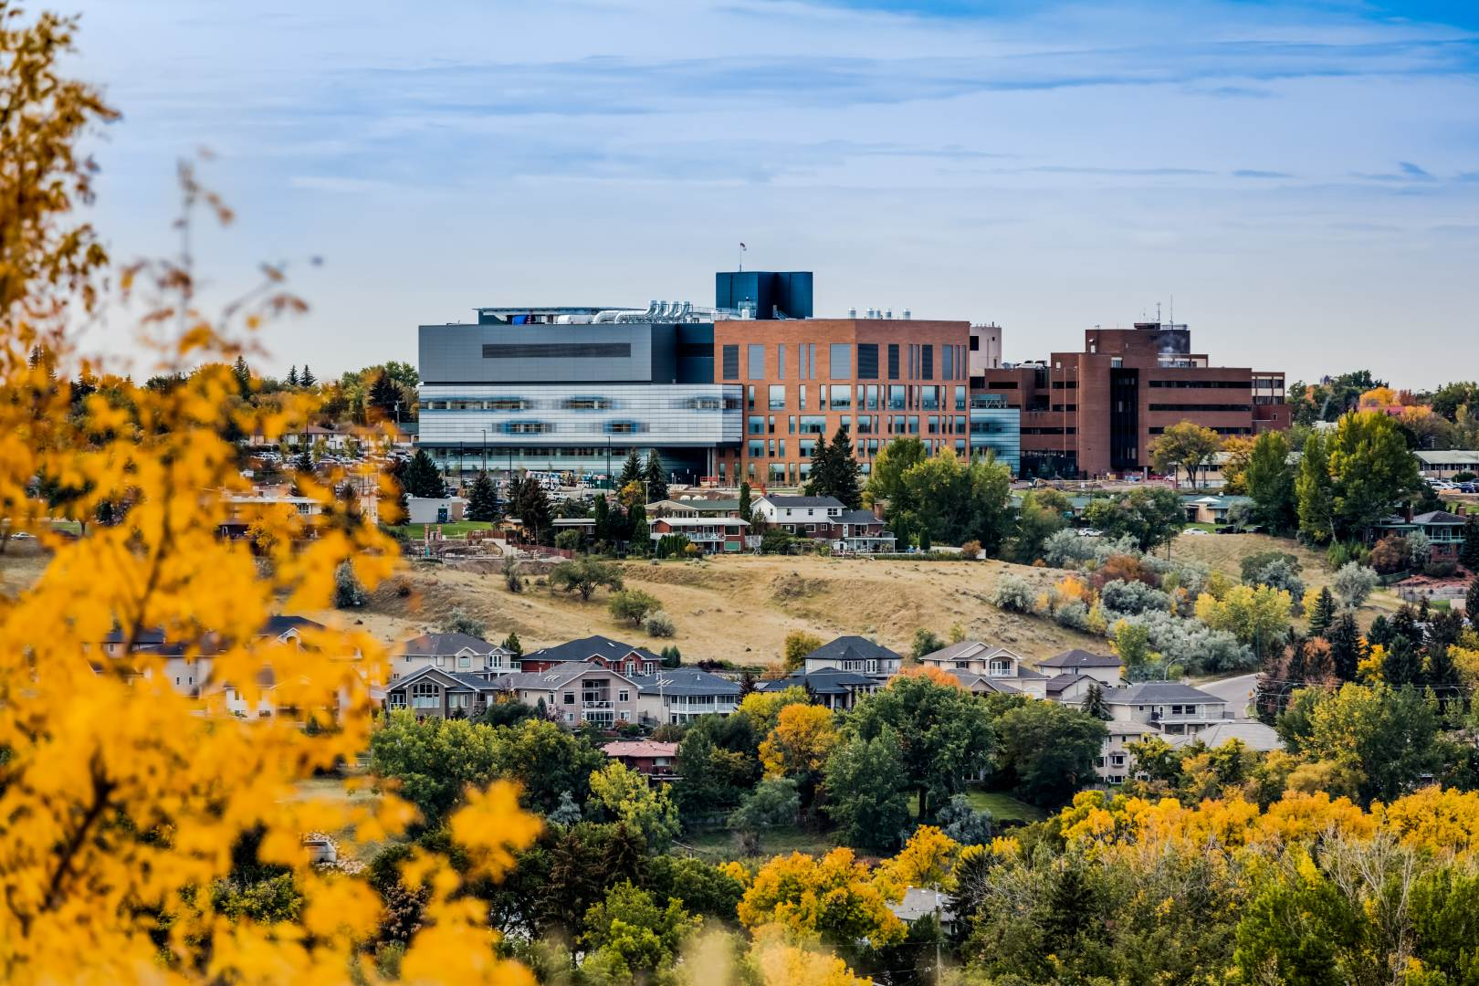
Medicine Hat Regional Hospital Medicine Hat, AB
Co-champion:
Dr. Herbert Alejandro Manosalva
Co-champion:
Dr. Adeel Azam
Research Coordinator:
R.N. Chloe Kilkenny

Slide 2
Key Players
Dr. A. Azam
Dr. J. Hawkwood
Dr. H. Bharwani
Dr. M. Shukla
Dr. H. A. Manosalva
Diabetes
Emergency
Family Medicine
Cardiology
Stroke Neurology
Canadian Stroke Consortium (CSC)
Diabetes Clinical Trial Network (DCTN)
Canadian Heart Function Alliance (CHF)
Canadian Covid 19 Emergency department rapid response network (CEDRRN)
(Librexia study)
Canadian medication appropriateness & deprescribing network (CADeN)

Slide 3
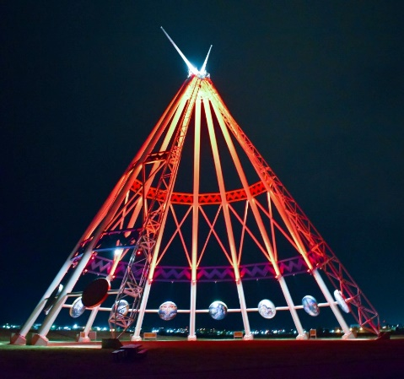
Site Details
210 Beds
24/7 Emergency Room
Primary Stroke Centre
(ACT Trial)
Level 3 Trauma Centre
Bariatric / Diabetes Clinic
Hemodialysis Unit
Services Offered
Diagnostic imaging (CT, MRI and Ultrasound)
Emergency
Inpatient Care (Family Medicine, Internal Medicine, Neurology, Palliative Care, Pediatrics)
Psychiatry / Mental health
Respiratory Therapy (Acute care, Asthma Education, Stress Testing)
Secondary and Tertiary Prevention (Cardiac Rehab, Diabetes Clinic)
Surgery (General, Orthopedics, Plastics, Urology) and Preoperative Clinic
Cancer Care
Renal Dialysis
Academic Affiliations
University of Calgary
Rural Family Medicine Program
University of Alberta
University of Lethbridge
Medicine Hat College
Nursing Program

Slide 4
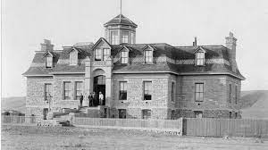
Highlights
Founded in 1889 as the first hospital in Alberta and was the major hospital between Winnipeg and Vancouver
Serves a catchment area of approximately 120,000 people
Long history as a clinical education hospital for a wide range of medical and allied health professionals – the School of Nursing was established in 1894.
Thank you!

