Slide 1
NIHR Clinical Research Network
Nick Lemoine
Head of Medical Directorate

Slide 2
Our mission
We do this by:
Funding high quality, timely research that benefits the NHS, public health and social care
Investing in world-class expertise, facilities and a skilled delivery workforce to translate discoveries into improved treatments and services
Partnering with patients, service users, carers and communities improving the relevance, quality and impact of our research
Attracting, training and supporting the best researchers to tackle complex health and social care challenges
Collaborating with other public funders, charities and industry to shape a cohesive and globally competitive research system
Funding applied global health research and training to meet the needs of the poorest people in low- and middle-income countries
To improve the health and wealth of the nation through research

Slide 3
How the NIHR CRN works

Slide 4
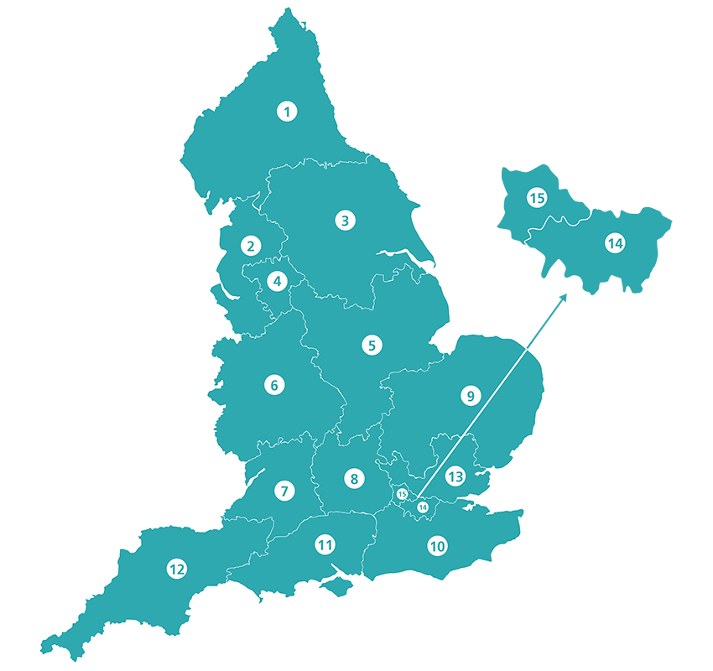
15 Local Clinical Research Networks
Local Clinical Research Networks (LCRNs) support organisations to participate in research
LCRNs develop relationships with public health and social care providers, allocate strategic funding, and pilot cross-NIHR working for health needs
LCRN teams include embedded and mobile research staff, learning and development, business intelligence, study support service, communications and PPIE
15
Local Clinical Research Networks
Notes:
This slide shows where the Local Clinical Research Networks are based in the UK.
There are 15 local Clinical Research Networks in the UK.
These LCRNs have been developed as a strategic response to local healthcare needs and are overseen by the National Coordinating Centre.
LCRNs have the ability to allocate funding and pilot cross-NIHR working for certain health needs.
They develop relationships with local populations, researchers, public health and social care providers (including all secondary care NHS organisations in England) and NHS providers and provide full coverage of secondary care NHS organisations in England.
Their teams operate across a range of specialties from embedded and mobile research staff, to learning and development teams, business intelligence, study support services, communications and PPIE.

Slide 5
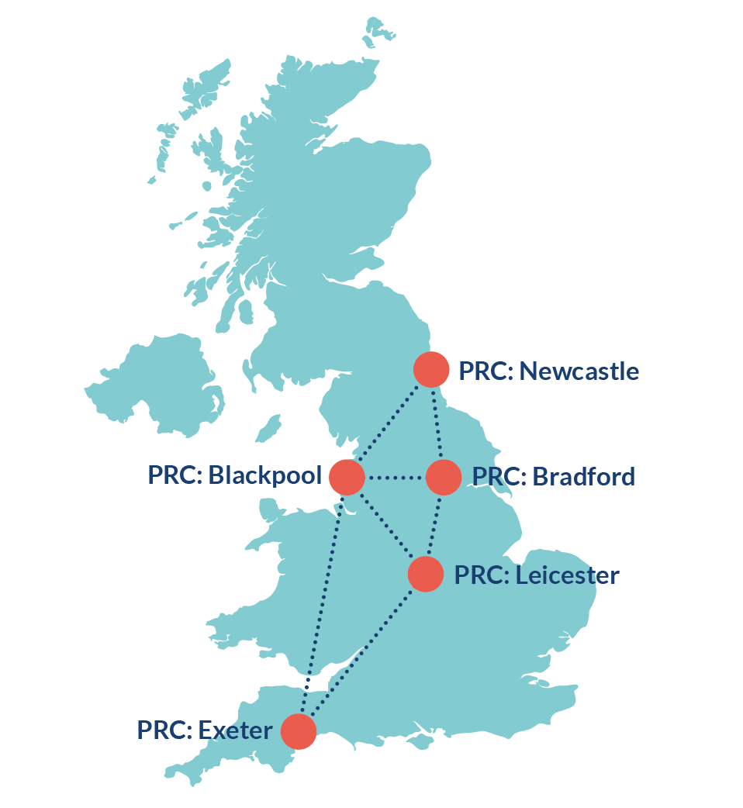
NIHR National Patient Recruitment Centres (PRCs)
100% dedicated to research funded by life sciences industry
Increase capacity and improve UK competitiveness
Easier and quicker
Specialised
Patient focussed - concierge service
Collaborative model - one costing, five sites
Strategically located with regional reach
Pioneering trial capabilities: DCTs
Proactive and inclusive recruitment strategies
Reach beyond specialist hospital clinics
Dedicated staff and facilities
www.nihr.ac.uk/prcs
Notes:
This slide provides and overview of the Patient Recruitment Centres purpose and unique selling points.
More detail available here: https://docs.google.com/presentation/d/1oHnnP266wwG8C-oimzDuXYRZtzRyfUdRsp8xncp7igc/edit#slide=id.g149f23662f6_0_66
SPEAKER NOTES / KEY MESSAGES
Purpose - Five purpose-designed centres established in the NHS to:
Increase the UK’s capacity to deliver late-phase commercial clinical research
Make it easier and quicker to deliver commercial clinical research in the NHS
Increase opportunities for patients to benefit from early access to innovation
Provide a test bed for future innovation in clinical trial delivery
USPs
Patient focussed
Patient experience KPI
Concierge-style service
Collaborative model
Streamlined communication
Coordinated feasibility
A single costing strategy
Strategically located with regional reach
Specialist sites focussed on
Late-phase, large-scale - can rapidly scale up operations - Recruitment engines
Reach beyond specialist hospital clinics E.g. common chronic conditions
Primary, community, social care
Reach diverse patient populations
Innovative
Test bed, forward thinking
Proactive and inclusive recruitment strategies - Registries / Social media campaigns - Drive engagement
Data driven patient identification
Pioneering trial capabilities: DCTs
Dedicated staff and space

Slide 6
Covering 30 specialties
Stroke
Diabetes
Each LCRN delivers research across 30 specialties:
Ageing Anaesthesia, perioperative medicine and pain management Cancer Cardiovascular disease Children Critical care Dementias and neurodegeneration Dermatology Diabetes Ear, nose and throat Gastroenterology Genetics Haematology Health services and delivery research Hepatology
Infectious diseases and microbiology Mental health Metabolic and endocrine disorders Musculoskeletal disorders Neurological disorders Ophthalmology Oral and dental health Primary care Public health Renal disorders Reproductive health and childbirth Respiratory disorders
Stroke Surgery
Trauma and emergency care
Cardiovascular disease
30
Clinical Research Specialties
Mental health
Notes:
This slide outlines the 30 specialties that the NIHR CRN covers.
The NIHR has widened its focus to include social care research that aims to improve the quality of life for users and carers through better social care provision and practice.
The 30 specialties are managed by are managed via six Specialty Cluster Leads and Assistant Specialty Cluster Leads.
The NIHR Clinical Research Network (CRN) has convened the NIHR Covid-19 Understanding and Elimination-Trials Implementation Panel (CUE-TIP) Group to provide cross-specialty oversight for the delivery of studies relating to COVID-19. The group provides strategic clinical oversight across the entire COVID-19 Portfolio..

Slide 7
Supporting studies across the UK
The CRN supports around 5000 health and social research studies each year by:
Funding research support posts in the NHS and providing training
Funding to meet the costs of using facilities
Helping identify and recruit participants
Facilities
Recruiting
Participants
Training
Notes:
This slide show how the NIHR CRN supports studies across the UK.
Every year the NIHR CRN supports around 5000 clinical research studies.
It does this by funding research support posts in the NHS and providing training, so that researchers have access to experienced front-line staff, who can carry out the additional practical activities required by their study – such as obtaining patient consent for participation, carrying out extra tests, and collecting the clinical data required for the research.
The NIHR CRN also provides funding to meet the costs of using facilities such as scanners and x-rays that are needed in the course of the study, so that research activity adds value to patient care.
And it provides practical help in identifying and recruiting patients onto Portfolio studies, so that researchers can be confident of completing the study on time, and on target.

Slide 8
NIHR Clinical Research Network: Future priorities
Support the right research, for the right people, in the right place.
Strengthen key partnerships to transform research delivery
Increased research capability and capacity across all health and care settings
Globally competitive in life sciences research to improve the health and wealth of our nation
Driving research through digital developments
Invest and develop an engaged workforce and increase our research workforce capacity
1
2
3
4
5
6
Notes:
Support the right research, for the right people, in the right place.
This means:
Developing a data driven approach to help target the research we support where it will meet the greatest need (for example by sharing and using data around disease prevalence, deprivation or other measures with partners)
Building local capacity and capability to enable research for under-served and high prevalence communities and, with the NIHR Academy, help support and develop local investigators.
Strengthen key partnerships to transform research delivery
Our core service is research delivery and while our system is the envy of the world, we can improve this further, working with those who use it, sponsors, researchers, R&D and others to keep this world-leading.
Working flexibly and in partnership where we can add most value is key to this, as will digital developments for our services.
Increased research capability and capacity across all health and care settings
Much research is still delivered around major academic centres and doesn’t necessarily reach those communities and areas with the highest prevalence or need. 90% of all clinical contacts in the NHS and the burden of disease and ill-health, is in primary care.
We are developing additional research infrastructure across primary care, social care and in the community for relevant public or population health studies. This will include working collaboratively with Integrated Care Systems as they set up and evolve.
Community based research will enable more real world evidence and also a holistic approach which will help us to address complex issues such as multiple long-term conditions, dementia and obesity.
Globally competitive in life sciences research
This supports the government's vision and implementation plan for the Future of UK Clinical Research Delivery.
Of course we must first recover our global position for delivering non-COVID research. Beyond this I see that improvements to study support service, our unrivalled data and insight as well as new optional services such as Find, Recruit and Follow-up and Patient Engagement in Clinical Development service, will make the UK more attractive to life sciences companies in the future.
Driving research through digital developments
There are a number of digital assets that could enable NIHR to accelerate opportunities, access, processes and outputs of research. One example that we’re already setting up is our Digital Trial Engagement interface which will enable participants to see research opportunities and maintain engagement throughout a study. Another is in interoperability, linking our systems with those of research funders and with for example, HRA.
Invest and develop an engaged workforce and increase our research workforce capacity
You and all our people are the core of our work. The support we provide for research delivery is led, mainly by several thousand staff, mainly nurses but also including midwives, allied health professionals and, increasingly, clinical research practitioners. Their well-being, career development and mentoring, as NIHR staff, is of paramount importance.
We also need to invest in the next generation of Principal Investigators such as through our Associate PI scheme and Clinician Researcher Credentialing Framework with RCP

Slide 9
Delivering the Urgent Public Health Research Portfolio for COVID-19
f

Slide 10
NIHR UPH Review Group Membership
National Specialty Leads & Specialty Representatives:
Trauma & Emergency care, Critical care, Children, Respiratory, Primary Care, Infection, Reproductive Health and Childbirth, Ageing, Rheumatology, Musculoskeletal, Public Health, Social Care
Plus additional specialty reviewers as needed
Other NIHR: MIC, rTRC, BRC
UKCRC Clinical Trials Network: CTUs
Devolved Authorities: Specialty representatives & Research Delivery
CRNCC Directorates: Medical, BDM, RDD, PPIE
Patient and Public representatives
Government bodies: NHSE, PHE, DHSC
Standard invite: 76 members
Notes:
https://docs.google.com/document/d/1aTGpc4RHLeiKnHO97d9L25kHXeTHrVFDfMWn6R96J6g/edit?ts=5e85ee0a

Slide 11
Review
How compelling is the science underpinning the proposed study?
Is it feasible to deliver in the current environment of the NHS and social care?
Is the study of appropriate scope and scale for National Priority status?
Is the funding appropriate to deliver the proposed outcomes of the study?
Is there an appropriate management plan to avoid interference with recruitment to other Urgent Public Health studies?
Will results be relevant to this pandemic?
95 studies s
elected from >1650 protocols

Slide 12
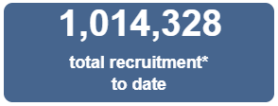
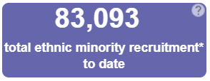
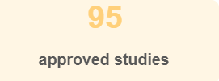
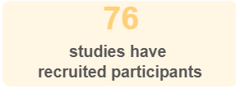
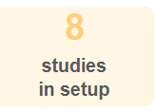
UPH Portfolio: All Studies
6,727
All UK
20
vaccine or prophylactic studies
28
studies have closed to recruitment
Data Collated: 29 March 2021
Notes:
29 March 2021 update:
Recruitment now stands at 1,014,328, which is an increase of 6,727 over the past week (was 1,007,601 last week). This increase has been across a number of the studies.
Of note: CCP-UK now stands at 197,113 recruits, SIREN at 42,901 recruits and RECOVERY at 39,288 participants.
In terms of ethnic minority recruitment, this now stands at 83,093 of the total recruits across the UPH portfolio (was 83,559 last week). This is a decrease of 463; this represents a correction of the BAME figures reported by UK-REACH.
The number of approved studies has now increased to 95, with the addition of the CLOCK and HEAL-COVID long COVID studies to our systems.
A total of 76 studies have now recruited participants (this was 75 last week), representing an increase of one study (following the reporting of data for CO@H; 101 participants recruited to date) .
There are still 8 studies in set-up, the same as last week.
There are 20 vaccine or prophylaxis studies on the UPH portfolio (no change from last week).
A total of 28 studies have now formally closed to recruitment, which is an increase of one study from last week. The latest study to close is STORM CHASER, which will be discussed further on a later slide.
In addition, the number of non-consenting studies is still four, and this will be updated on verbally if this number changes between weeks.
The number of withdrawn studies is still 5.

Slide 13
Platform Studies: PRINCIPLE, RECOVERY, REMAP-CAP
Funded by MRC
Adaptive design, Acute setting
Close date: 31 December 2020
UK only, sample size: 25,000
353 sites ( Trusts) 39,510 participants
Dexamethasone
Tocilizumab
Colchicine
Lopinavir/Ritonavir
Convalescent plasma
Hydroxychloroquine
Global study: 13 countries
Funded by European Commission
Adaptive platform design, ICU setting
Opened: 28 May 2019
Close: 31 July 2021
UK sample size: 800
149 UK sites 4,401 participants >70% of global recruits
Dexamethasone
Tocilizumab
Anticoagulants
Funded by NIHR & UKRI
Design: Adaptive platform trial
Setting: Community-based
Opened: 01/04/2020
Close date: 25/03/2022
UK sample size: 3000
1,292 UK sites 4,786 participants
Budesonide
Azithromycin
Doxycycline
Notes:
Update daily: #sites, #recruited, date stamp
Source: COVID-19 Research Activity.qvw > latest intelligence tab
Phase 3 multi-center study to assess the efficacy and safety of ruxolitinib on Cytokine Release Syndrome (CRS) in patients with COVID-19 (RUXCOVID) (CVD1900143)
CPMS: 45565
Number of days from application to decision: 8.2 days
Submitted to UPHR: 30 MARCH 2020
UPHR badge: 6 April 2020 (8.2 days)
HRA Approval: 28 April - 7days
MHRA approval: 28 April (8 days)
Opened: 30 April 2020
First patient: Sat 2nd May
Set up; days elapsed from UPGH submission to site first patient:
Close: 18 July 2020
Global sample 366 / UK sample 40

Slide 14
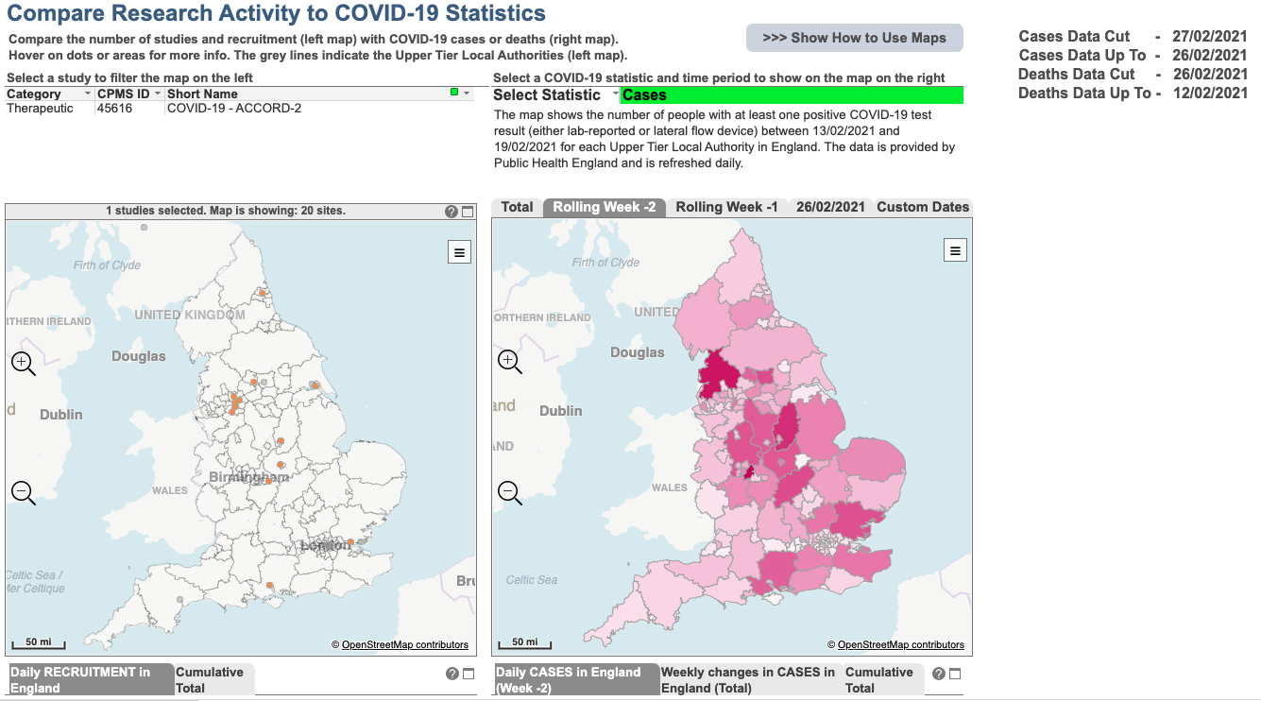

Slide 15
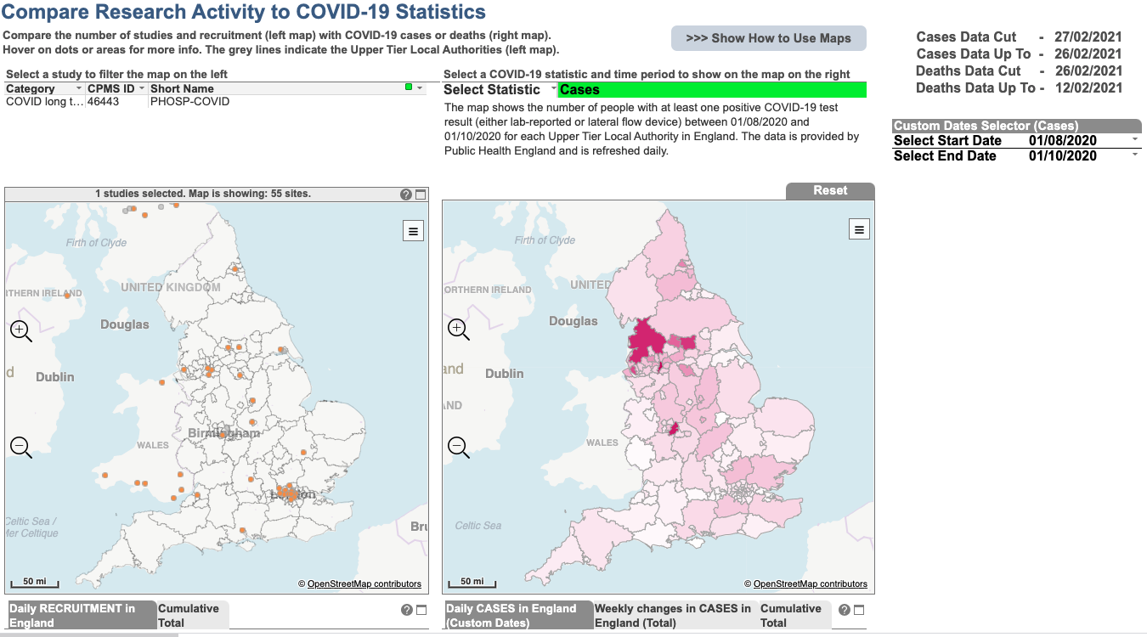

Slide 16
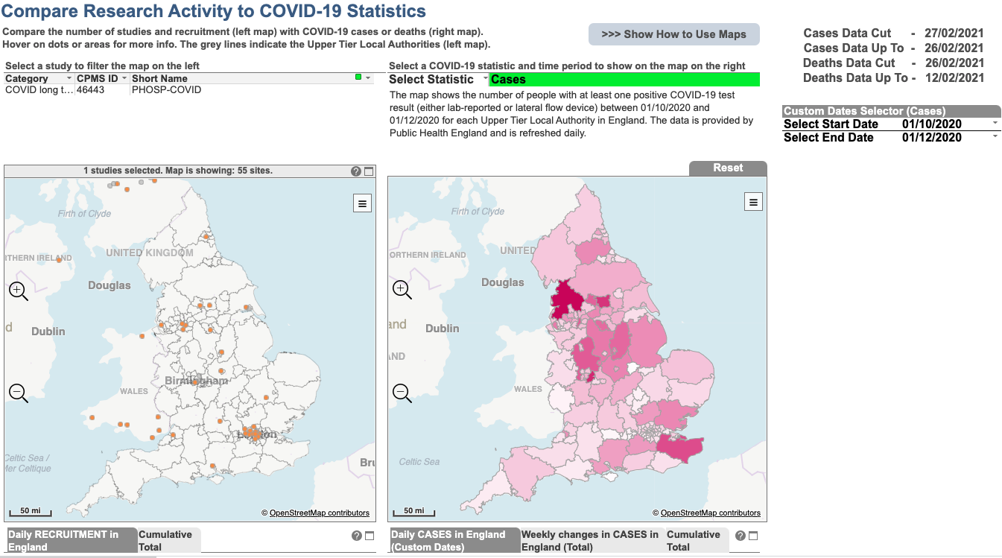

Slide 17
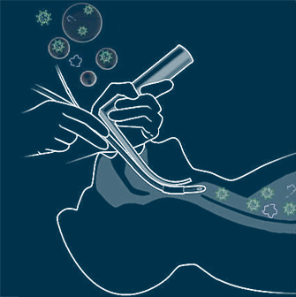
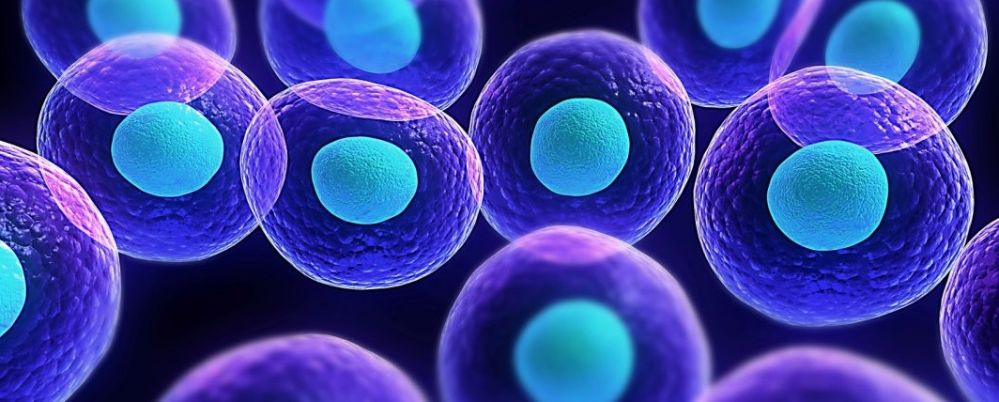
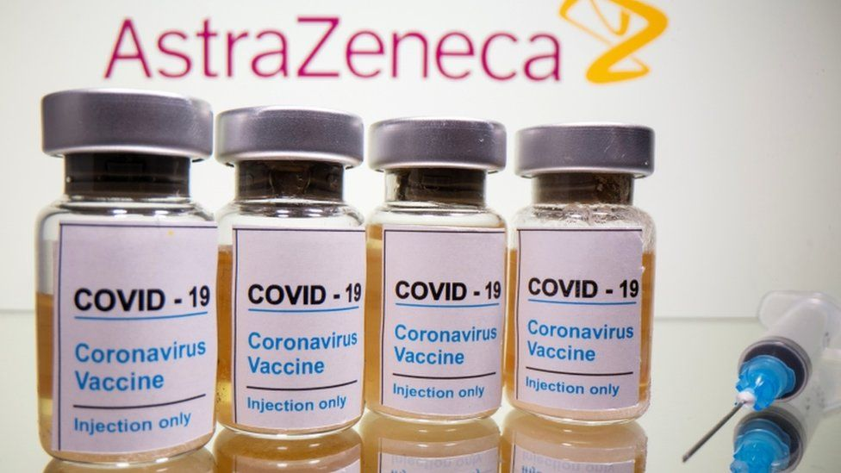
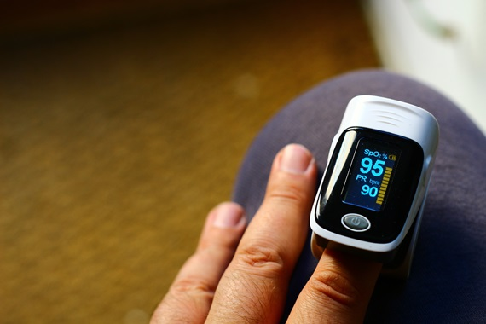
The Good (or perhaps the great)….
Supported the development of vital research into AGPs and Schools
Reviewed and recommended world leading treatments and therapies for COVID-19
Informed UK Government Policy
Championed COVID research in underserved groups
Delivered pioneering interventions and technology
Engaged COVID patients and the public in the recommendation of prioritised studies
Set up virtual trials to allow for remote delivery and recruitment
Delivered clinical research in schools and care homes
Recommended, supported and rapidly delivered vaccines for the world. First in the world to test mixing vaccines

Slide 18
Any questions?
Notes:
Questions at the end of the presentation.

